Slide 1


Slide 2
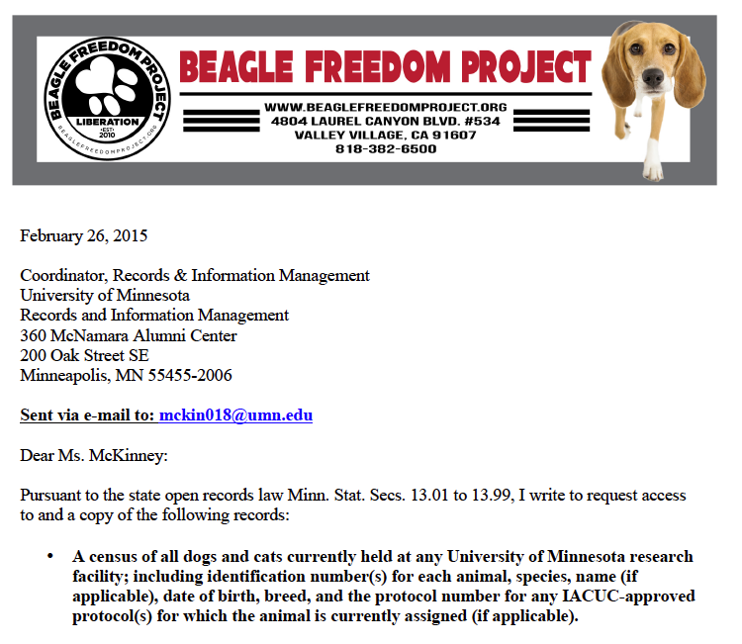
Identity Campaign

Slide 3
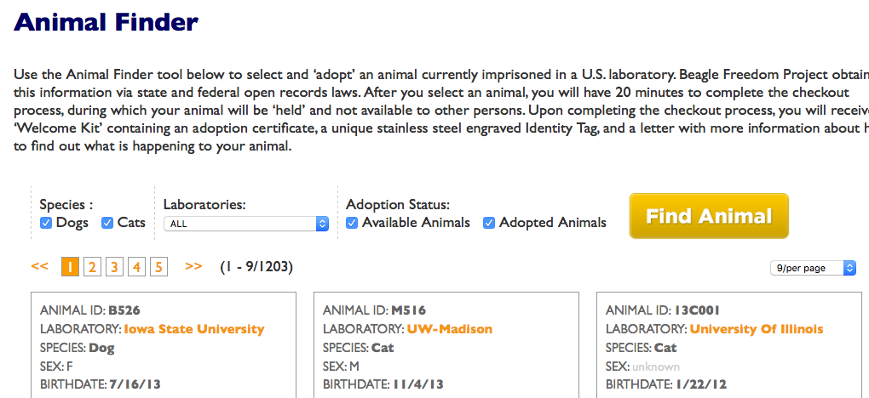
Identity Campaign

Slide 4
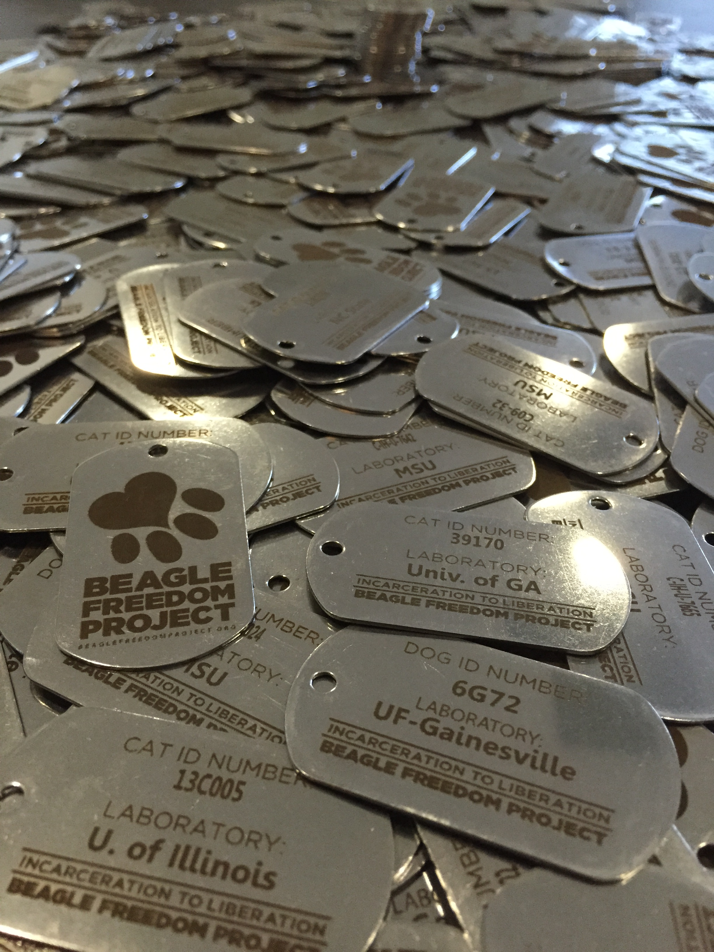
Identity Campaign

Slide 5
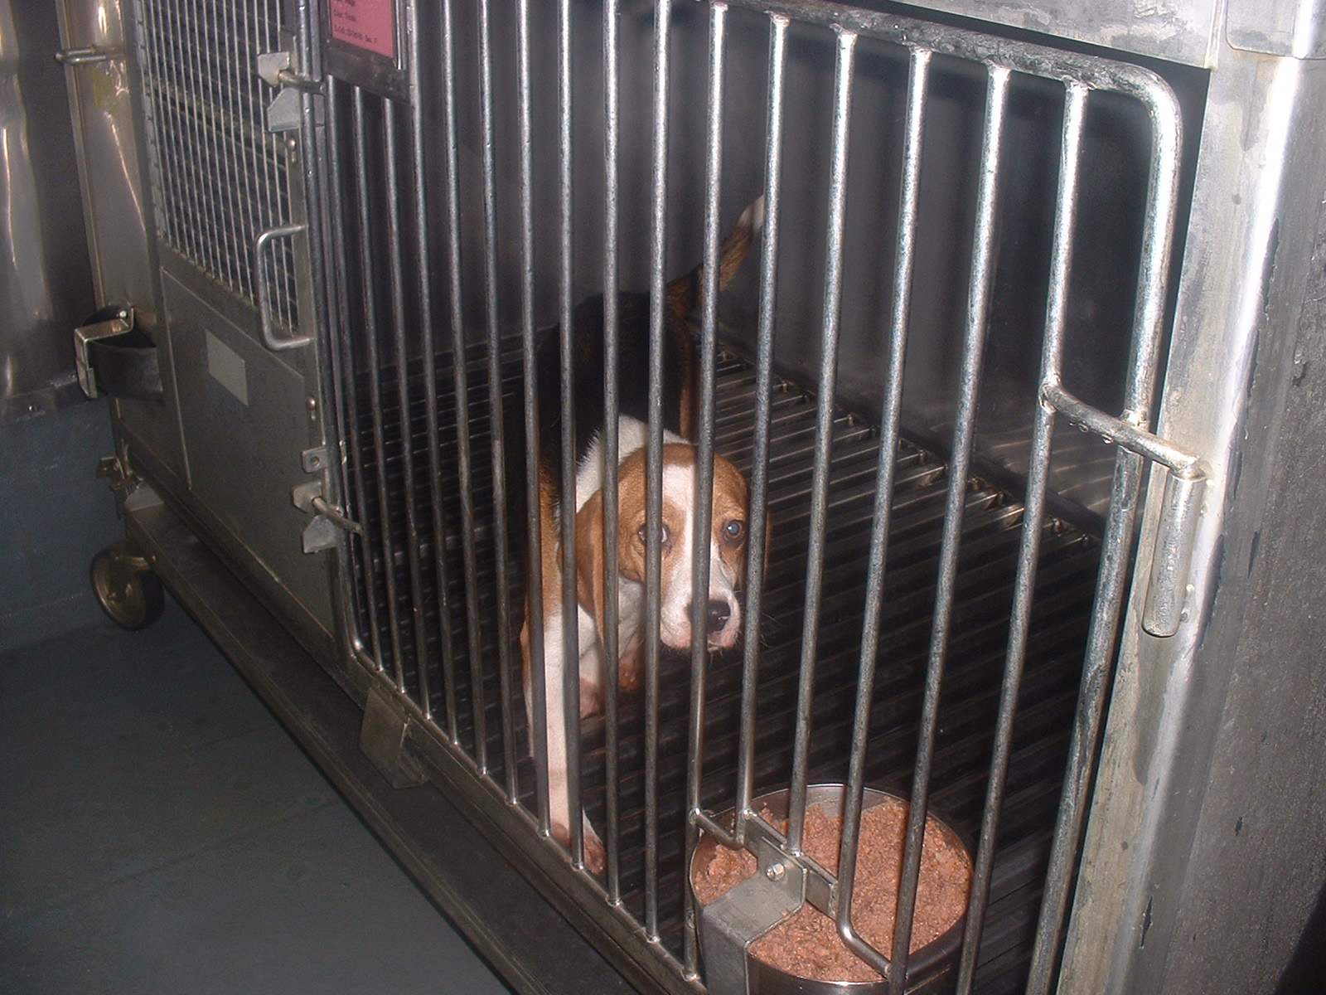
Newton

Slide 6
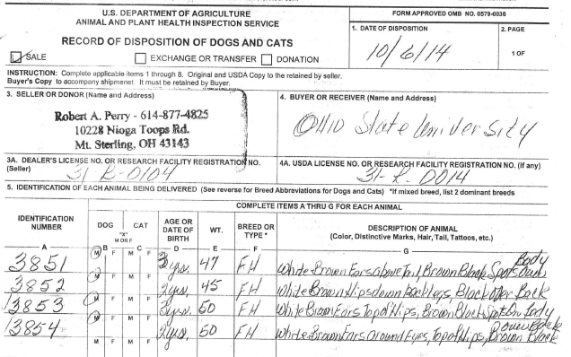
Identity Campaign

Slide 7


Identity Campaign

Slide 8





Identity Campaign

Slide 9


Identity Campaign

Slide 10
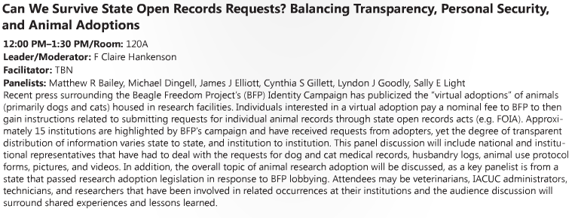
Identity Campaign

Slide 11
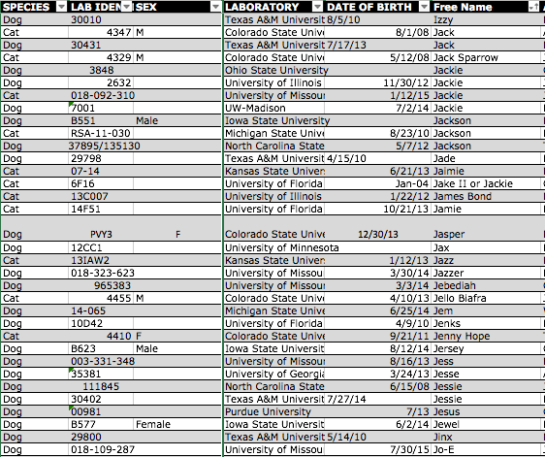
Identity Campaign

Slide 12
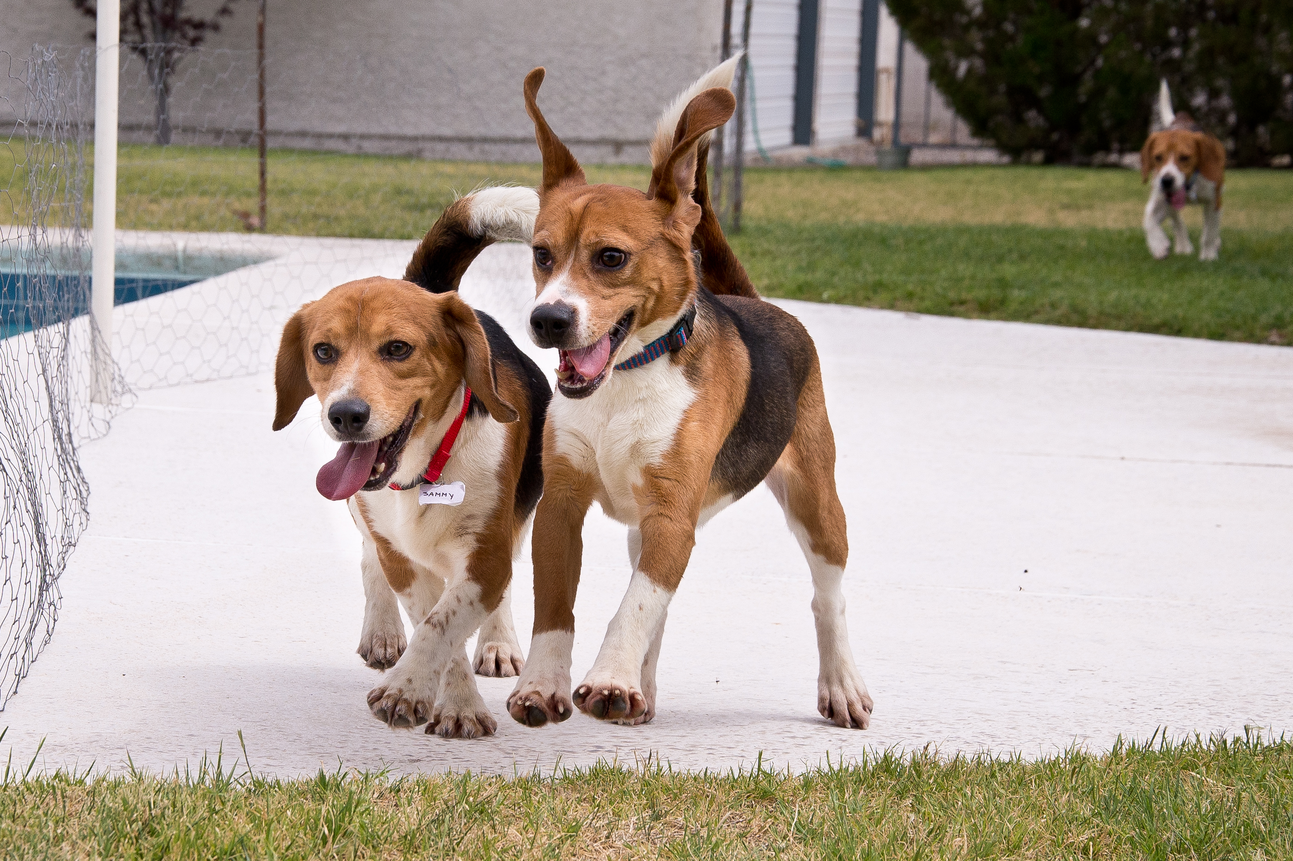
Questions?

