Slide 1
OECD’s work on Adverse outcome pathways
Bob Diderich, 20 November 2015
bob.diderich@oecd.org
www.oecd.org/ehs

Slide 2

Growing concern over lack of toxicological data
Chemicals on
the market
Chemicals
Only 10 -20%
has been
fully assessed
1736
1900
2000

Slide 3






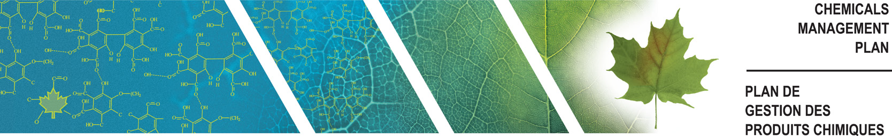
Countries are improving their legislation to assess more chemicals in a shorter time frame
Chemical Substances
Control Law

Slide 4



Standard toxicity testing is costly, time consuming and requires many animals
5000 animals / chemical
Costs
€2,000 - €2,000,000
Test duration
30 – 720 days

Slide 5
Mutual Acceptance of Data
OECD Principles of
Good Laboratory Practise and
Compliance Monitoring Procedures
OECD Test Guidelines
Mutual Acceptance of Data

Slide 6

SAVINGS FROM MAD
BY AVOIDING DUPLICATIVE TESTING BY INDUSTRY AND
NON-TARIFF TRADE BARRIERS:
AT LEAST € 150 MILLION / YEAR

Slide 7
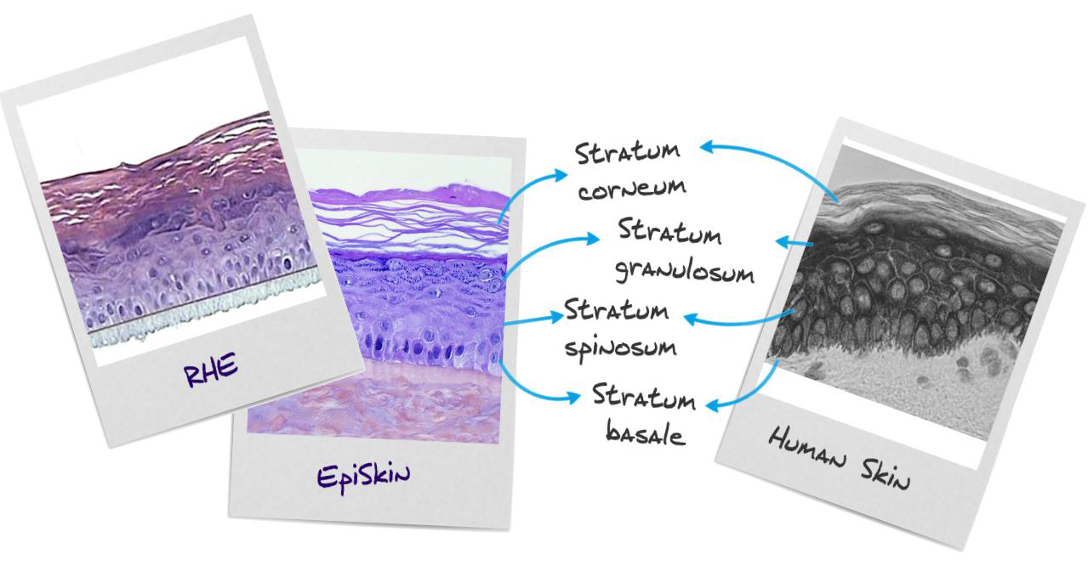
Promoting the use of non-animal methods
OECD Test Guidelines based on non-animal methods
- skin and eye corrosion / irritation
- phototoxicity
- skin absorption
- genotoxicity
Notes:
For instance to test corrosivity and irritancy to skin, so-called in vitro methods are available based on reconstructed human skin models, which closely mimic the upper layers of human skin.
Another way to introduce changes in testing and assessment strategies is through the development of models to predict the toxicity of chemicals.
For example we use a grouping approach, where we look for chemicals which are structurally similar and likely to have similar effects.

Slide 8

Developing models to predict toxicity
Target Chemical
Allergy
+
+
+
+
+
+
(Q)SAR
Prediction
+
+
+
+
+
+
Read
across
+
+
-
+
+
-
(Quantitative) Structure
Activity Relationships

Slide 9

QSAR Toolbox (1)
Free software application to predict the properties of chemicals (currently version 3.3)
Estimate missing experimental values by read-across and trend analysis (grouping of similar chemicals, chemical categories)
www.oecd.org/env/hazard/qsar

Slide 10
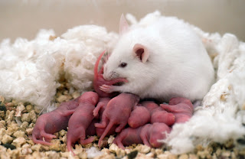


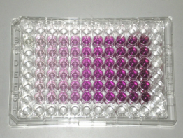
Need for mechanistic understanding
Target Chemical
Target Chemical
Developmental & Reproductive toxicity

Slide 11















Identifying the mechanism at work
Key Event (KE)
Adverse Outcome (AO)
Population
Organism
Organ
Tissue
Cellular
Organelle
Molecular Initiating Event
(MIE)
Molecular
pathogenesis / time

Slide 12


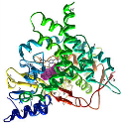



Key events triggered by aromatase inhibition that lead to population reduction
Aromatase Inhibition
Reduced E2 synthesis
Reduced E2 concentration
Reduced VTG production
Low Vitellogenin in
blood vessles
Reduced circulating VTG
Estrogen
Blood Vessel
Aromatase
Ovary
Reduced VTG uptake
Liver
Testosterone
Female
Decreased spawning
Population reduction

Slide 13

Early key events can be measured with non-animal tests, which can be used to predict the adverse outcome
Population decline
Population
Decreased spawning (in vivo)
Organism
Reduction egg production (in vivo)
Organ
Reduction VTG synthesis (in vitro)
Reduction in estrogen synthesis (in vitro)
Tissue
Cellular
Organelle
Enzyme binding (QSAR)
inhibition of aromatase (in vitro)
Molecular

Slide 14
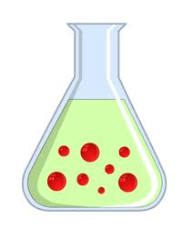

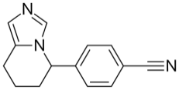
Read-across based on mechanistic understanding
Endocrine Disruptor
Endocrine Disruptor
Organism
Egg production 
Organ (in vivo)
VTG 
VTG 
Cellular (in vitro)
Aromatase 
Aromatase 
Molecular (in vitro)
Enzyme binding
Enzyme binding
Structure (QSAR)
Target chemical
Results from structurally related chemicals

Slide 15
A chemical can trigger different MIEs leading to different adverse effects
MIE1
KE
KE
KE
AO1
Chemical
MIE2
KE
KE
KE
AO2
MIE3
KE_{X}
KE
KE
AO3
Chemical
concentration

Slide 16
A chemical can trigger a network of AOPs
MIE1
KE
KE
AO2
Chemical
MIE2
KE
KE
AO3
MIE3
KE
KE
AO4

Slide 17
Use of AOP Networks to assess toxicity of mixtures
Chemical 1
MIE
KE
KE
KE
AO4
Chemical 2
MIE
Chemical 1
Chemical 2
concentration

Slide 18
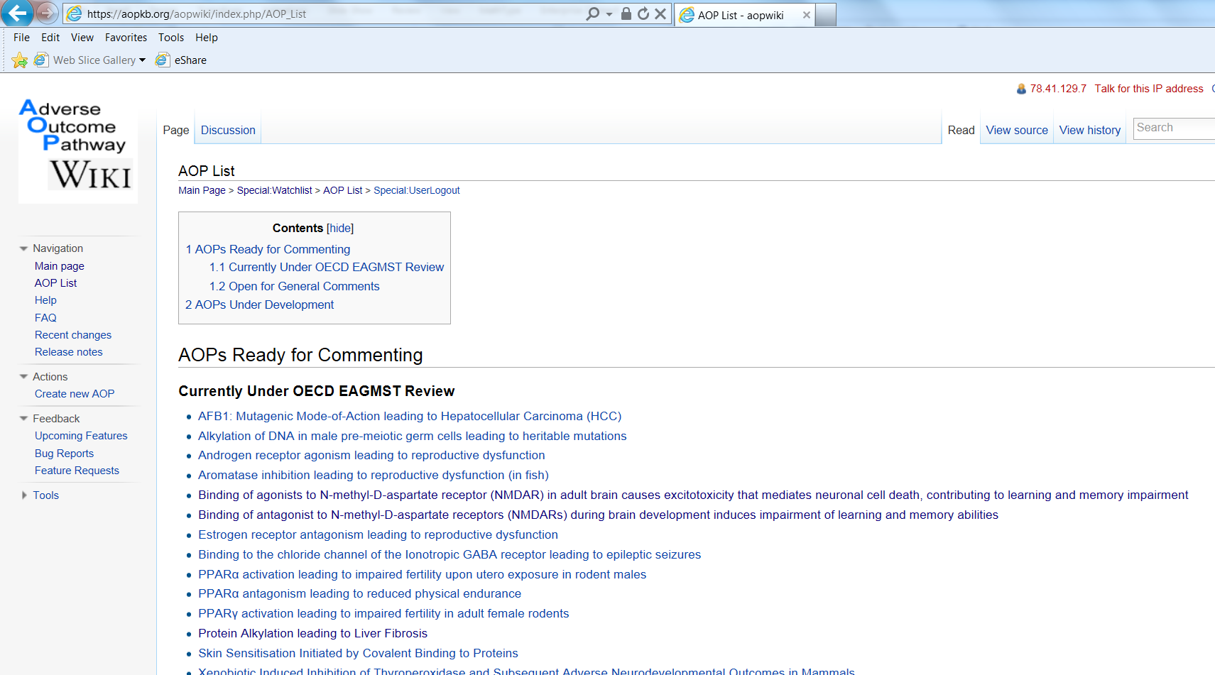
AOP Wiki

Slide 19

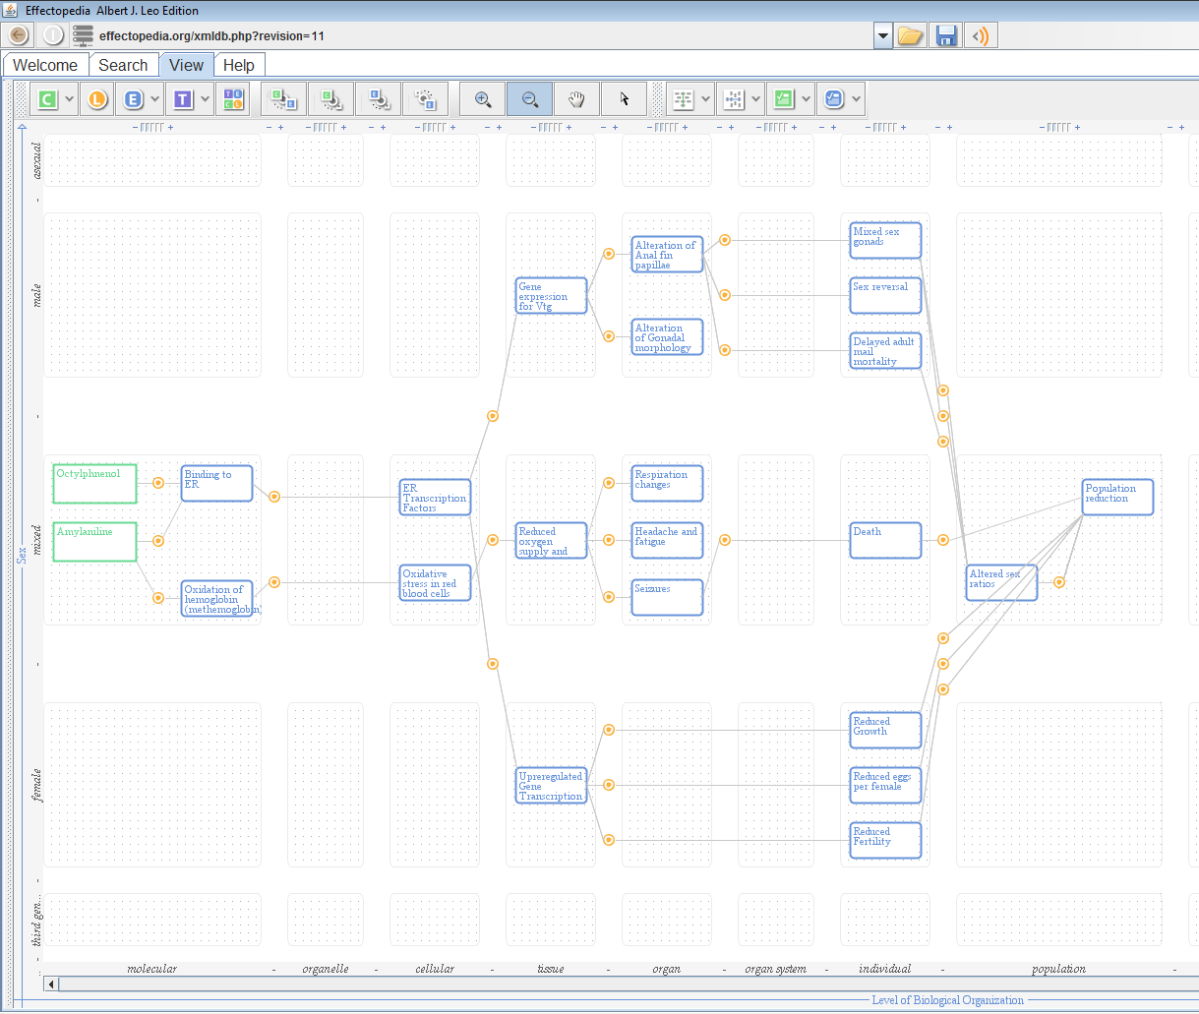
Effectopedia provides visualisation for all pathway elements
Capture all experimental information and models needed to make quantitative predictions
Allow collaborative work between AOP developers

Slide 20
Benefits of AOPs
Opportu-nities for colla-boration
Effective use of existing knowledge
Prioriti-sation
risk assessment
AOP
Reduce Animal use
Develop predictive tools

Slide 21
AOPs under external review
Initiating event | Adverse Outcome
Alkylation of DNA | Heritable mutations
Androgen receptor agonism | Reproductive dysfunction
Aromatase inhibition | Reproductive dysfunction
Protein Alkylation | Liver Fibrosis
PPARα activation | Impaired fertility
PPARγ activation
Binding of Antagonists to NMDAR | Learning and memory impairment
Binding of Agonists to NMDAR

Slide 22
Thank you for your attention

