Slide 1
AOPs and a 1R Approach to Safety Testing for Cosmetics
Lush Prize Conference, London, 20th November 2015
Dr Carol Treasure, Founder, XCellR8

Slide 2
3Rs or 1R?
Russell and Burch 1959: The Principles of Humane Experimental Technique
Over 50 years of progress
Reduction
Replacement
Refinement
Notes:
Russell and Burch 1959: created a much-needed positive shift in perception at the time.
Now: 21st Century Science (Toxicology)

Slide 3
XCellR8’s 1R approach: key drivers
    Consumers expect safe products that are ethically tested using the latest scientifically advanced methods
Public pressure
Regulatory Change
Adoption of new methods
Scientific progress
Industry investment in alternatives
Cosmetics Regulation 1223/2009: cosmetics must be tested without the use of animals

Slide 4
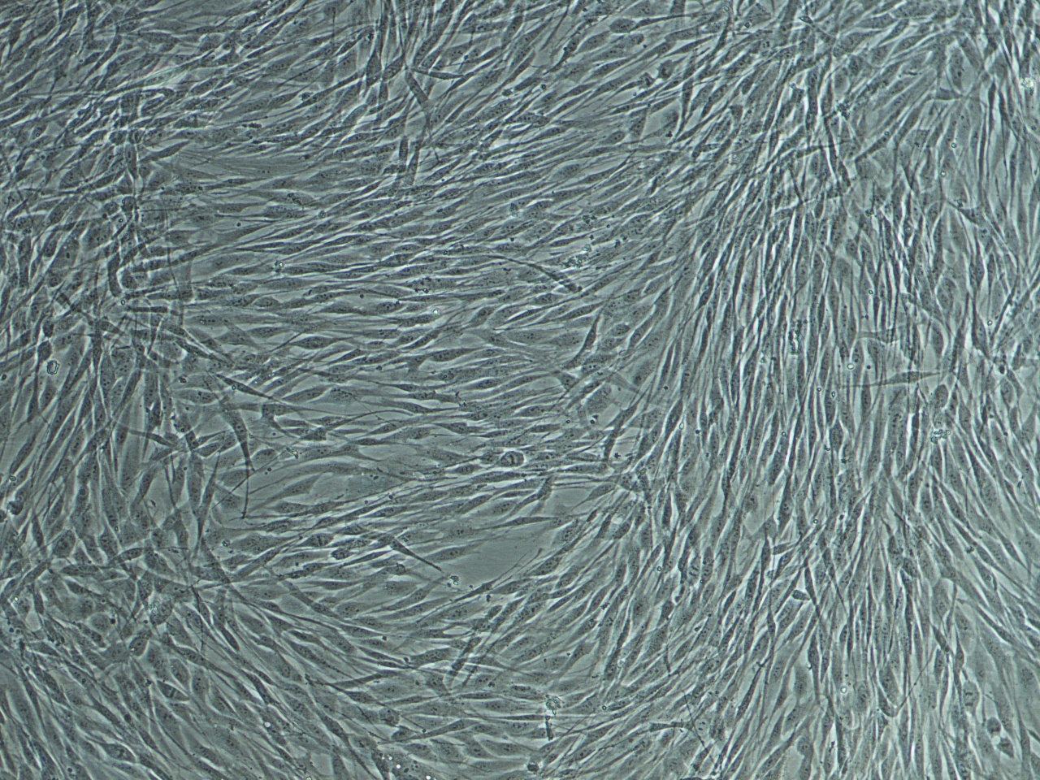
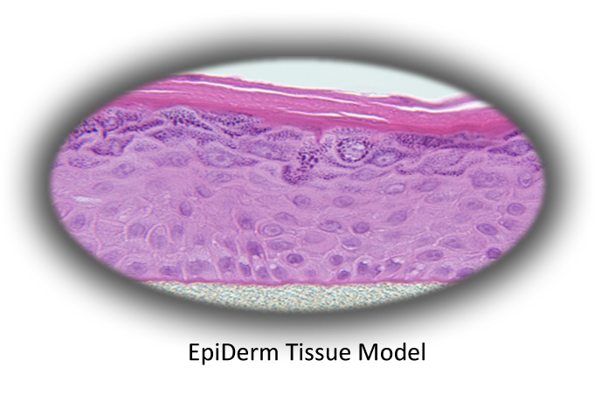
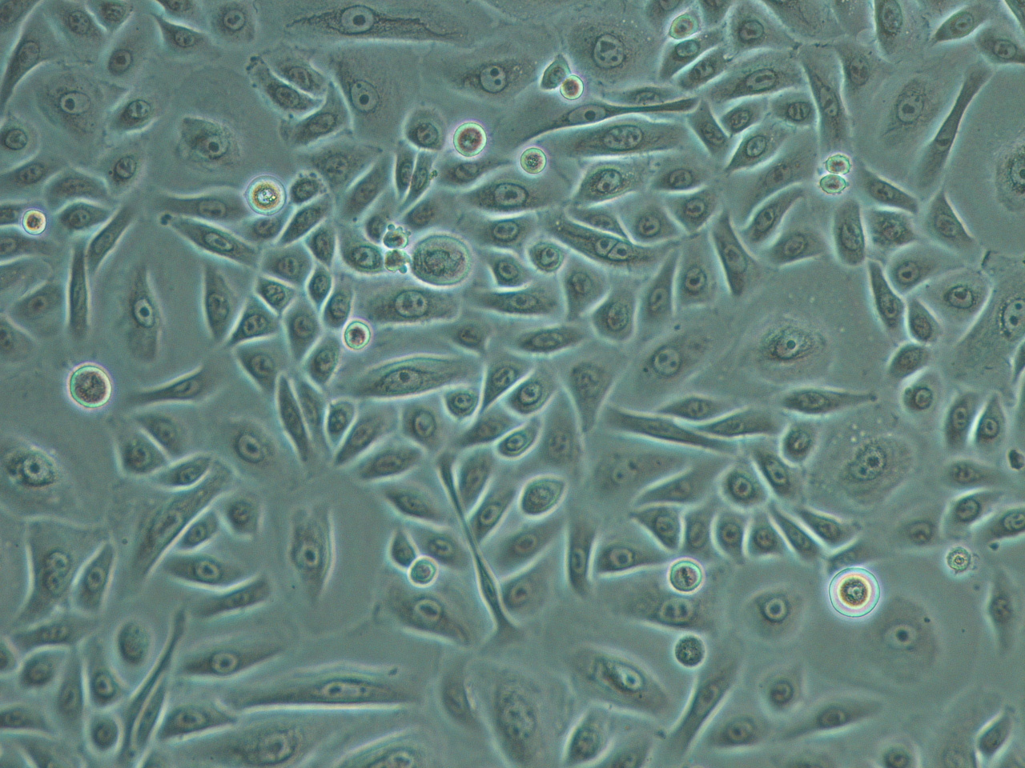
XCellR8’s 1R approach
  How we do it
    Human cell culture based and biochemical methods
    No animal-derived components (where necessary, re-work existing methods and work to maintain regulatory compliance)
    Submerged cell cultures and reconstructed human tissue models
UK-based, Good Laboratory Practice (GLP) accredited laboratory for regulatory in vitro safety testing

Slide 5

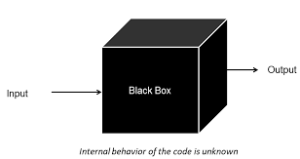



Why are AOPs important?
In vivo (whole body) testing is like a “black box”
  Eg skin sensitisation (allergy) resulting from ongoing use of a cosmetic product
Mouse local lymph node assay (LLNA): OECD TG 429
Human repeat insult patch test (HRIPT)
Notes:
Black box refers to both animal and human testing

Slide 6
Why are AOPs important?
In vitro (outside body) testing must measure what is going on in the Black Box. To know what that is, we need AOPs!
Event B
Event A
Event C
Test B
Test A
Test C
Notes:
Scientifically advanced approach compared with historical animal models
AOPs were originally figured out (in part) using animal tests.
However now that they exist, they provide a useful part of our tool box to adopt a 1R testing strategy going forward.

Slide 7
Adverse Outcome Pathway (AOP) for Skin Sensitisation
Chemical Structure & Properties
Molecular Initiating Event
Cellular Response
Organ Response
Body Response
Absorption Metabolism
Peptide Binding
Key Event 1
Keratinocyte Activation
Key Event 2
T-Cell Proliferation
Key Event 4
Adverse Outcome
Electrophilic Substance
Dendritic Cell Activation
Key Event 3
Challenge by Allergen Causes Inflammation
Direct Peptide Reactivity Assay (DPRA)
Test 1
Human Cell Line Activation Test
(h-CLAT)
Test 3
KeratinoSensTM
Test 2
Notes:
ECVAM: 2 out of 3 strategy for classification of skin sensitisers
Regulatory approval this year

Slide 8
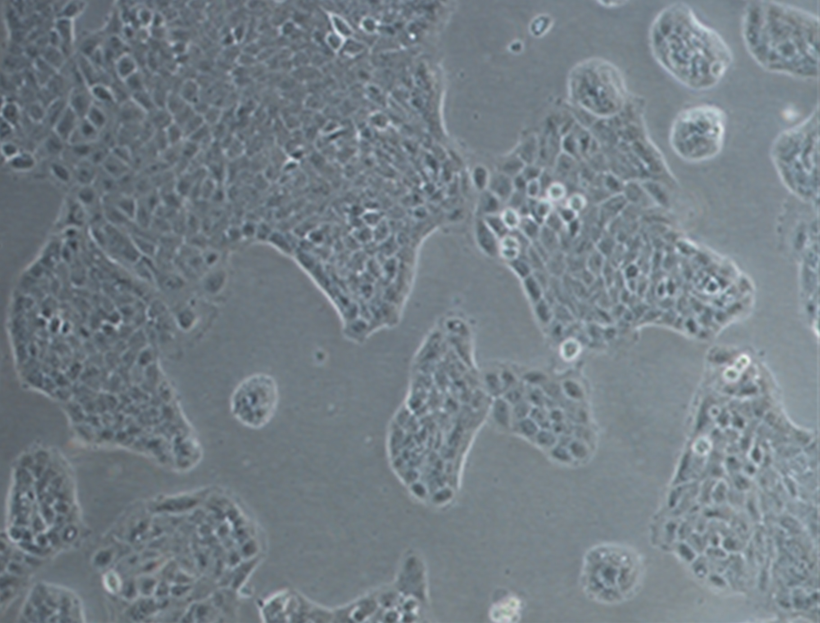
Latest Regulatory Guidance on Skin Sensitisation
    Validated tests available for Key Events 1-3 and should be combined to provide the best prediction currently possible:
      Direct Peptide Reactivity Assay (DPRA): OECD TG 442c
      KeratinoSensTM: OECD TG 442d
      (h-CLAT: ECVAM Recommendation (2015) for the development of OECD TG )

Slide 9
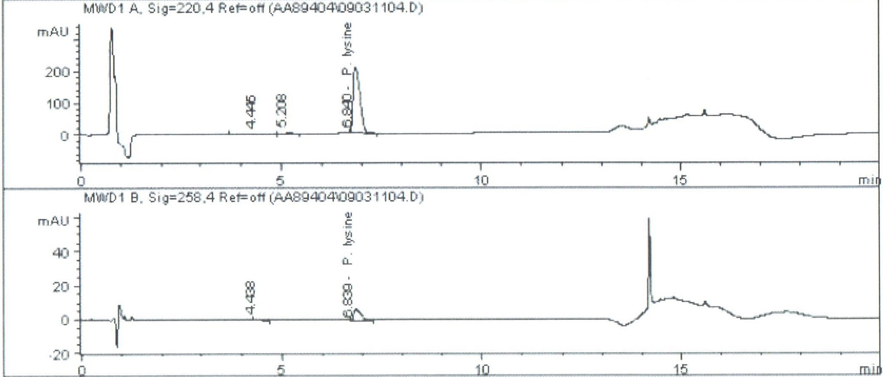
Direct Peptide Reactivity Assay (DPRA) (OECD Test Guideline 442c adopted 2015)
  - Principle of the Test
Models Key Event 1 in the AOP
Test item incubated with cysteine or lysine peptides for 24 hours.
Peptide depletion measured by High Performance Liquid Chromatography (HPLC).

Slide 10
Direct Peptide Reactivity Assay (DPRA) – Prediction Model
Definition of Reactivity Class for Mean of Lysine and Cysteine Depletion
 |  | % Depletion
Classification | Reactivity Class | Minimum | Maximum
Non-Sensitiser | Minimal | 0 | 6.38
Sensitiser | Low | 6.38 | 22.62
Sensitiser | Moderate | 22.62 | 42.47
Sensitiser | High | 42.47 | 100
In-house validation (“Proficiency Testing”) using 15 chemicals as per OECD TG 442c
Validated for hazard identification but also gives preliminary indication of potency

Slide 11
KeratinoSensTM Test for Skin Sensitisation (OECD Test Guideline 442d adopted 2015)
  Principle of the Test
Models Key Event 2 in the AOP
Sensitisation activates Anti-oxidant Response Element (ARE).
Luciferase gene inserted into the cells, linked to the ARE.
In the presence of a skin sensitiser, the ARE is switched on and luciferase converts an added substrate to cause the emission of a light signal.
Induction of luciferase activity by >1.5-fold above untreated controls results in classification as a skin sensitiser.

Slide 12
KeratinoSensTM Test for Skin Sensitisation
Cinnamic Aldehyde
EC1.5 = lowest concentration where the luciferase-linked gene was induced >1.5-fold (the threshold for classification as a sensitiser).
I_{MAX} = maximum induction of the luciferase-linked gene. I_{MAX} values can be used as a preliminary comparison of the differences in skin sensitisation potential between products (potency).
Controls must meet acceptance criteria.

Slide 13
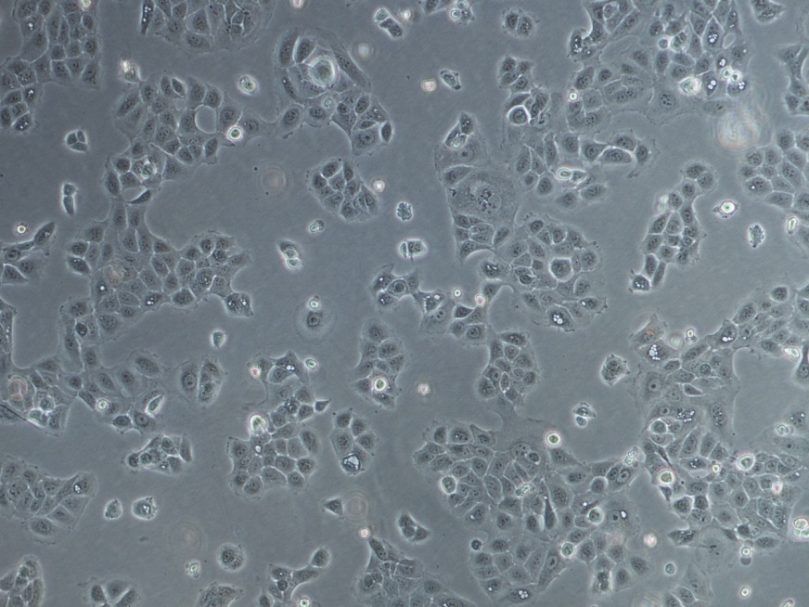
KeratinoSensTM: adaptation to animal-free conditions
Adaptation of KeratinoSensTM Cells to Culture in Human Serum
In human serum, cells grew faster but in a different pattern (patches)
In human serum, cells need “special treatment” to maintain healthy cultures.
Some modifications to the KeratinoSensTM standard method were required to ensure the correct conditions (cell number etc) on the day of testing.
KeratinoSensTM cells grown in culture medium containing foetal calf serum.
KeratinoSensTM cells grown in culture medium containing human serum.
Notes:
Done with support from Lush

Slide 14
Preliminary Validation of KeratinoSensTM in Animal Product-Free Conditions
 | I_{MAX} Value | Mean EC1.5 Value | Classification as per OECD Guideline | Classification as per XCellR8 Test | Pass or Fail
Isopropanol | 1.32 | N/A | Non-Sensitiser | Non-Sensitiser | Pass
Salicylic Acid | 1.72 | N/A | Non-Sensitiser | Non-Sensitiser | Pass
Lactic Acid | 1.71 | N/A | Non-Sensitiser | Non-Sensitiser | Pass
Glycerol | 1.65 | N/A | Non-Sensitiser | Non-Sensitiser | Pass
Cinnamyl Alcohol | 12.25 | 62.5μM | Sensitiser | Sensitiser | Pass
Ethylene Glycol Dimethacrylate | 9.0 | 24.7μM | Sensitiser | Sensitiser | Pass
2-Mercaptobenzothiazole | 15.04 | 62.5μM | Sensitiser | Sensitiser | Pass
Methyldibromo Glutaronitrile | 3.20 | 15.3μM | Sensitiser | Sensitiser | Pass
4-Methylaminophenol Sulfate | 24.3 | 2.7μM | Sensitiser | Sensitiser | Pass
2,4-Dinitro-chlorobenzene | 26.1 | 2.7μM | Sensitiser | Sensitiser | Pass
10 “Proficiency Chemicals” used as per OECD Test Guideline 442d
Notes:
In house preliminary validation = proficiency testing

Slide 15
1R Testing Strategy for Skin Sensitisation
  Aim:
    Build a knowledge base of the sensitisation potential of cosmetic ingredients to inform product development.
    Correlate results for mixtures (finished products) with key ingredients
Emerging patterns build confidence in tests
Notes:
Data base to assist formulators
ECVAM 2 out of 3 strategy: addition of h-CLAT would complete this analysis but that is for regulatory hazard identification: this is non-regulatory product development work

Slide 16
Skin Sensitisation Testing at XCellR8
  Next steps
    Set up h-CLAT test (“Key Event 3” in the AOP).
    Carry out “performance standards” testing to gain full regulatory recognition for KeratinoSensTM animal-free version.
    Bring DPRA in-house to ensure GLP regulatory status of studies.
Notes:
Not everyone agrees with our approach and these methods do still have their limitations.
However the traditional animal tests also have many limitations but became the historical bench mark without validation.
Current in vitro technologies combined with robust validation ensure the best – ethically and scientifically.

Slide 17
XCellR8’s 1R approach
Public pressure
Regulatory Change
Adoption of new methods
Ultimate success of the 1R approach depends on willingness of industry to invest in, and adopt, new advanced methods
Scientific progress
Industry investment in alternatives

Slide 18
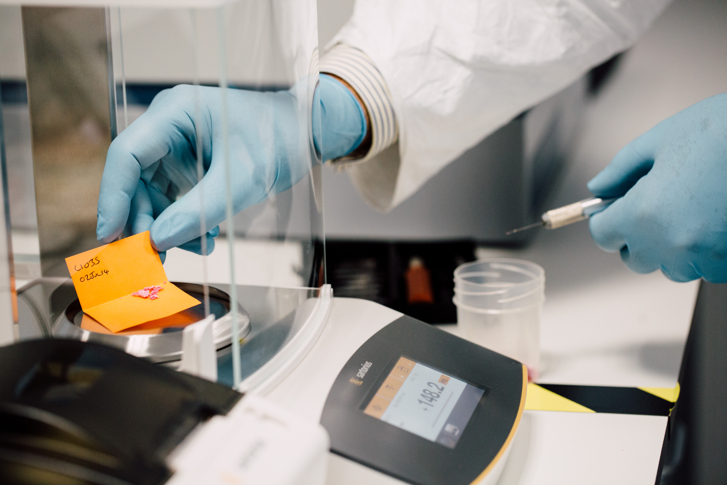

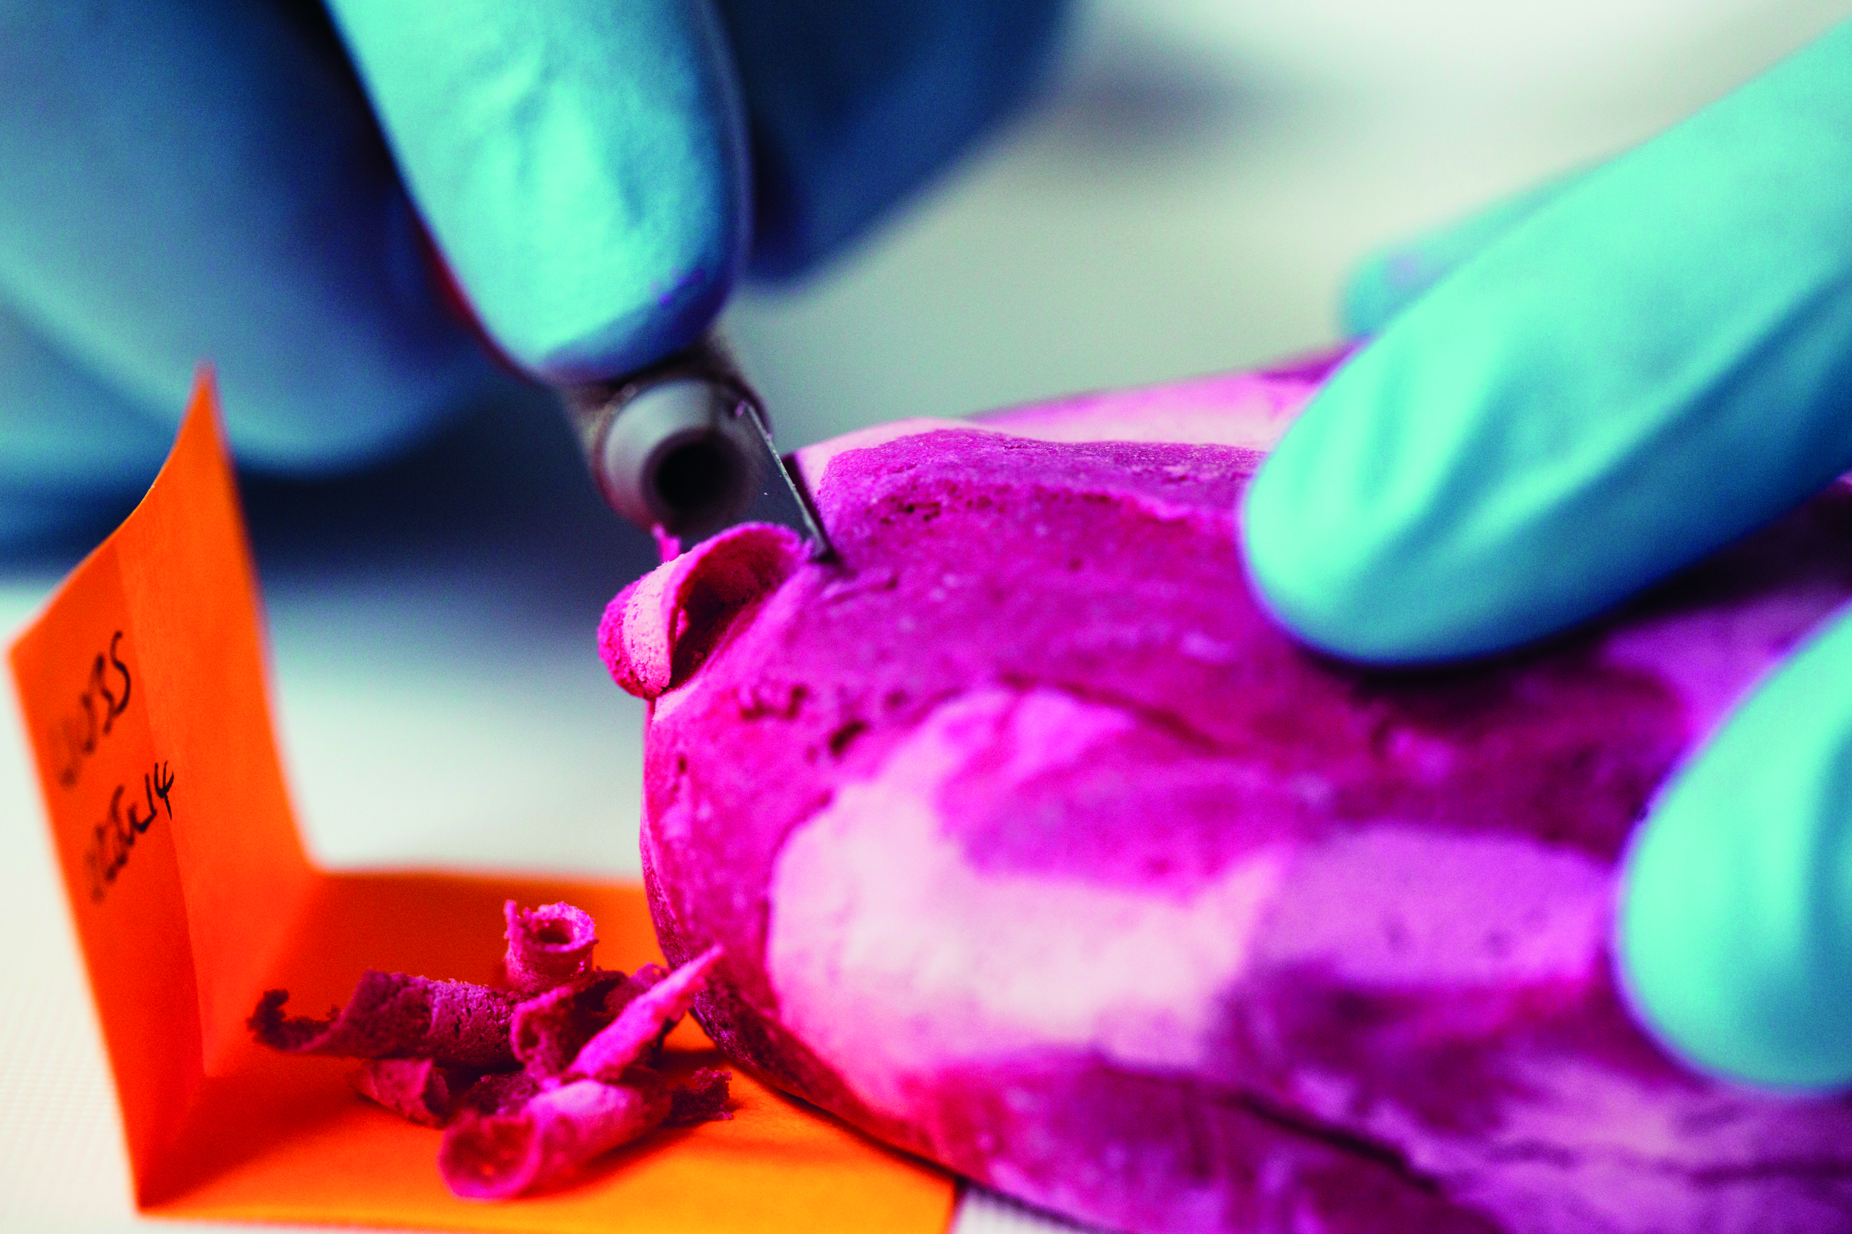
Thank you Lush!

Slide 19


Contact us
XCellR8
@XCellR8_labs
+44 (0)1925 607 134
info@x-cellr8.com
www.x-cellr8.com
XCELLR8 Ltd | The Innovation Centre | Sci-Tech Daresbury | Keckwick Lane | Daresbury | Cheshire | WA4 4FS | UK

