Slide 1
ADVERSE OUTCOME PATHWAYS Lessons from sensitisation
Dr david Basketter, dabmeb consultancy ltd, sharnbrook, uk

Slide 2
Key concepts
Humans are complicated (in any number of ways!)
Our physiology and pathology is fiendishly complex
Risk perception v. risk reality
Pharmacology Versus Toxicology
the expected Versus the unexpected!
The toxicity of a substance is implicit in its molecular structure
Which means we must understand the chemistry
Expression of that toxicity depends on two things
Exposure dose
Individual susceptibility

Slide 3
The KEY challenge facing 21st century toxicology is ensuring our health without animal tests The first target for this was cosmetic products, arguably a really difficult category…but also an informative example

Slide 4
Overview of Allergy
FOOD ALLERGY
Proteins
SKIN ALLERGY
Mostly chemicals, occasionally proteins
RED RASH, BLISTERS & ITCHING
Caused by T lymphocytes
RESPIRATORY ALLERGY
Proteins and chemicals
SNEEZING, WHEEZING & ITCHY EYES
Caused by immunoglobulin E
First - Induction:
silent phase
Second - Elicitation:
The disease
Skin sensitising chemicals induce contact allergy; further exposure elicits the disease, allergic contact dermatitis

Slide 5
some chemicals
can cause skin allergy
and are used in cosmetics
giving allergic skin rashes
diagnosed by dermatologists
who tell the toxicologists that
This is not an Adverse Outcome Pathway, but arguably it is unique in toxicology

Slide 6
More on skin sensitisation
We have had good predictive tests for over half a century
We understand key events of the toxicological mechanism
We developed the first formally validated alternative (LLNA)
We have a process for quantitative risk assessment
We have rapid and reliable feedback from dermatologists
….and we even have a portfolio of in vitro alternatives, validated and moving into use

Slide 7
Skin Sensitisation AOP
Key event 1 QSAR
Chemical Structure
&
Properties
Molecular initiating event
Cellular Response
Organ Response
Organism Response
Key event 3 eg h-CLAT
Humans & guinea pigs
Dendritic cells (DCs)
Induction of inflammatory cytokines and surface molecules
Mobilization of DCs
Metabolism
Penetration
Key event 1 eg DPRA
Lymph node
Covalent interaction
With cellular protein
Skin
Antigen presentation by DCs
Activation of T cells
Proliferation of activated T cells
Inflammation upon challenge with allergen
Electrophilic
substance
Keratinocytes
Murine local lymph node assay
Activation of inflammatory cytokines
Induction of cyto-protective gene pathways
Key event 2 Keratinosens

Slide 8
How do we use in vitro data - 1?
Basketter et al (2015) Alternatives for skin sensitisation testing and assessment. Regulatory Toxicol Pharmacol, online.

Slide 9
How do we use in vitro data - 2?
Can we use skin sensitisers in products?
Yes, eg. virtually all cosmetics contain them
Safety is a matter of dose/risk assessment
Remember the dermatology feedback loop
Basketter DA and Safford RJ (2015) Skin sensitisation quantitative risk assessment; a review of underlying assumptions. Regulatory Toxicol Pharmacol, accepted.

Slide 10
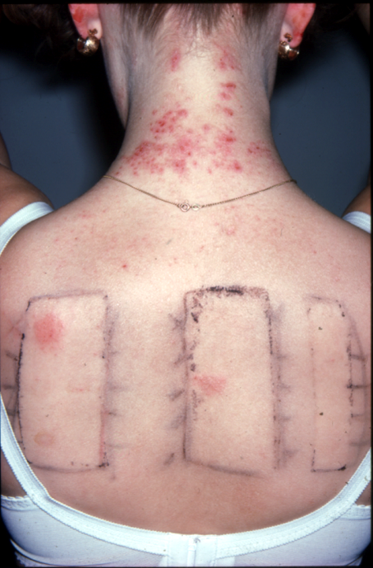
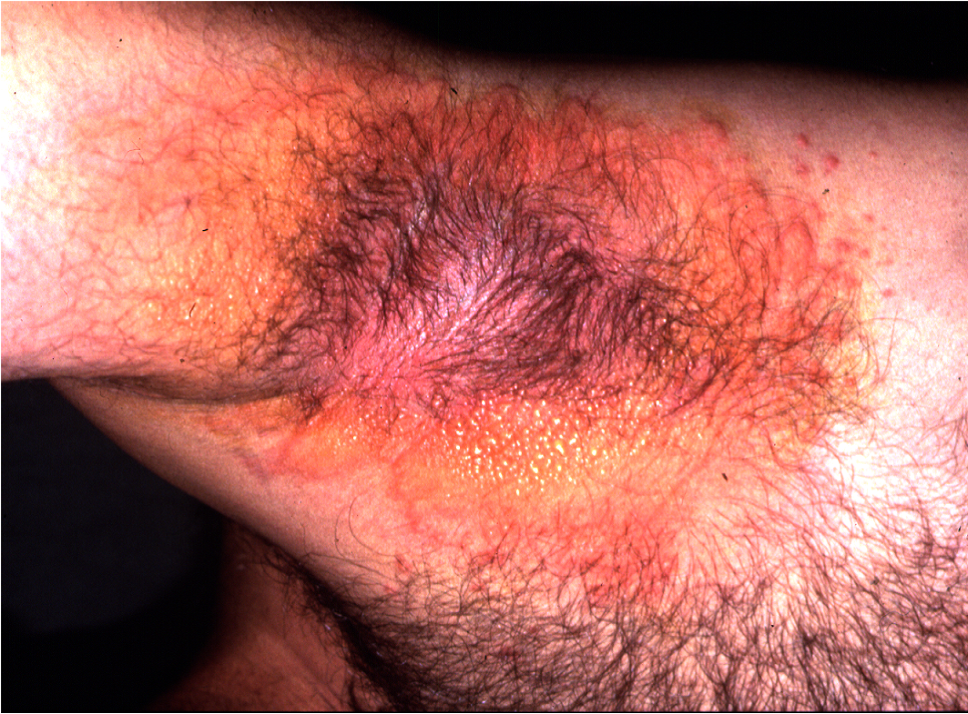
this is a real endpoint!

Slide 11
And respiratory sensitisation?
The mechanism is partly defined, but an Aop has proven difficult
There are no accepted predictive tests…
which partly explains why we have no alternatives
assessment is based largely on human experience
Clinical feedback is limited as diagnostic testing is absent
Currently, research focuses on chemical structure activity relationships
gaining focus and consensus is challenging
Kimber et al (2014) Chemical respiratory allergy – reverse engineering an AOP. Toxicology 318, 32-39.
Basketter and Kimber (2015) Fragrance sensitisers: is inhalation an allergy risk? Regul Pharmacol Toxicol, online.

Slide 12
where next with aops?

Slide 13
Perhaps the AOP concept has two functions…
Adverse outcome pathways (embedded at the OECD) is a concept that ensures toxicologists focus on the essential mechanisms associated with adverse health effects and thereby deliver in vitro assays that are relevant to humans
In the absence of having a clear idea of how to make progress, adverse outcome pathways provide a real opportunity for toxicologists to sound knowledgeable and seek out research funding whilst working out what to do!

Slide 14
three thoughts
Regulatory toxicology
Using human data
Thresholds / exposure
I wonder whether this a false target for in vitro alternatives
Do we really take proper account of it and use it to drive our approach?
TTC will not be sufficient to remove the need for in vitro alternatives

Slide 15
SEURAT-1 – A 5 year €50,000,000 project
For SEURAT-1, 2015 might be the most interesting and challenging year as projects are coming to an end and sponsors and stakeholders alike will be keen to learn about tangible results as indicators for ‘return on investment’. The SEURAT-1 books are an excellent tool to take stock but the final outcomes will also need to be in the peer reviewed publications to form the basis for follow-up on promising methodologies to further build the toolbox on animal free testing. It is also expected that SEURAT-1 will be providing sufFIcient ground for setting the strategy of next research programmes on alternatives for systemic toxicity.
The SEURAT-1 symposium on December 4th 2015 will be a showcase to learn more about the extensive research efforts during the last 5 years and how these can be translated into solutions for safety assessment ultimately replacing animal testing. Another important objective of the symposium is to put the SEURAT-1 outcomes into context of other related on-going and future initiatives from the EU and the US as co-ordination and sharing of research will also contribute to making progress in the FIeld.
For any successful economy, science, research and innovation is core. For Cosmetics Europe they are essential and key drivers for maintaining the industry’s competitive position and securing its license to operate in a global market. The industry also needs to be able to build upon solid risk-based regulation making best use of the current scienti c knowledge. Ultimately science will be the only and ultimate solution to overcome the need for animal testing for proving safety of product ingredients and chemicals.
Marketing safe products is the highest priority of the industry. However, current safety assessment and regulatory practices are still largely depending on animal testing which in time is hindering innovation in the industry. Given the ban no new animal testing will be forthcoming. On the positive side there is the wish and the scienti c capabilities to improve safety assessment approaches based on alternatives. It is our belief that in time research on alternatives can provide us with better safety assessment tools in terms of predictability (ie. more relevant for assessing human risk) at a faster pace and at lower costs. This will help better, faster and more competitive innovation.
SEURAT has and still will make in our view a substantial contribution on the journey away from traditional animal testing and towards a mechanistic understanding of key toxicological events based on (human) cell responses, a comprehensive understanding of bioavailability and systems biology. This already has helped to improve Read Across and TTC approaches and to pave the way for ab initio approaches.
Another learning from SEURAT-1 is that case studies will help establish, validate and implement the test tool box and we recommend that programmes following SEURAT-1 will build on this experience.
The industry is committed to continue the journey and is optimistic that the availability of new technologies will help to better understand the complex chains linking early molecular events at cellular level with organ and systemic effects. The ability to link multiple data streams and to translate non-animal (in vitro or in silico) FIndings in A quantitative way to in vivo is essential to drive a paradigm shift in chemical safety testing to meet regulatory requirements.
In our view SEURAT-1 and following projects will only be fully successful if the scientific efforts are accompanied by continuous exchange with stakeholders worldwide, including the regulatory community, validating agencies, interested public and academia as well as partners for commercial exploitation (small and medium sized enterprises and large industries) to maximise its impact.

Slide 16
An example: Sanderson et al, 2015 Toxicology Research, in press
Mechanistic understanding of Molecular Initiating Events using NMR spectroscopy
Paul N. Sanderson, Wendy Simpson, Richard Cubberley, Maja Aleksic, Stephen Gutsell and Paul J Russell
Toxicological risk assessments in the 21st century are increasingly being driven by the Adverse Outcome Pathways (AOP) conceptual framework in which the Molecular Initiating Event (MIE) is of fundamental importance to pathway progression. For those MIEs that involve covalent chemical reactions, such as protein haptenation, determination of relative rates and mechanisms of reactions is a prerequisite for their understanding. The utility of NMR spectroscopy as an experimental technique for effectively providing reaction rate and mechanistic information for early assessment of likely MIE(s) has been demonstrated. To demonstrate the concept, model systems exemplifying common chemical reactions involved in the covalent modification of proteins were utilized; these involved chemical reactions of electrophilic species (representing different mechanistic classes) with simple amine and thiol nucleophiles acting as surrogates for the reactive groups of lysine and cysteine protein side chains respectively. Such molecular interactions are recognized as critical mechanisms in a variety of chemical and drug toxicities, including respiratory and skin sensitization and liver toxicity as well as being the key mechanism of action for a number of therapeutic agents.

Slide 17
Thanks for listening

