Slide 1
UNDERSTANDING CHEMICAL ALLERGEN POTENCY THROUGH THE MOLECULAR EVENTS THAT TRIGGER IMMUNE CELL ACTIVATION
Elena Kummer

Slide 2
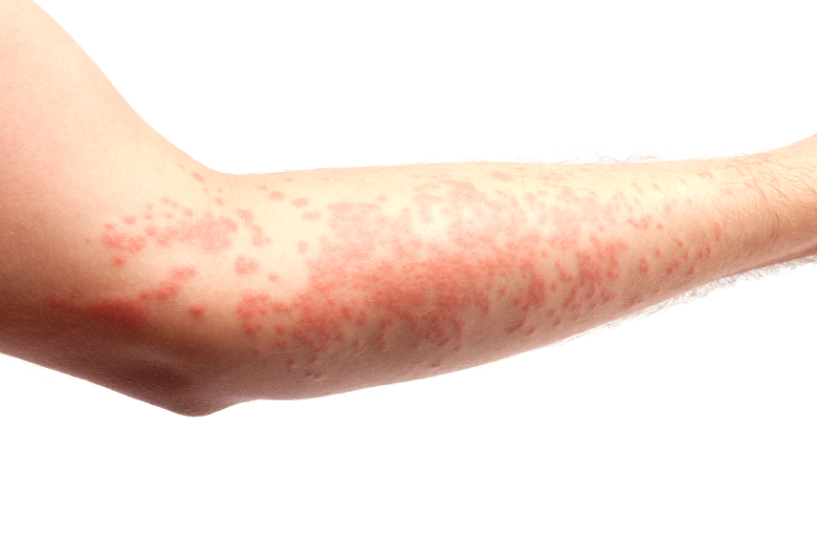
Allergic contact dermatitis
Allergic contact dermatitis (ACD) is a common and important environmental and occupational health hazard
ACD is a T cell-mediated skin disease
Many hundreds of organic chemicals and some metals ions are contact sensitizers
As a consequence is really important for a toxicologist, to identify and characterize the skin potential of chemicals, and estimating the risk they pose to human health.
After the new European policy on chemicals (REACH) and the EU cosmetic directive (2013), a ban was introduced, by the second one, on the use of animals for identifying chemicals used in cosmetic ingredients and products.
In vitro methods are likely to play a major role in a near future.

Slide 3
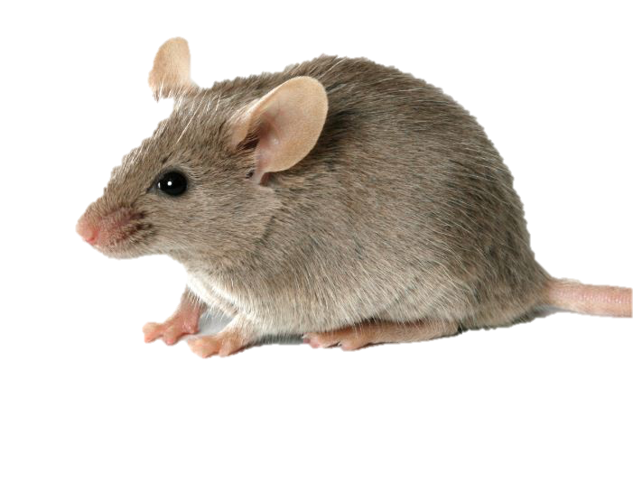
Evaluation of the contact sensitization potential of chemicals
It is currently done using the local lymph node assay (LLNA - OECD guideline 429) as first choice.
Hazard identification and assessing the skin sensitizing potency of chemicals.
Low EC3* values correlate well with sensitizers known to be potent in man
High EC3* values are usually associated with weakly human sensitizers
*EC3: Effective Concentration for a Stimulation Index of 3

Slide 4
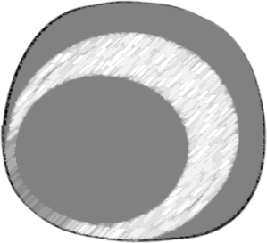
Adverse Outcome Pathways (AOP)
Four key events:
Molecular interaction of the chemical allergen with skin proteins, to form the complete antigen
The second key event takes place in the keratinocytes (KCs). This includes inflammatory responses as well as expression of genes associated with specific cell signalling pathways
Activation of dendritic cells (DCs), which is typically assessed by the expression of specific cell surface markers and release of chemokines and cytokines
The final key event is the specific T-cell clonal expansion
T
T
1
2
3
4

Slide 5
Working hypothesis
UNDERSTANDING OF THE MOLECULAR EVENTS THAT TRIGGER CELL ACTIVATION FOLLOWING EXPOSURE TO CONTACT ALLERGENS
Protein Kinase C (PKC) activation is central to DCs activation.
Hypothesis

Slide 6
Protein Kinase C (PKC) activation is central to DCs activation
PKC plays a key role in a variety of cellular functions:
Cell growth and differentiation
Gene expression
Hormone secretion
DCs differentiation
PKCβII: consistently activated during DCs differentiation-inducing stimuli
UP-REGULATION OF DCs SURFACE MARKERS:
MHC I, MHC II
CD11c, CD40, CD80, CD83 and CD86

Slide 7
Aim of the project
To correlate allergen potency with the vigour of PKC activation, co-stimulatory molecules and cytokine production, and longevity in DCs.

Slide 8
Experimental model
Cell line | Target of use
THP-1 (Human promyelocytes) | Surrogate of DCs
Chemicals
Strong (i.e. benzoquinone),
Moderate (i.e. diethyl maleate)
Weak (i.e. penicillin G)

Slide 9
Experimental plan - 1
DCs activation/maturation will be assessed by measuring up-regulation of co-stimulatory molecules and production of cytokines.
HLA-DR, CD80 and CD86 expression will be evaluated by FACS analysis;
IL-1β, IL-6, IL-8, IL-10, IL-12p40 will be determined by Real Time PCR and ELISA
mRNA stability by assessing AU-rich element binding proteins HuR and TTP expression, and mRNA half-life

Slide 10
Experimental plan - 2
The effective contribution of PKCβ in chemical allergen-induced DCs activation will be assessed using specific PKCβ inhibitors commercially available (i.e. PKCβ pseudosubstrate).

Slide 11
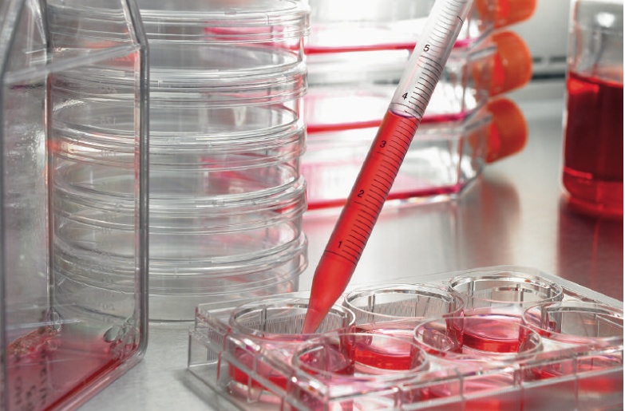
Experimental plan - 3
Dose- and time-related experiments will be conducted to assess the effects of contact allergen-induced on the selected markers of activation/maturation to understand the quality and longevity of DCs activation in relation to the potency of allergens.

Slide 12
Significance of the project
The goal is to provide a simple in vitro assay based on the use of a commercially available cell lines able to provide potency information, which is required for full replacement of animals in the assessment of the allergenic potential of xenobiotic.

Slide 13
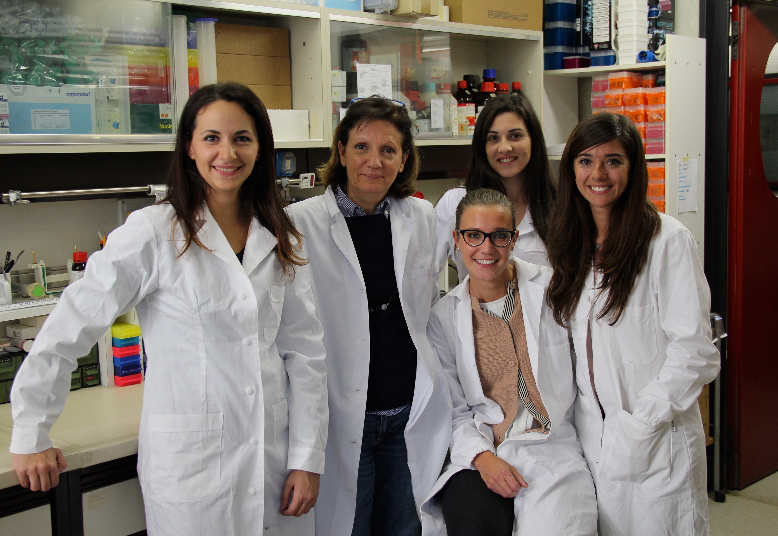
ACKNOWLEDGMENTS
Toxicology Laboratory
Prof C.L. Galli
Prof.ssa M.Marinovich
Prof.ssa E.Corsini
V. Galbiati, PhD
A.Papale

Slide 14
THANK YOU FOR YOUR ATTENTION!

