Slide 1
Operation Alekto
revealing the truth about vivisection

Slide 2
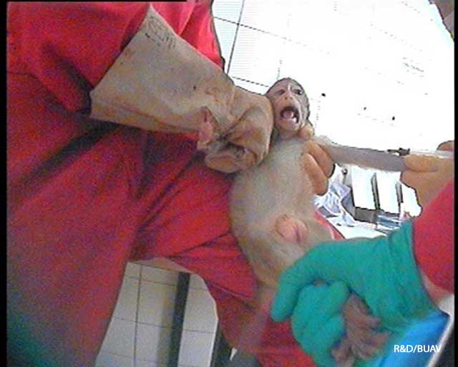
Why Operation Alekto?
10 years after Covance
SOKO Tierschutz
R&D / BUAV

Slide 3
Alekto the Greek goddess for justice for our relatives

Slide 4
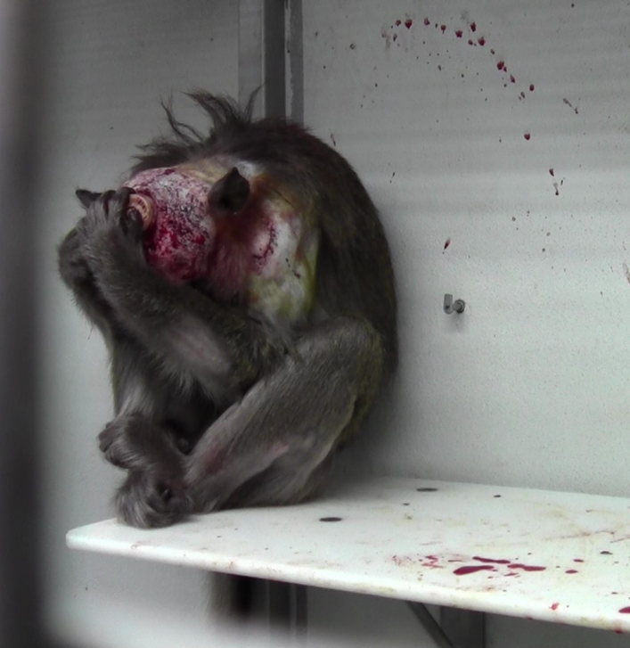
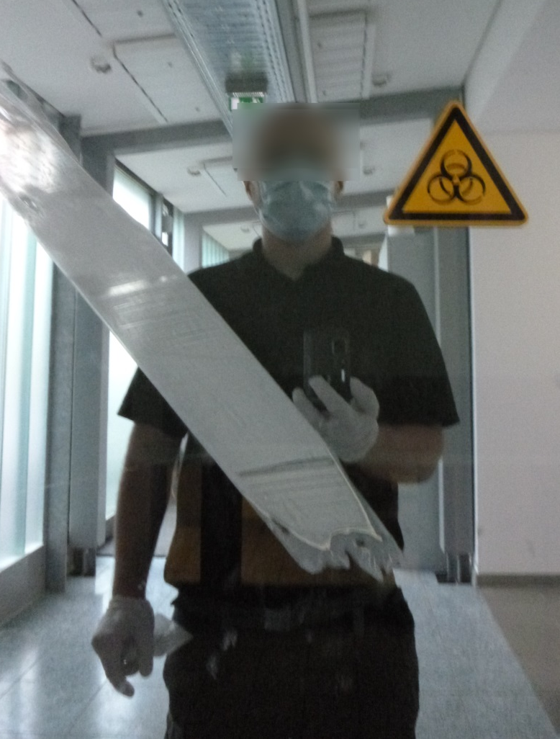
6 ½ month undercover
SOKO Tierschutz
BUAV

Slide 5
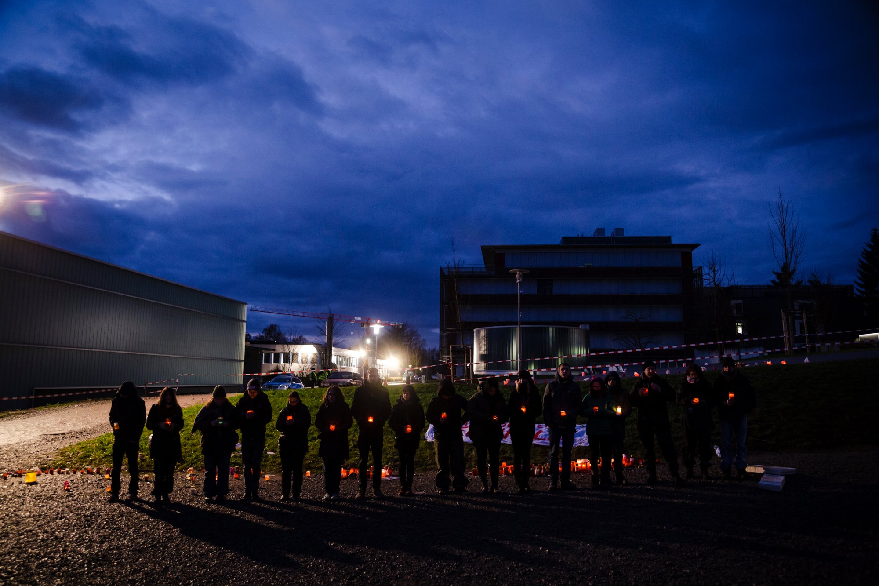
The Target
The Max Planck Institute for Biological Cybernetics

Slide 6
The Target
One of the most notorious and well known animal testing labs worldwide

Slide 7
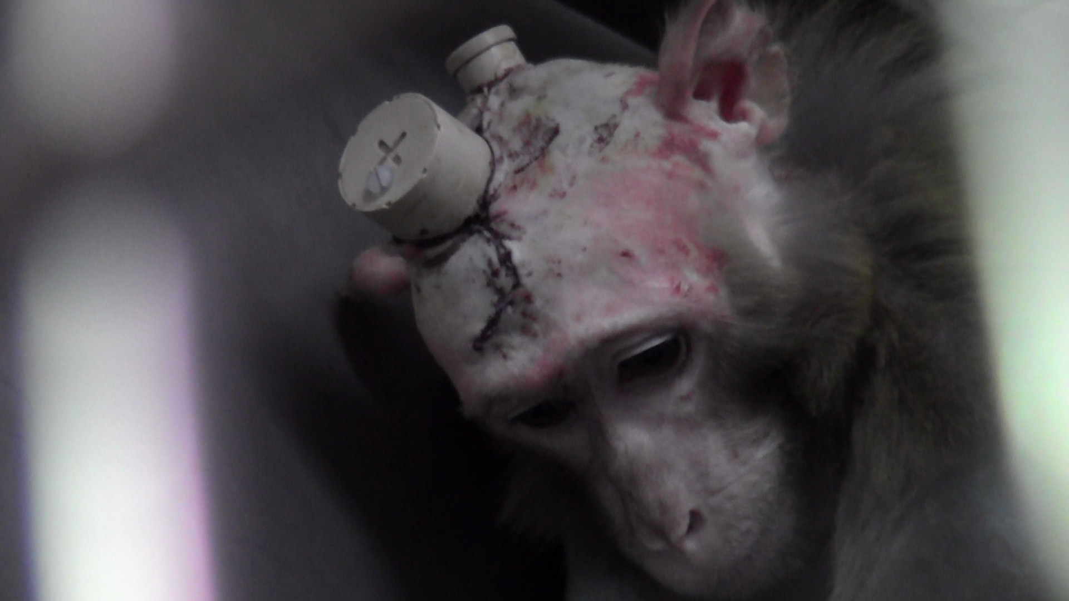
The Target
Primate research
SOKO Tierschutz
BUAV

Slide 8
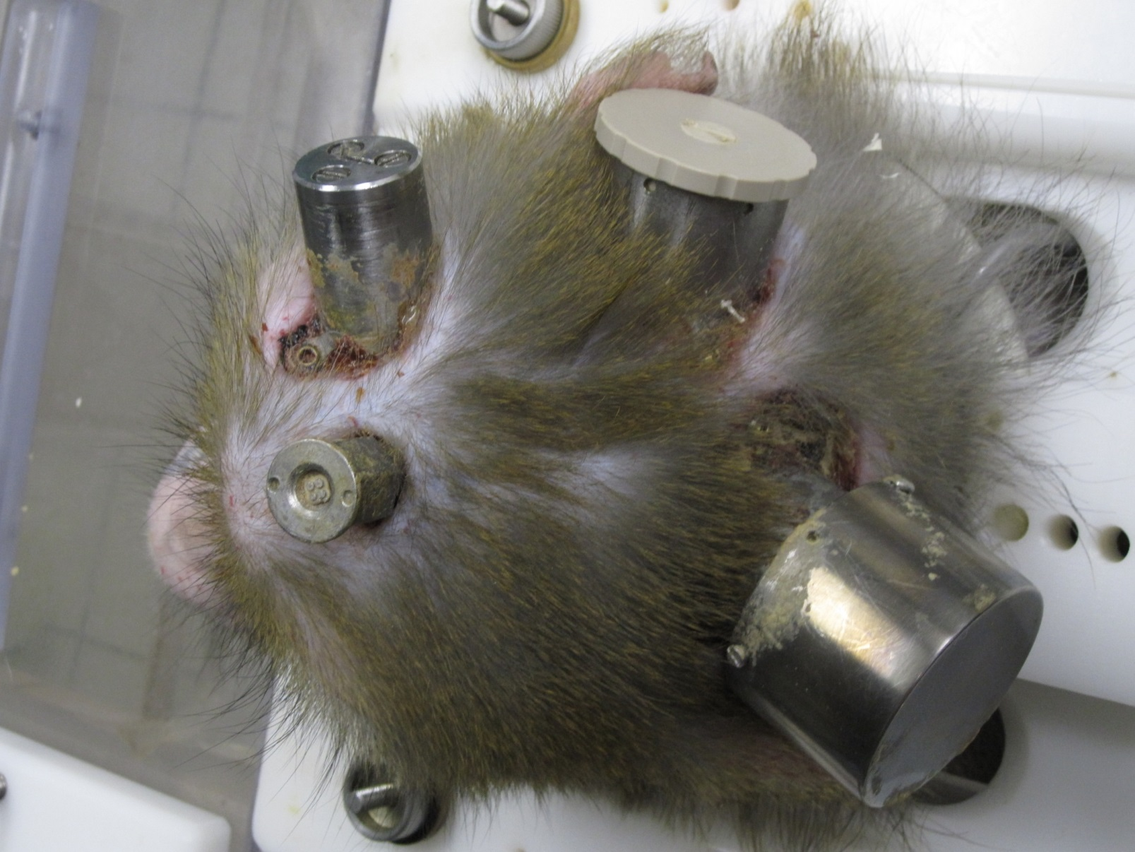
The Target
Basic brain research
SOKO Tierschutz
BUAV

Slide 9
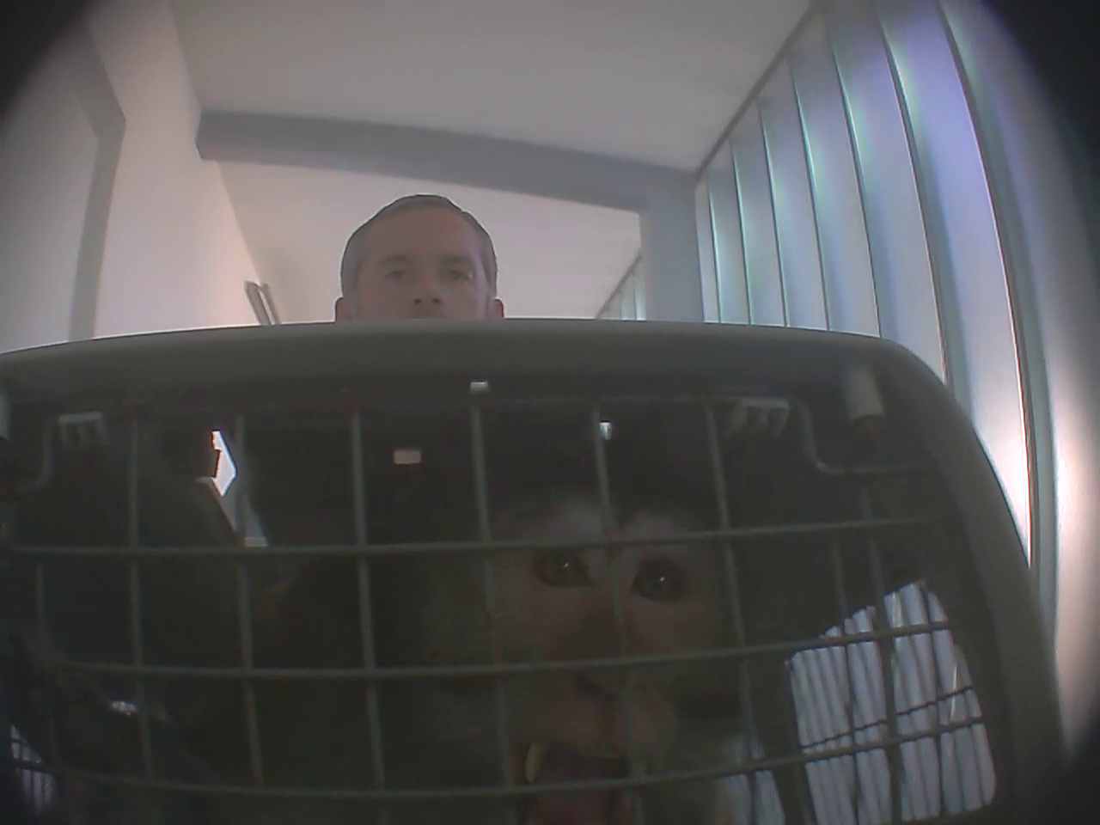
The Target
Involved in the international primate trade
SOKO Tierschutz
BUAV

Slide 10
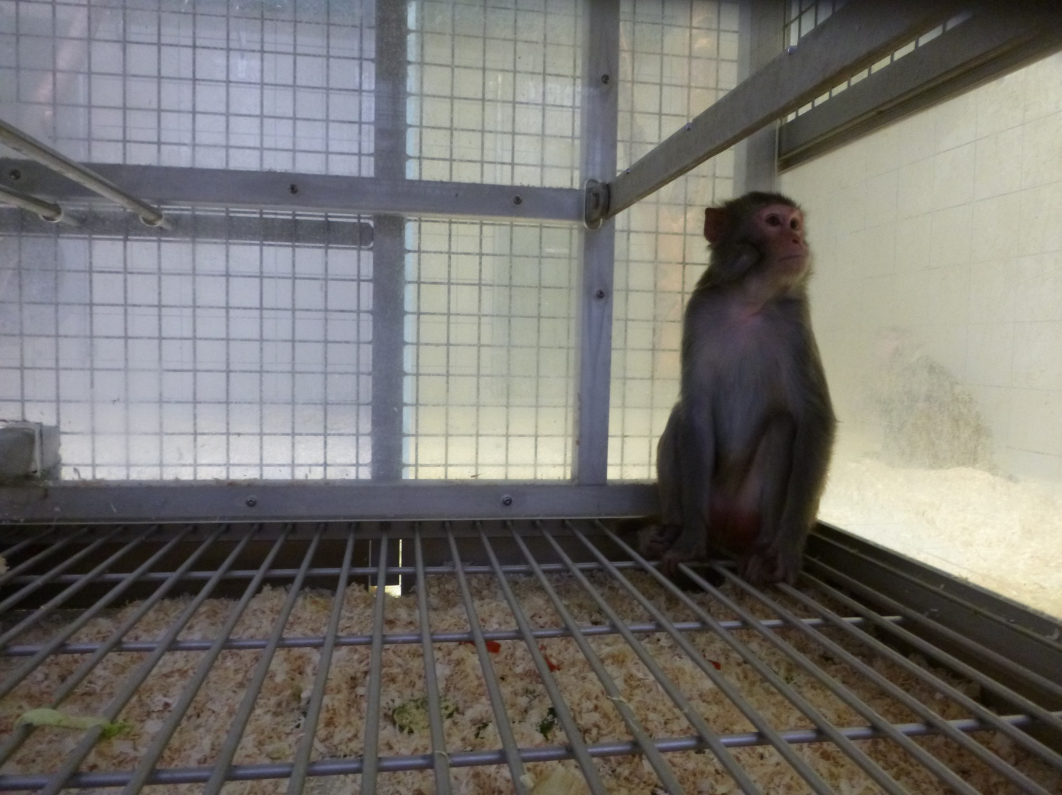
The findings of 6 ½ month undercover
Cage battery keeping
SOKO Tierschutz
BUAV

Slide 11
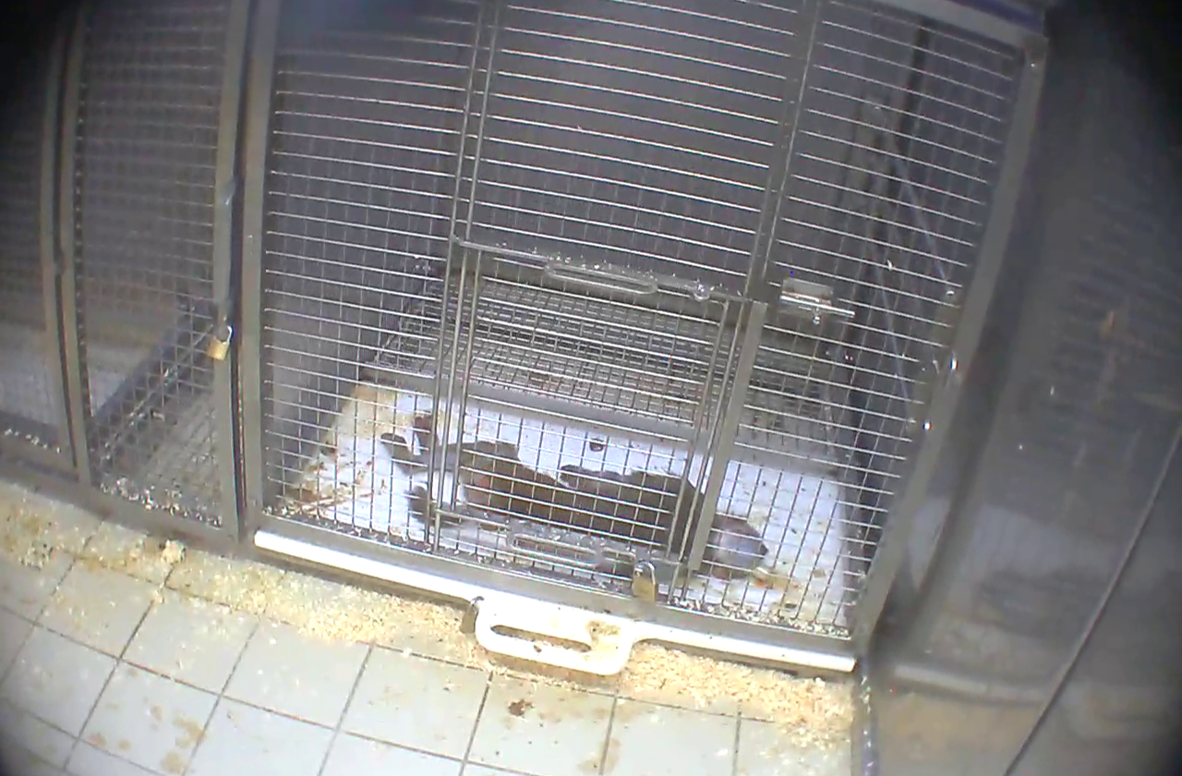
The findings of 6 ½ month undercover
Insufficient post operational care
SOKO Tierschutz
BUAV

Slide 12
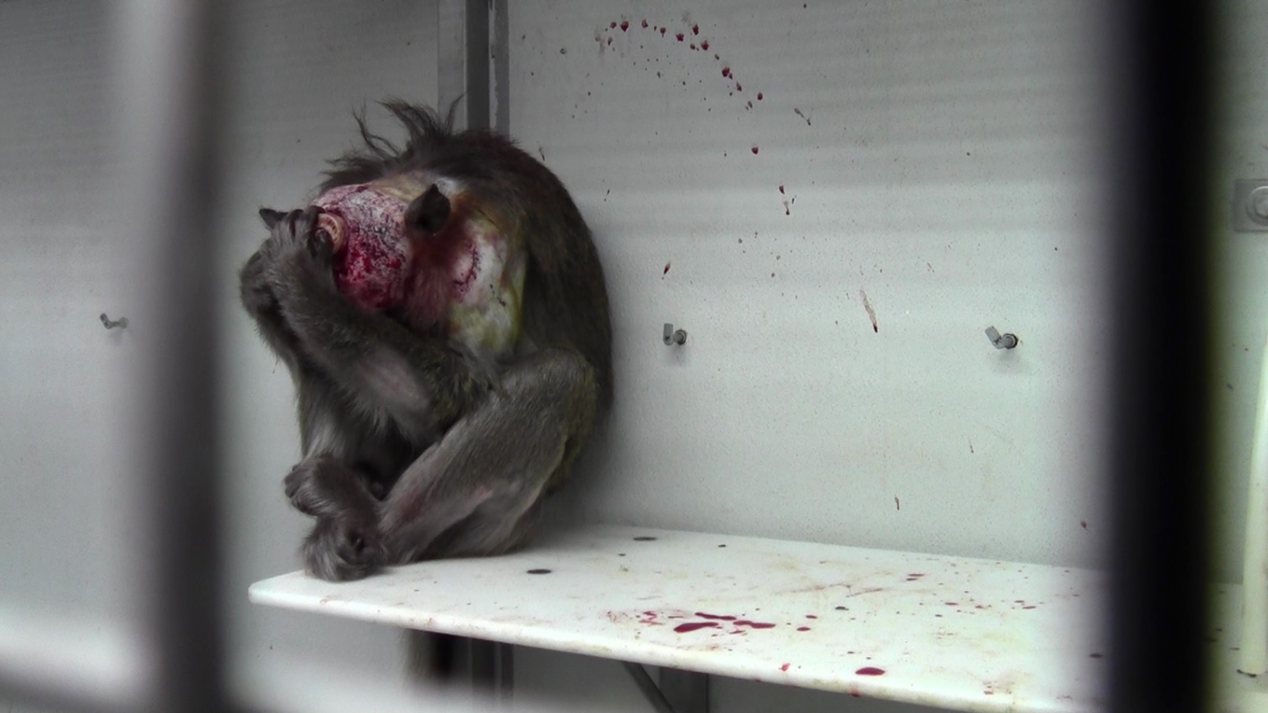
The findings of 6 ½ month undercover
Reoccuring medical complications after surgery and experiments
SOKO Tierschutz
BUAV

Slide 13
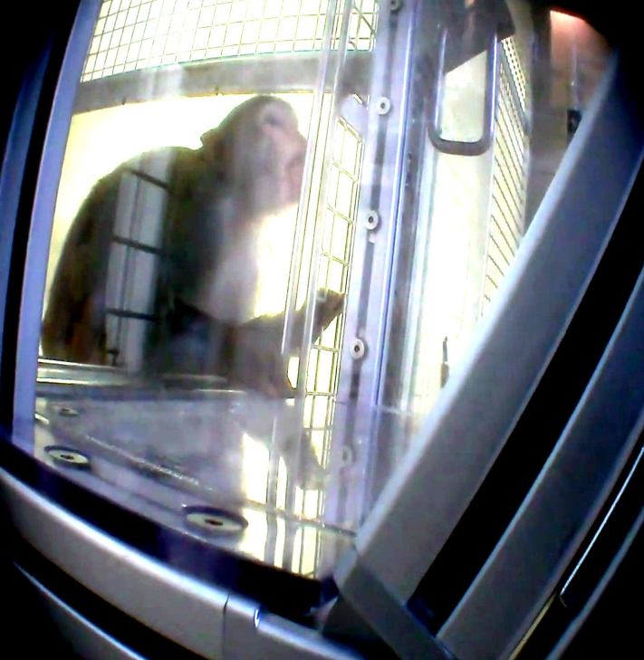
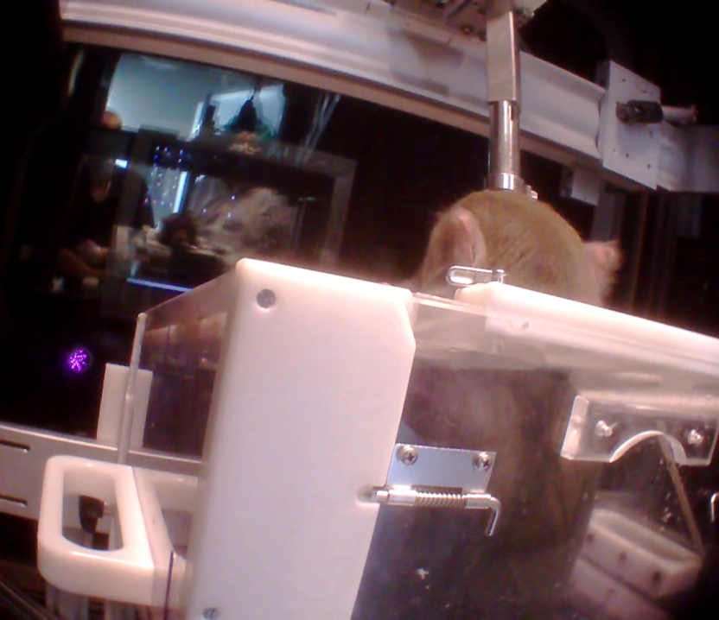
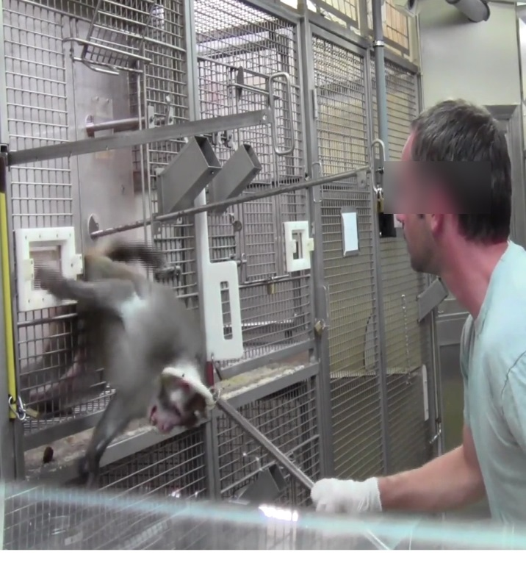
The findings of 6 ½ month undercover
Water deprivation, restrainment and force
extreme strain levels
SOKO Tierschutz
BUAV

Slide 14
The findings of 6 ½ month undercover
Cruel standard operation procedures
SOKO Tierschutz
BUAV

Slide 15
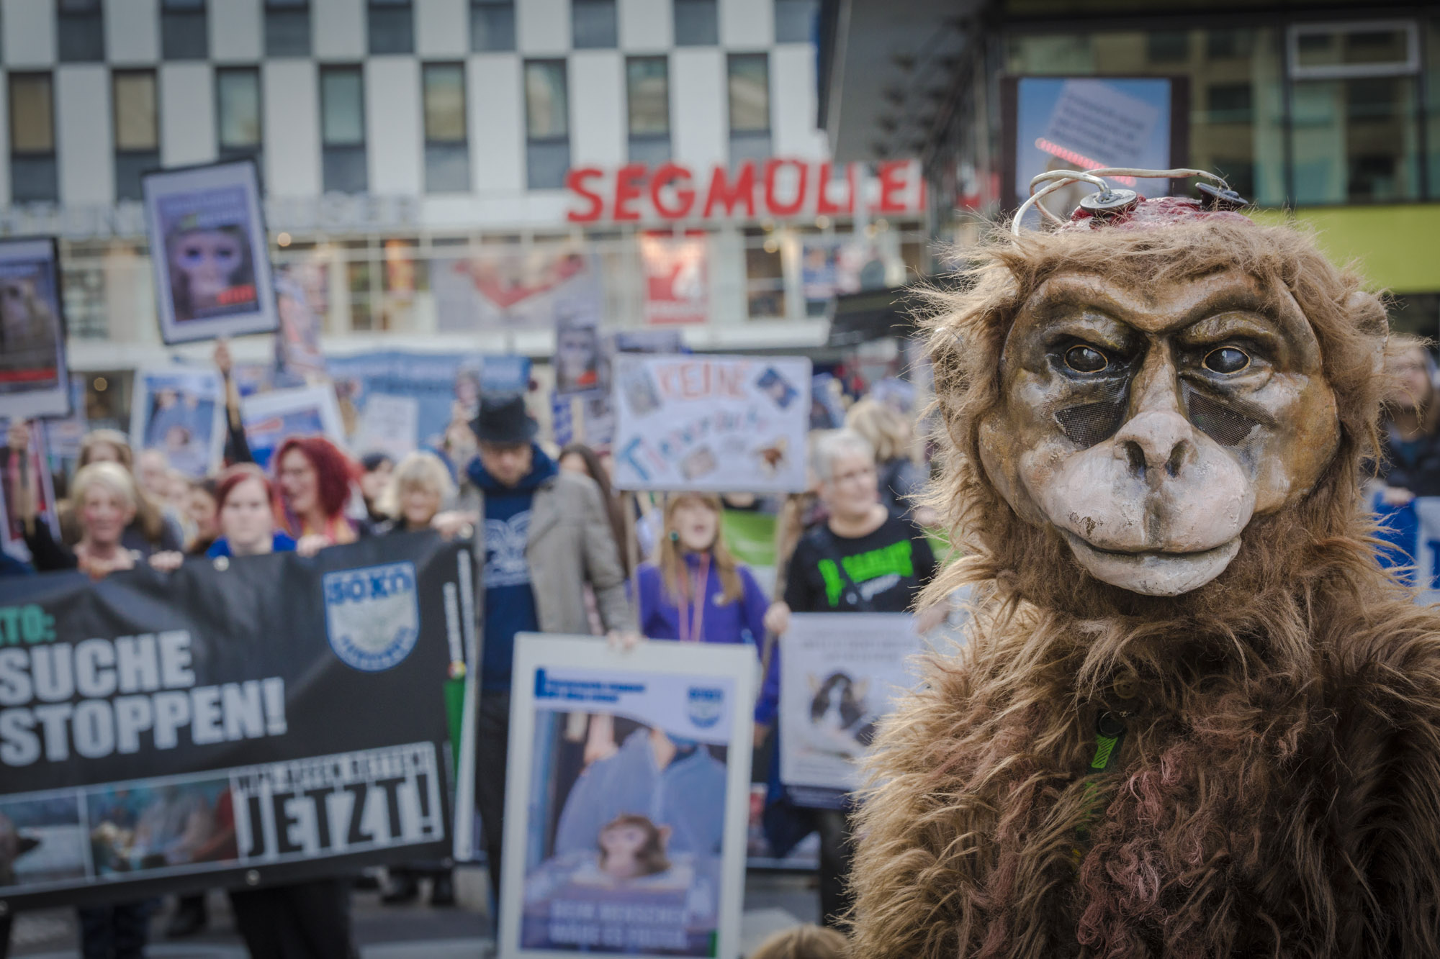
The public campaign
Demonstrations and vigils

Slide 16
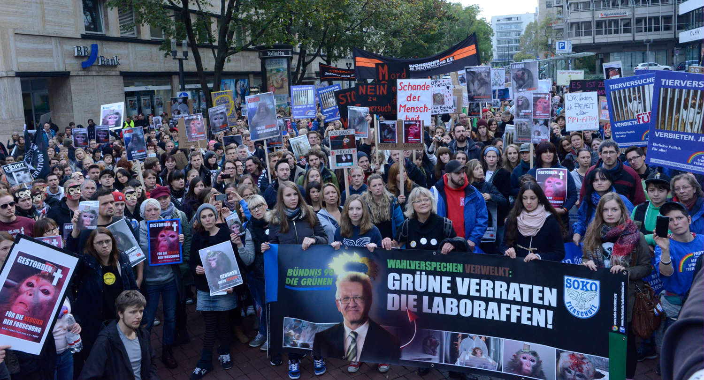

Slide 17
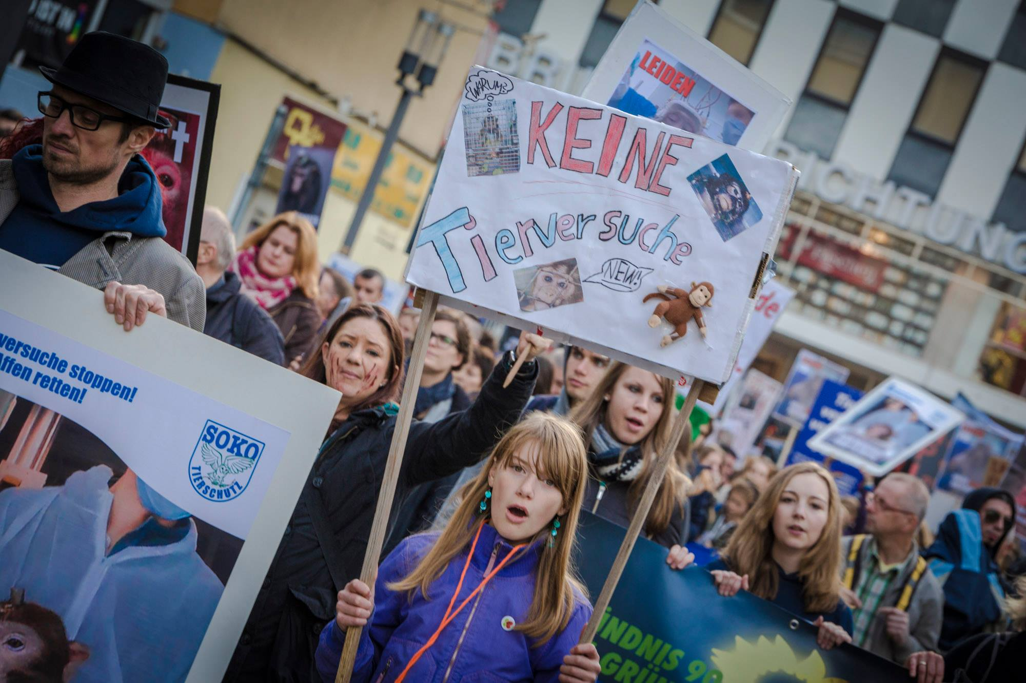

Slide 18
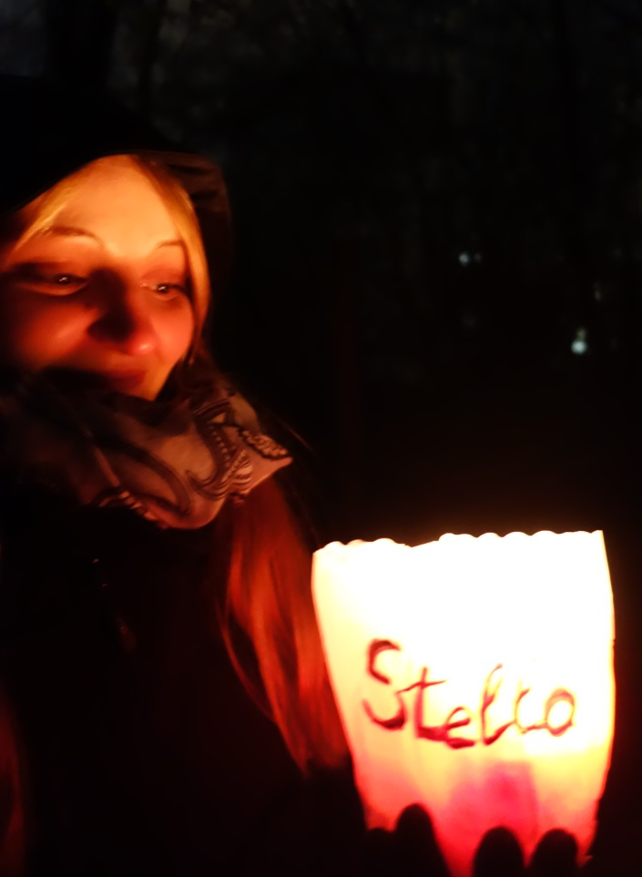
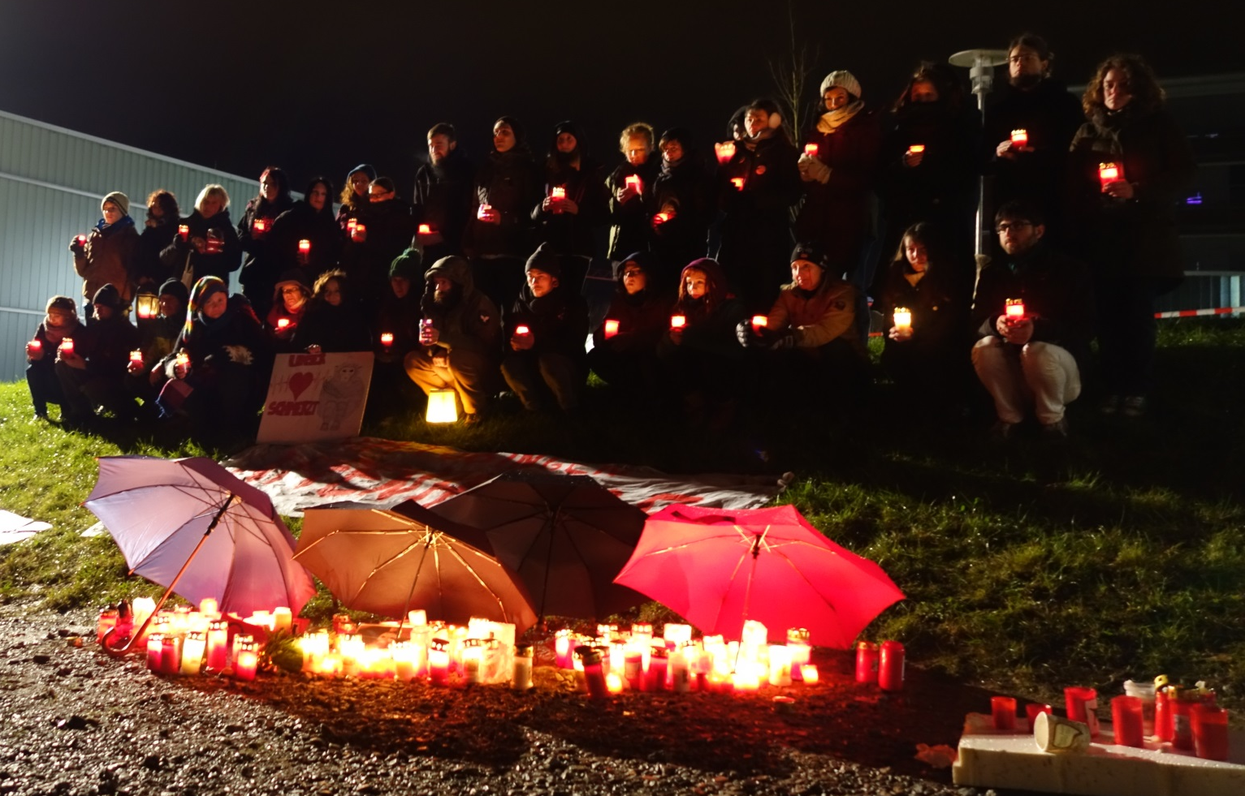

Slide 19
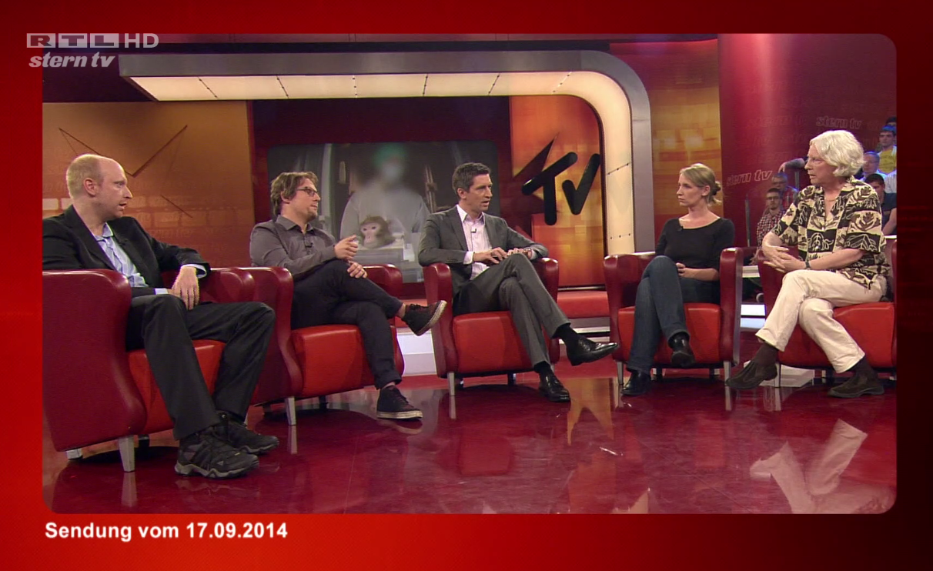
The public campaign
Media

Slide 20
The public campaign
Legal complains and police raid

Slide 21
Outcome
Announcement to end to primate research
Police raid and legal investigations
Ongoing media and public interest
Created public discussion on animal testing in the whole
SOKO Tierschutz
BUAV

Slide 22
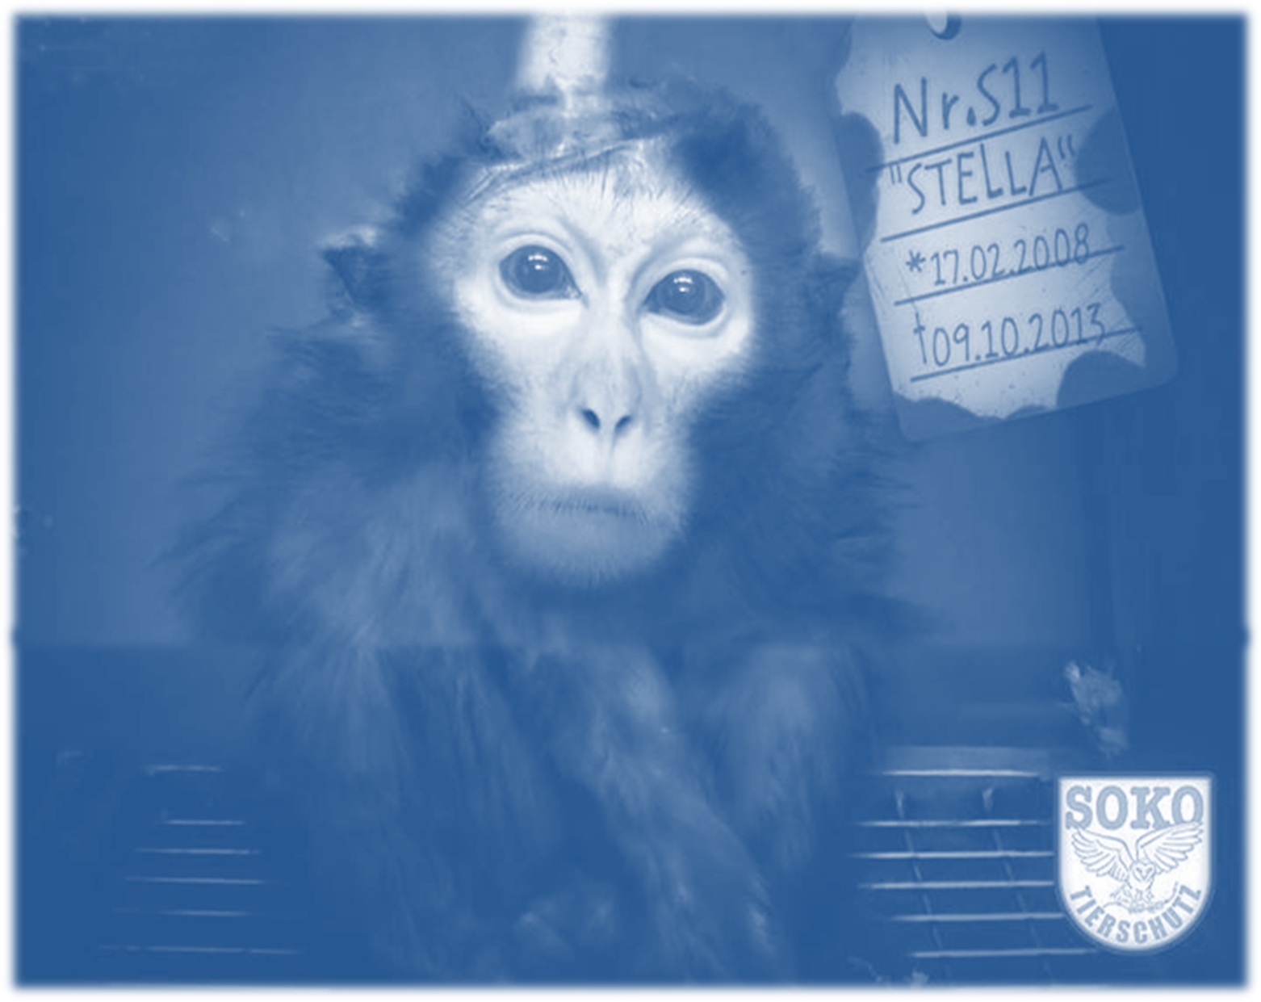
It´s not over!
We hold the line against wrong science and animal cruelty!

