Slide 1


Black Box Lush Prize 2015:
Skin Sensitization Adverse Outcome Pathway
G. Frank Gerberick
The Procter & Gamble Company

Slide 2

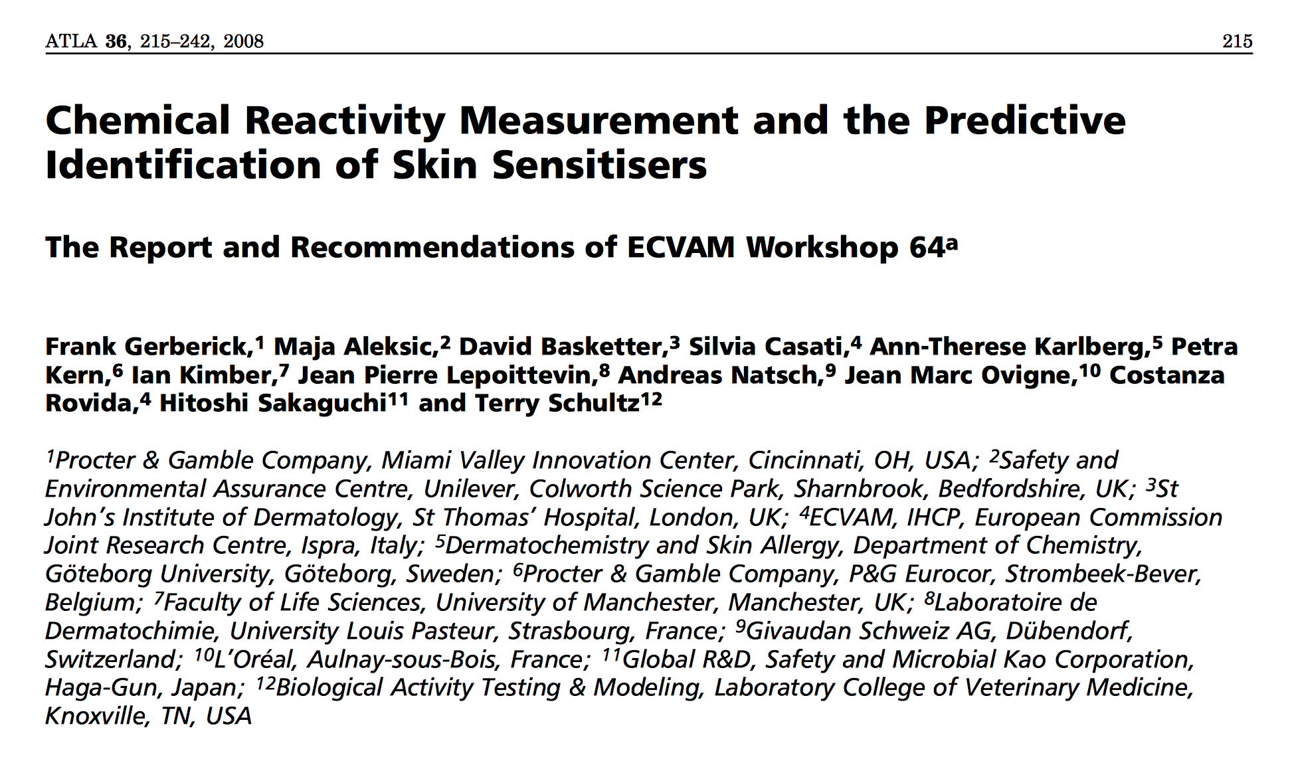
Evaluation of Chemical Reactivity Methodologies for Screening Skin Sensitisation Potential
23 – 25 May 2007, Ispra, Italy

Slide 3

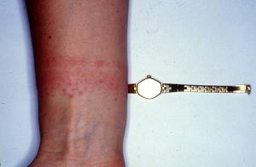

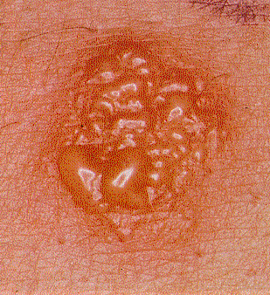
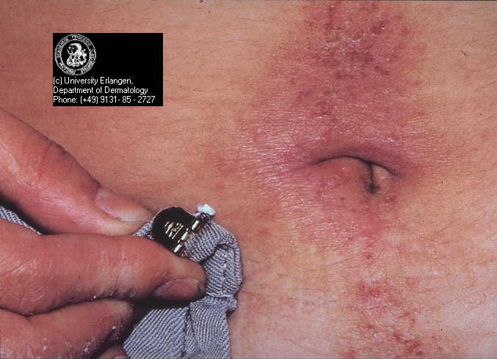
Skin Sensitization: Allergic Contact Dermatitis
Why is it important?

Slide 4
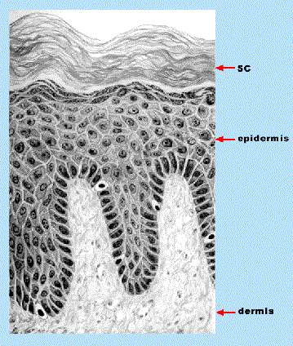
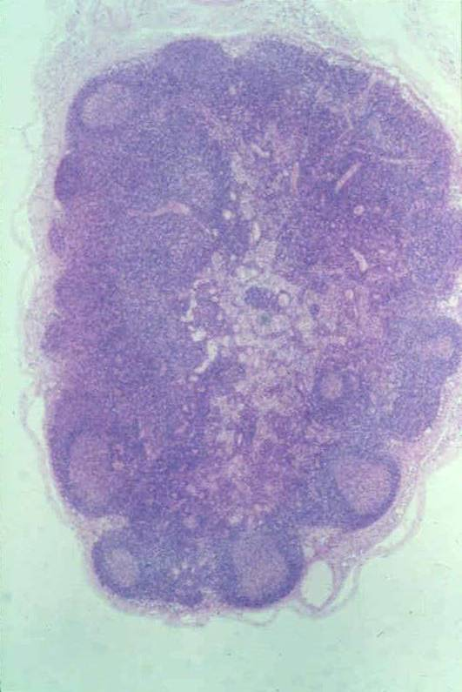
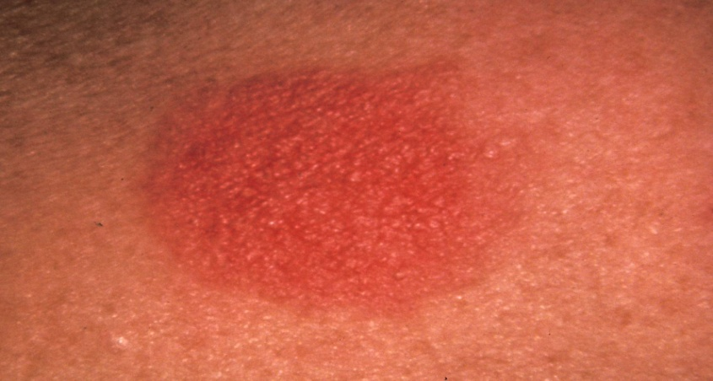
What do we know about Skin Sensitization?
A
B
1
7
2
8
3
4
9
5
6
Toxicological Sciences, 2011; 120(S1):S238-S268

Slide 5

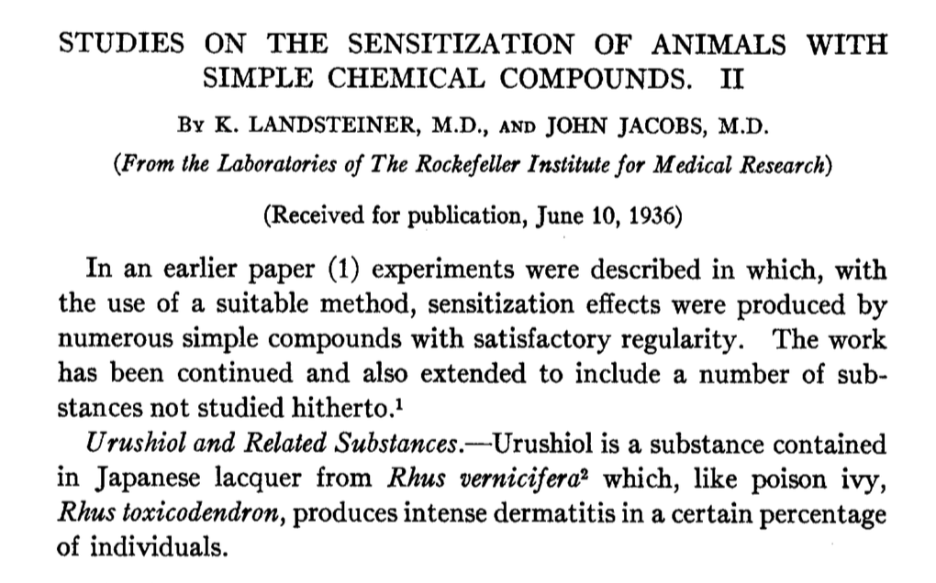

Learning from the past

Slide 6
Chemical-Protein Reactivity:
Skin Sensitization
Nucleophilic-electrophilic interaction:
Pro/Pre-Hapten
:Nu
Hapten
E
Protein
Hapten
Protein
The correlation of skin protein reactivity and skin sensitization is well established and has been known for many years.
(Landsteiner and Jacobs, 1936; Dupuis and Benezra, 1982; Lepoittevin et al, 1998)
Notes:
6

Slide 7
Alternatives Strategy for Skin Sensitization
GP Tests, HRIPT
NH₂
Skin penetration
NH₂
Protein binding
NH₂
DC activation
LLNA
NH₂
T
DC
1° T reaction
Notes:
7

Slide 8
Adverse Outcome Pathway and Predictive Testing
Chemical Structure & Properties
Molecular Initiating Event
Cellular Response
Organ Response
Organism Response
1. Skin Penetration
7-8. Presentation of haptenated protein by Dendritic cell resulting in activation & proliferation of specific T cells
9-11. Allergic Contact Dermatitis: Epidermal inflammation following re-exposure to substance due to T cell-mediated cell death
3-4. Haptenation: covalent modification of epidermal proteins
5-6. Activation of epidermal keratinocytes & Dendritic cells
2. Electrophilic substance: directly or via auto-oxidation or metabolism
Key Event 1
Key Events 2 + 3
Key Event 4
Adverse Outcome
Keratinocytes
KeratinoSensTM [Givaudan]
In silico models
SAR/ QSAR
In chemico models
In vitro
cell-based
models
LuSens [BASF]
Dendritic Cells
h-CLAT [KAO/Shiseido]
Reactivity Assays
MUSST [L’Oreal]
Modified version of flow diagram from ‘The Adverse Outcome Pathway for Skin Sensitisation, OECD report
PBMDC [Beiersdorf]
Notes:
The next key events in the AOP for skin sensitization are the activation of epidermal keratinocytes and dendritic cells.
There are a number of in vitro cell-based models at various stages of development and validation which address this cellular response.
Keratinocyte assays include the KeratinoSens and LuSens assays.
And among the dendritic cell based assays are the human cell line activation test or h-CLAT, the myloid u-937 skin sensitization test or MUSST and the peripheral blood monocytic dendritic cell assay or PBMDC. Since time is running short we will focus on the two assays which are furthest along in the validation process – they are the KeratinoSens assay and the h-CLAT.

Slide 9
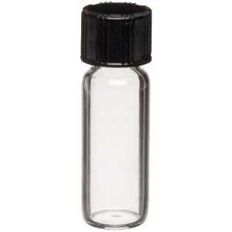
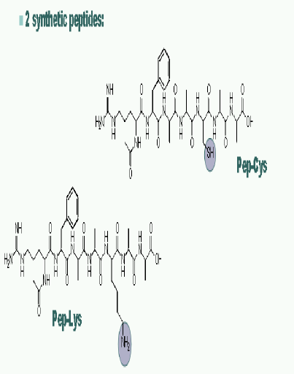

Direct Peptide Reactivity Assay (DPRA) Method
Screening method for evaluation skin sensitization potential (haptens, prehaptens)
Direct Peptide Reactivity Assay (DPRA)
The reactivity is quantified based on the percentage of peptide depletion (HPLC/PDA)
Test chemical
in solvent
Synthetic model peptides
in buffer
Incubation for 24 h, 25°C (dark)
Lysine (Ac-RFAAKAA-COOH)
1:50
at pH 10.2
Cysteine (Ac-RFAACAA-COOH)
1:10
at pH 7.4
Gerberick, et al. (2004) Tox. Sci. 81, 332-343
Notes:
The Direct Peptide reactivity Assay, or DPRA, developed by Procter and Gamble scientists, was recently validated by the European Center for the Validation of Alternative Methods and was endorsed by their scientific advisory group as a useful tool for early decision making during product development (screening) and as a component in a weight-of-evidence approach or integrated testing strategy for safety/hazard assessment.
Test chemical in acetonitrile.
Cys peptide (Ac-RFAACAA-COOH) in phosphate buffer, pH 7.5.
Lys peptide (Ac-RFAAKAA-COOH) in ammonium acetate, pH 10.2.
Test chemical reacted with peptide (10:1 or 50:1) for 24 hours.
Peptide depletion monitored by HPLC at 220 nm.
Test chemicals are dissolved in solvent to prepare 100mM solution.
The peptides are dissolved in buffer to prepare 0.667mM solutions.
The cysteine reaction is run at a ratio of 1:10 peptide:test chemical and the lysine reaction is run at a ratio of 1:50 peptide:test chemical. Three replicates are run for each chemical
The chemical peptide mixtures are incubated for 24 hrs at room temperature in the dark.

Slide 10
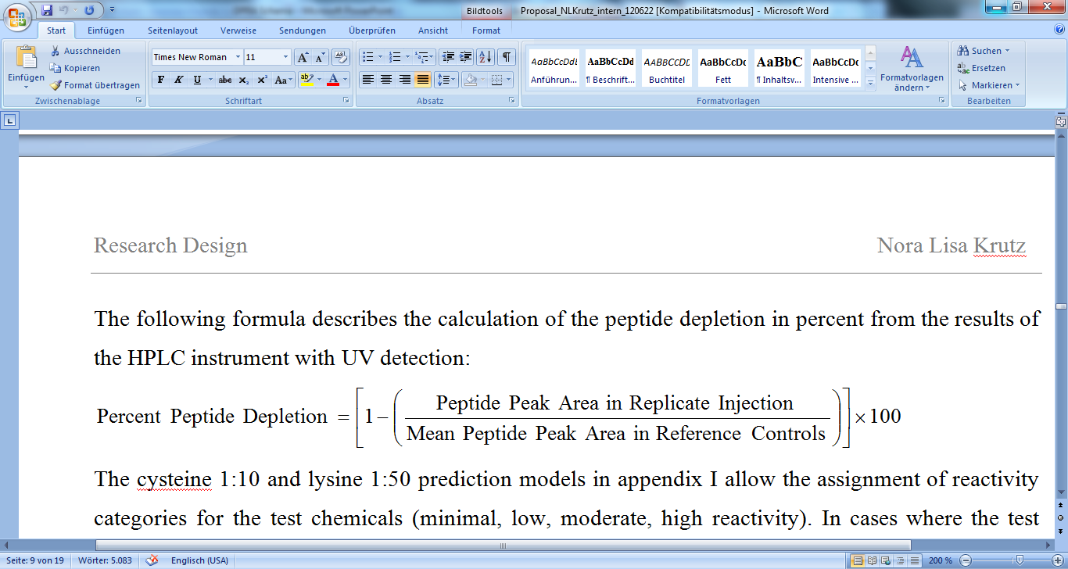

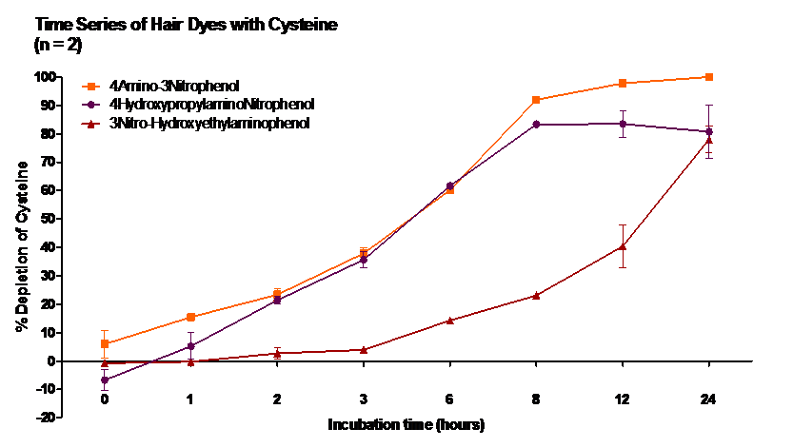
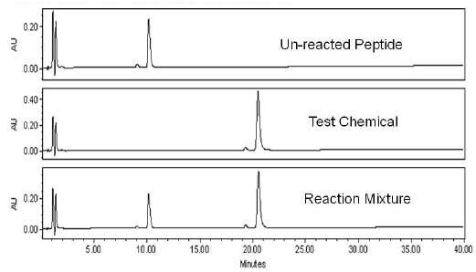
in chemico DPRA Method
Calculation of peptide depletion
HPLC/PDA

Slide 11
DPRA Prediction Model
Cys 1:10 and Lys 1:50
Total Sample
Avg Score < 22.62%
Avg Score > 22.62%
Avg Score < 22%
Avg Score > 22%
Minimal Reactivity
Avg Score <6%
Low Reactivity
Avg Score >6%
Moderate Reactivity
Avg Score <42%
High Reactivity
Avg Score >42%
Non-sensitizing
Sensitizing
Gerberick et al. (2007). Tox. Sci., 97, 417-427
Notes:
11
The DPRA prediction model was developed by comparing peptide reactivity data were with existing local lymph node assay data using recursive partitioning methodology to build a classification tree..
The average depletion of the two peptides is used in a decision tree prediction model to ‘bin or rank’ the chemical into one of 4 classes of reactivity. minimal, low, moderate, and high
Generally, nonallergens and weak allergens demonstrated
minimal to low peptide reactivity, whereas moderate to
extremely potent allergens displayed moderate to high peptide
reactivity. Those with minimal reactivity are considered to be non-sensitizing
and those with low, moderate or high reactivity are classified as sensitizing
model based on cysteine and lysine gave a prediction accuracy of 89%.

Slide 12

in chemico DPRA:
Accuracy Performance
Natsch, et al. (2013). Journal of Applied Toxicology 33: 1337-1352
EURL/ECVAM Results for 157 Chemicals:
Sensitivity = 80%; Specificity = 77%; and Accuracy = 80%
Current published dataset of DPRA includes 145 chemicals
  30 Extreme/Strong
  39 Moderate
  33 Weak
  43 Non-sensitizers
Sensitivity = 82%; Specificity = 74%; and Accuracy = 80%

Slide 13
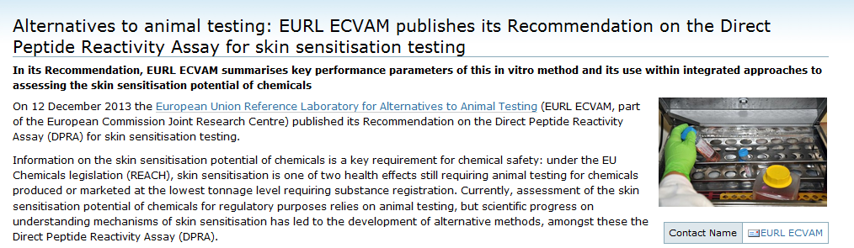
ECVAM endorsement DPRA
OECD GUIDELINE APPROVED!!!
Test No. 442C: In Chemico Skin Sensitization - Direct Peptide Reactivity Assay (DPRA): This Test Guideline provides an in chemico procedure (Direct Peptide Reactivity Assay – DPRA) used for supporting the discrimination between skin sensitizers and non-sensitizers in accordance with the UN GHS.
Link: http://www.oecd-ilibrary.org/environment/test-no-442c-in-chemico-skin-sensitisation_9789264229709-en
ECVAM Pre-validation started in 2009 (after successful inter-laboratory evaluation).
Development of SOP and testing 2010-2011.
Notes:
The DPRA was evaluated in a EURL ECVAM led validation study and peer reviewed by ESAC. The DPRA was considered scientifically valid to be used as part of an integrated approachs to testing and assessment to support the discrimination skin sensitizers and non-sensitizers for the purpose of hazard identification.
The development of an OECD Testing Guideline for the DPRA is in process.
The DPRA is a good assay - it has the potential to identify chemicals that are directly reactive with most common protein nucleophiles.
but it does have its limitations – some chemicals may preferably react with amino acids other then cysteine and lysine so they would fall outside the applicability domain of DPRA and
and while some pre-haptens have been correctly identified by the DPRA, the extent to which the assay does or does not detect pre-haptens is not fully known and it does not detect pro-haptens.
Much work has been done to develop a second generation reactivity assay which will address some of these limitations.

Slide 14
Next Generation: in chemico Peroxidase Peptide Reactivity Assay (PPRA)
Screening method for evaluation skin sensitization potential (haptens; pre-, prohaptens)
Incubating test chemical with H₂O₂, HRP, desferroxamine, model peptide for 24h followed by the addition of DTT
The reactivity is quantified based on the percentage of peptide depletion (LC/MS/MS)
H₂O
H₂O₂
Peroxidase (O)
Peroxidase (R)
Test Chemical
Reactive Metabolite (electrophilic hapten)
Auto-oxidation
Peptide (Cys) (nucleophile)
Fe²⁺ + H₂O₂ Oxidant
Reversed by DTT
Peptide Dimer
desferroxamine
Electrophilic-nucleophilic covalent binding
Adduct Formation

Slide 15

Alternatives for Skin Sensitization:
The Challenge – Data Integration
Bioavailability
Peptide Reactivity
Hazard ID
and Potency
(NESIL)
and
QRA
Modeling
Simulation
T cell Activation
DC
Activation
SAR
Metabolism
Data Integration / ITS / WoE / IATA
Bayesian Network (P&G)
Artificial Neural Network (Shiseido)
Weight of Evidence (BASF)

Slide 16
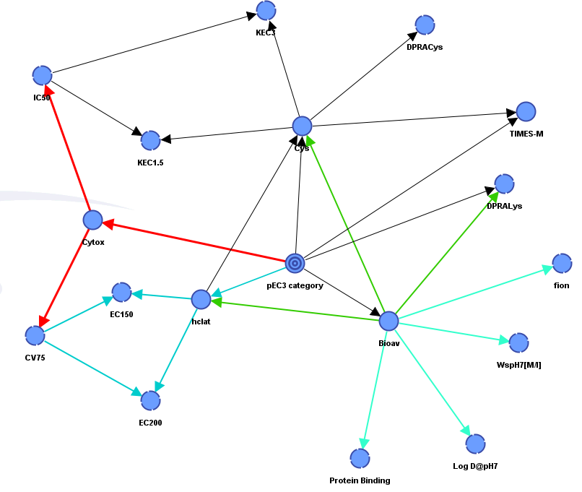
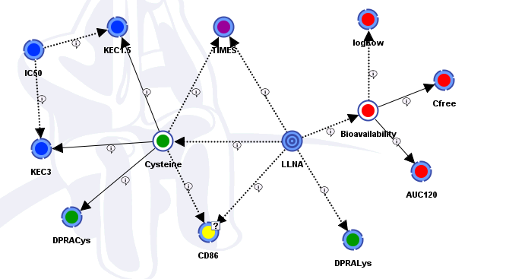
Bayesian Network Integrated Testing Strategy
The BN developed by Jaworska et al, combines in silico, in chemico, and in vitro data related to skin penetration, peptide reactivity, and dendritic cell activation.
The structure of the BN ITS represents the underlying mechanistic processes leading to an in vivo effect.
The BN ITS framework formulates a probabilistic hypothesis about the target variable based on cumulative evidence from initial data and guides subsequent testing by Value of Information calculations.
Jaworska et al. J. Appl. Tox. 2013, 33: 1353–1364;
Dataset published Natsch et al. J. Appl. Tox. 2013, 33:1337-1352
Jaworska et al. Arch. Tox. 2015 (accepted)
Notes:
The BN developed by Jaworska et al, combines in silico, in chemico, and in vitro data related to skin penetration, peptide reactivity, and dendritic cell activation.
The structure of the BN ITS represents the underlying mechanistic
processes leading to an in vivo effect. We can think of it as an abstracted skin sensitization process embedded into a decision analytic tool -
The BN ITS framework formulates a probabilistic hypothesis about
the target variable based on cumulative evidence from initial data and guides subsequent testing by Value of Information (VoI) calculations.
The ‘target variable’ is the induction of skin sensitization as an LLNA potency class prediction.
The input data used are
Bioavailability & phys/chem. parameters (Kasting’s model): Log Kow, AUC120, Ctot,free
Reactivity data: DPRA Cys & DPRA Lys / Keratinosens (KEC & IC50)
Dendritic cell activation (CD86)
TIMES-Metabolite / TIMES-Parent
Both the BN-ITS and the dataset used to train and test the network are published.

Slide 17
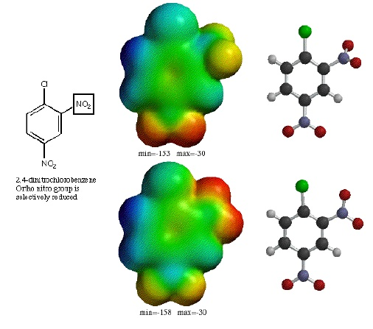



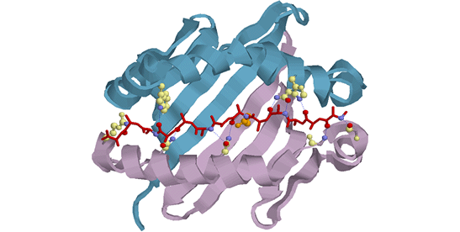


Where are we at now with
Skin Sensitization Assessments?
Risk
Hazard/Potency Assessment
Exposure
In Silico
In chemico/In Vitro
Product
Safety Assessments
Notes:
What does this means for the Cosmetic industry?
Up to now, before introducing a new ingredient, Cosmetic companies performed risk assessment using data obtained from historical sources – existing animal and human data, and maybe also some in silico data
additional in vivo experiments could also be conducted if needed to define the hazard and combined these data with exposure calculations.
Now it is not possible to generate new in vivo data so that leaves historical in vivo data along with in silico predictions and in vitro tests.
However, for new materials, there may be no existing historical data which leaves only in silico and in vitro data for use in determining human risk.
Much work has been done in the area of alternative methods development but the ultimate challenge is to be able to integrate data from the various assays in such a way that information on allergenic potency is derived which can be used in a quantitative risk assessment approach.

Slide 18




External Partners!
 | Jean-Pierre Lepoittevin Elena Gimenez-Arnau
 | Ian Kimber Rebecca Dearman
 | Anne Marie Api Jon Lalko
DABMEB Consultancy Ltd | David Basketter
 | Brunhilde Blömeke Nora Kurtz Jenny Hennen

Slide 19
John Troutman
Leslie Foertsch
Joanna Jaworska
Petra Kern
Roy Dobson
Frank Gerberick
Mike Quijano
Jian Dai
Cindy Ryan
Joel Chaney
Carsten Goebel

