Slide 1
“Placenta-on-a-chip” – replicating organ functions in a microfluidic chip
Jeremy Caplin

Slide 2
Issues with current drug testing methods
In vivo:
unethical
Can Often be an inaccurate representation of actual human responses
expensive
In vitro
Difficult to replicate the complexity of the human anatomy
Typically miss some sort of important physiological trait in favor of simplicity (two-dimensional models, static conditions, etc.)

Slide 3
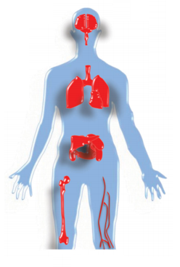
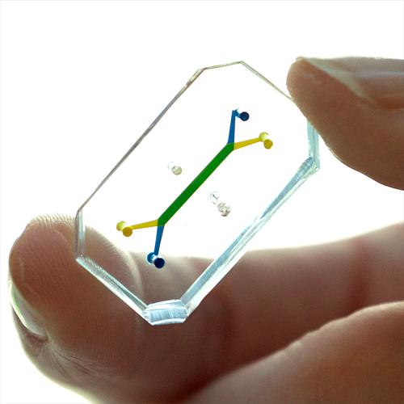
Organ-on-a-chip
The intersection of in vivo and in vitro drug testing
Centered around recreating the in vivo microenvironment
Has the potential to replicate human organs, and connect them to create a “body-on-a-chip”

Slide 4
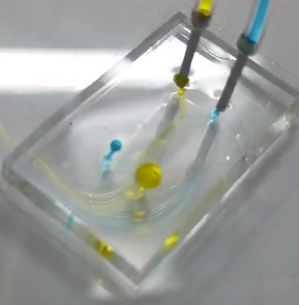
Organ-on-a-chip
Take advantage of microfluidic phenomena
Minimal products and materials
Relatively Easy to manufacture
Physiologically similar to the body
Replace unethical alternatives

Slide 5
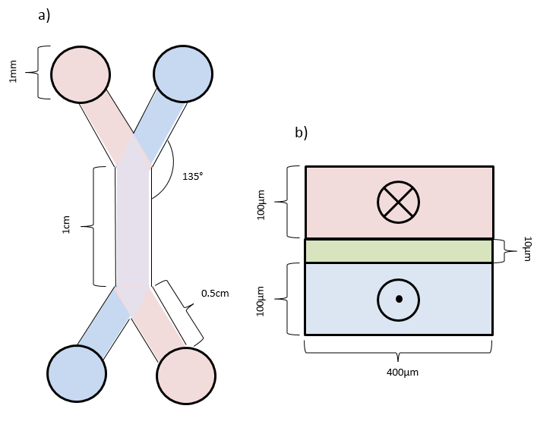
Chip layout
Width: 400 microns
Height: 100 microns
Midsection length: 1 Cm
Inlet/outlet diameter: 1 mm
Membrane thickness: ~10 microns
Inlet/outlet to midsection angle: 135°

Slide 6
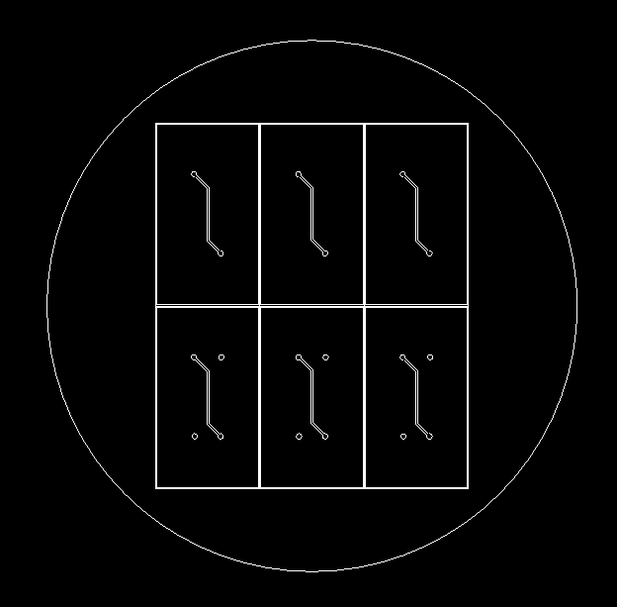
Chip design
Fabrication Techniques
Polymethyl methacrylate (PMMA)
micromilling
Polydimethylsiloxane (PDMS)
Soft lithography -> Master mold
Collagen vitrification

Slide 7
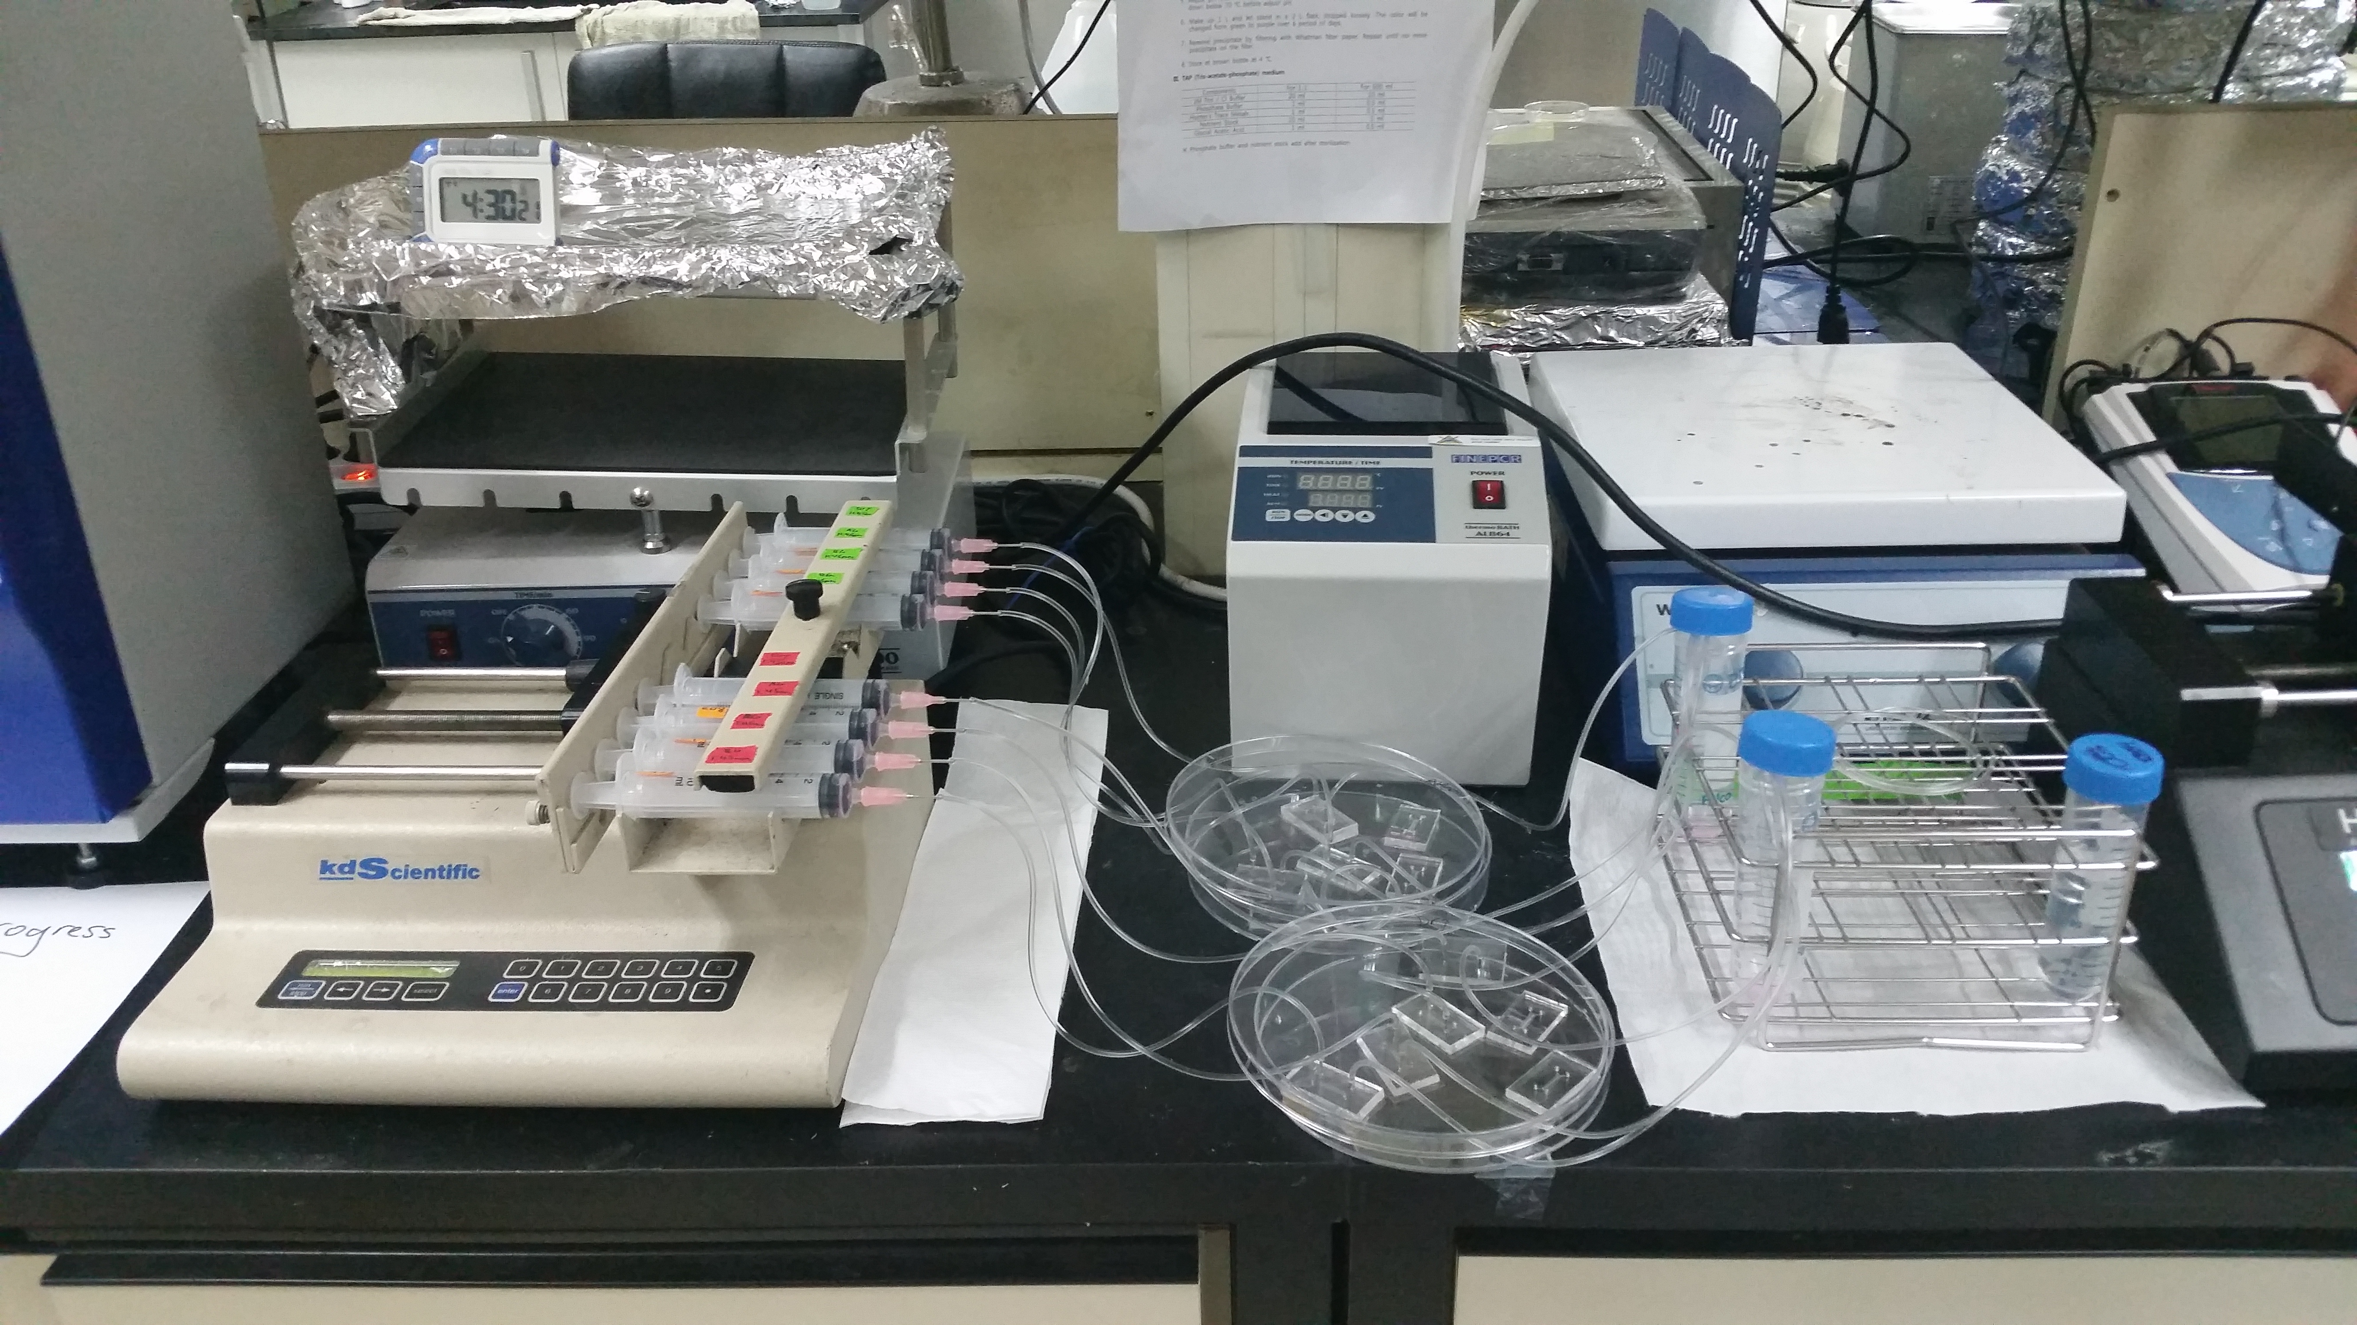
Liver-on-a-chip
System consists of a syringe Pump delivering media into the chip at a constant flow rate, with outlet streams collected as waste
Can sustain multiple trials at once, allowing many different parameters to be tested (concentration of ethanol, duration of cell seeding before exposure, etc.)

Slide 8
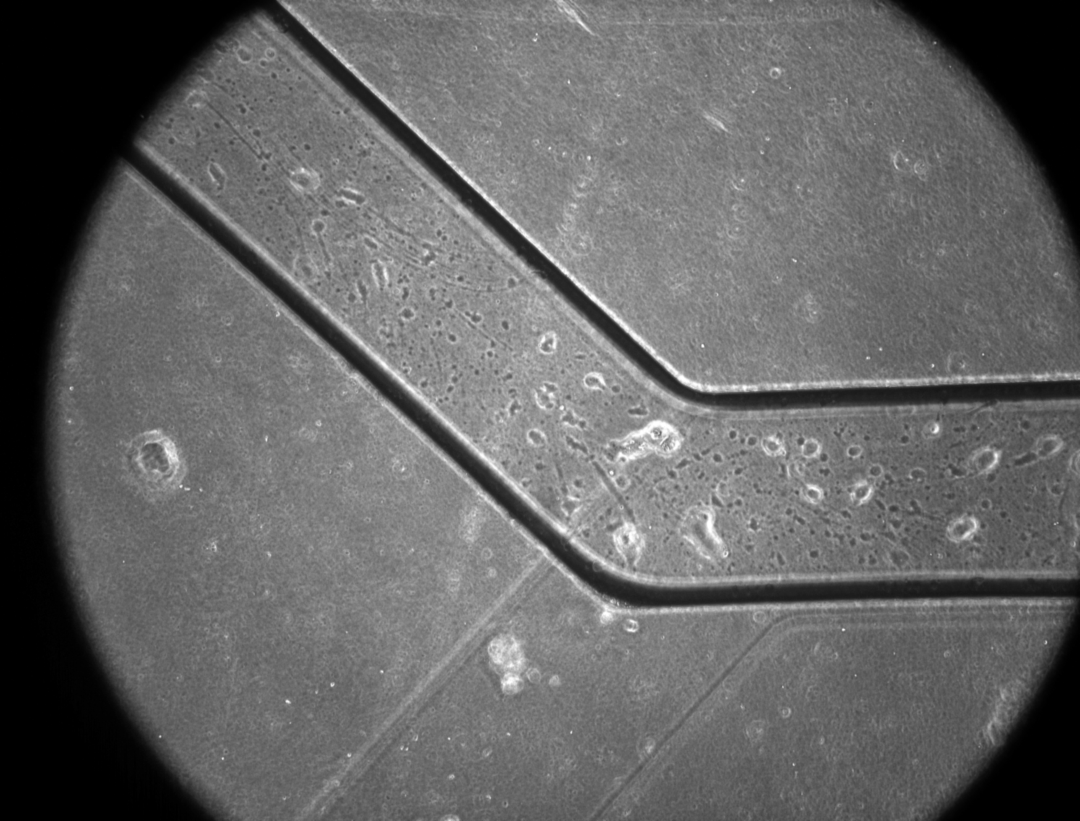
Liver-on-a-chip
Top layer
Cells
Human umbilical vein endothelial cells (HUVEC)
Media
EGM-2
Bottom layer
Cells
Hepatoma cells (Hepg2)
Media
DMEM with supplements

Slide 9
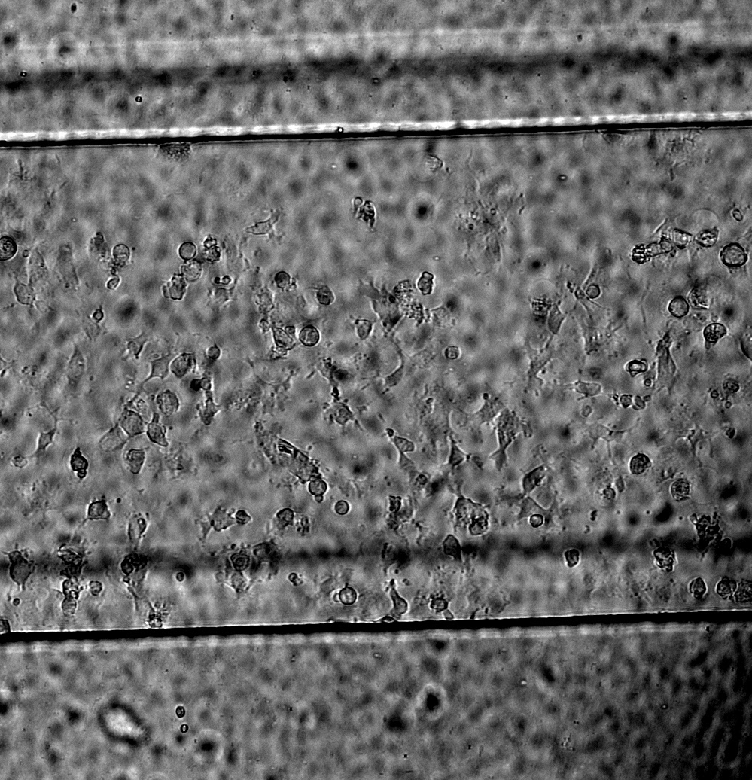
Placenta-on-a-chip
Top layer
Cells
Human umbilical vein endothelial cells (HUVEC)
Media
EGM-2
Bottom layer
Cells
Syncytiotrophoblast cells (BEWO)
Media
F-12k

Slide 10
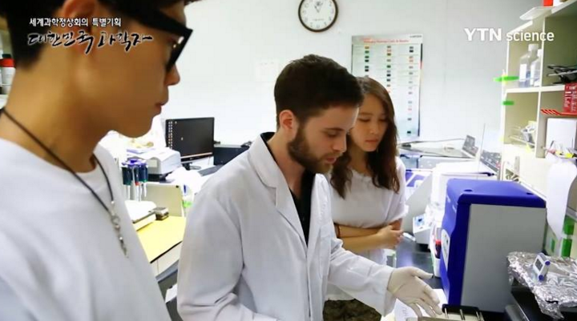
Future work
Future Work
100% animal free design
Focus: extracellular matrix and serum
Marker identification
E-cadherin
Viability tests in ethanol
Mapping non-ideal environments
TEER measurements

Slide 11
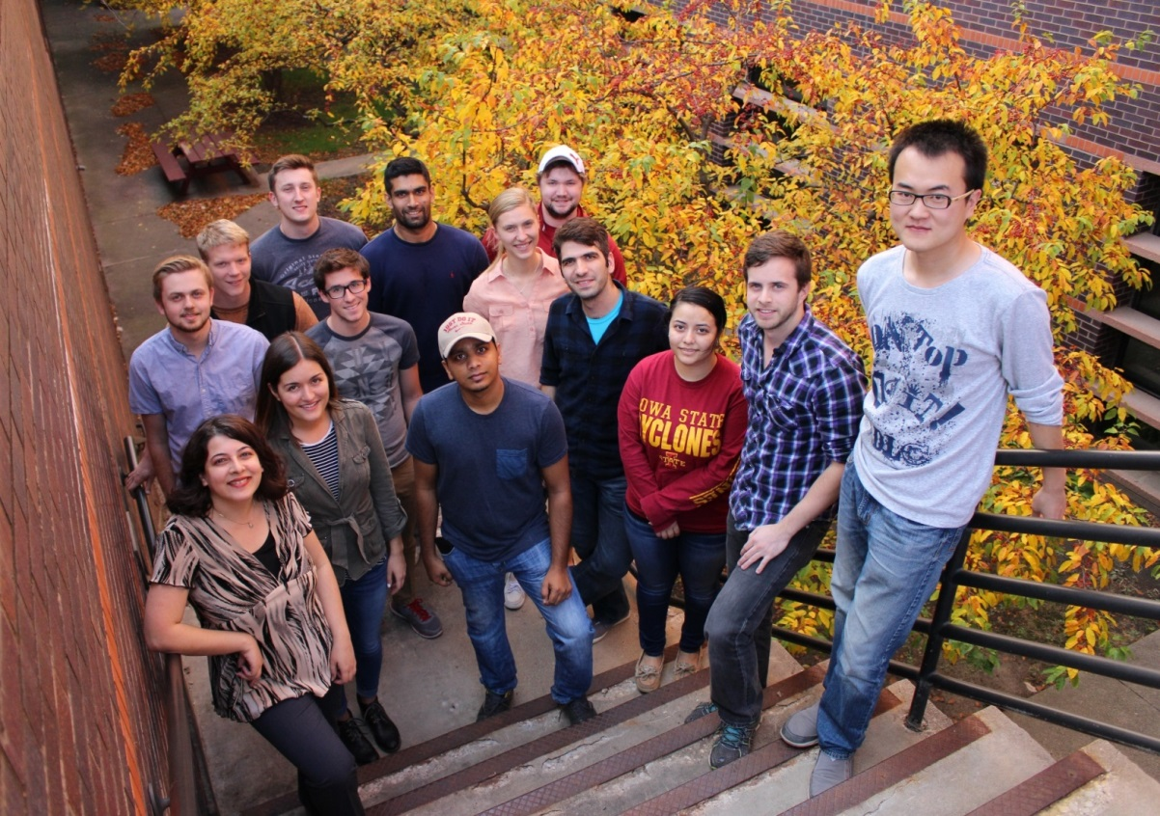
Thanks for listening!
FUNDING PROVIDED BY IOWA STATE UNIVERSITY, WITH ADDITIONAL FUDING PROVIDED BY THE NATIONAL SCIENCE FOUDATION AND PETA
I’d like to thank the lush foundation for this award, as well as recognize the efforts of Dr. Nastaran Hashemi and the hashemi lab at iowa state university, and Dr. Noo Li Jeon and the MBEL lab at seoul national university

