Slide 1
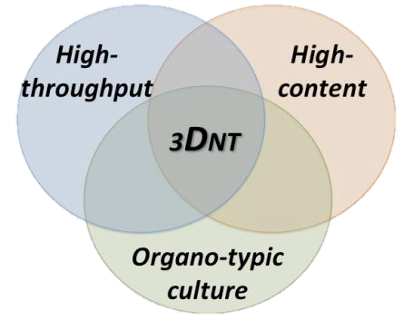
3D brain models and microRNA to study developmental neurotoxicity
Lena Smirnova
Center for Alternatives to Animal Testing
Johns Hopkins Bloomberg School of Public Health

Slide 2
CAAT’s research specific goals in DNT
DNT
~omics
PoT
3D human brain models
miRNomics
Notes:
Aim 1
To develop a 3D aggregating human neural cell culture models based on iPSC or LUHMES neuronal progenitors cell line.
Aim 2
To evaluate the effects of reference developmental neurotoxicants on the model using omics technics (gene expression incl. miRNA profiling and low molecular weight metabolites).
Aim 3
To integrate the data using bioinformatic tools to identify pathways of toxicity
Of course there many other pillars to support DNT (like functional assays, HCI)

Slide 3
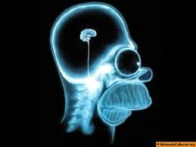
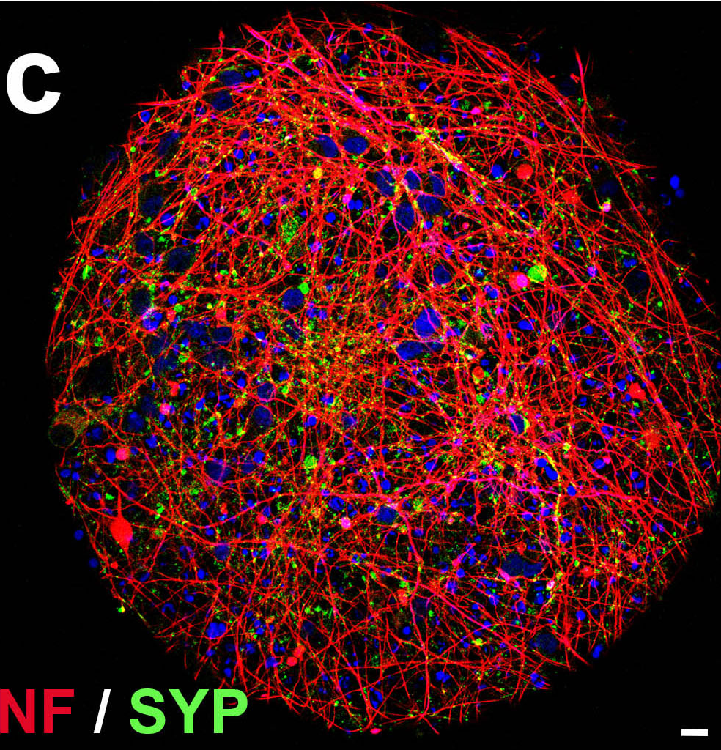
iPSC-derived mini-brains
All cell types but micro-glia
Reproducible
Electrophysiological active
From patient cells: gene/environment interactions
8 weeks until
mature !!!

Slide 4
A 3D model of human dopaminergic neurons: LUHMES-derived aggregates
Smirnova et al, Arch Tox, in press 2015
MAP2/NF200
d12
d21
d12
Syn/NF200
d12
d21
d12

Slide 5
3D LUHMES
Homogeneous
300 um diameter
Reproducible
Study long-term exposures, recovery and delayed response
Only one
cell type !!!
Glia support???
Smirnova et al, Arch Tox, in press 2015

Slide 6
CAAT’s research specific goals in DNT
DNT
~omics
PoT
3D human brain models
miRNomics
Notes:
Aim 1
To develop a 3D aggregating human neural cell culture models based on iPSC or LUHMES neuronal progenitors cell line.
Aim 2
To evaluate the effects of reference developmental neurotoxicants on the model using omics technics (gene expression incl. miRNA profiling and low molecular weight metabolites).
Aim 3
To integrate the data using bioinformatic tools to identify pathways of toxicity
Of course there many other pillars to support DNT (like functional assays, HCI)

Slide 7
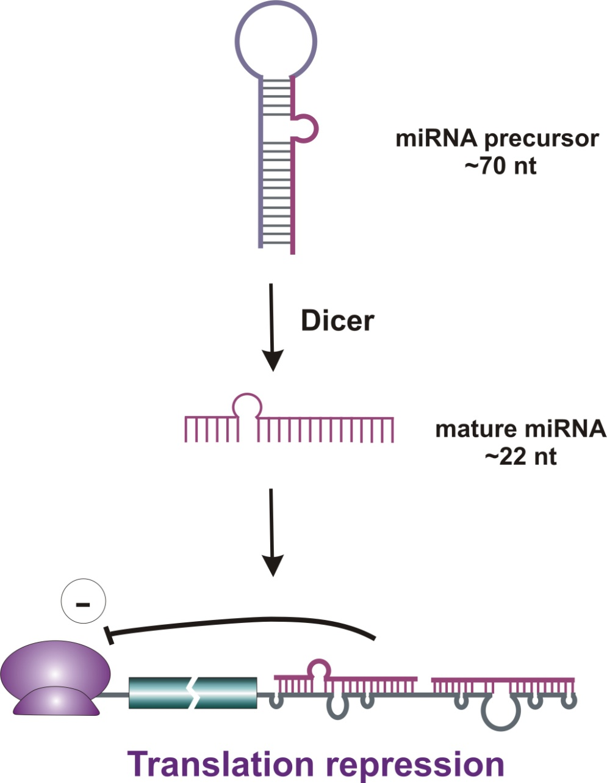
What are microRNAs?
Class of small non-coding RNA molecules. Phylogenetically conserved molecules
~22nt RNAs, produced from a ~70nt hairpin precursor
Bind to sites of imperfect complementarity in the 3‘UTR of mRNA target
Post-transcriptional repressors of target mRNA

Slide 8
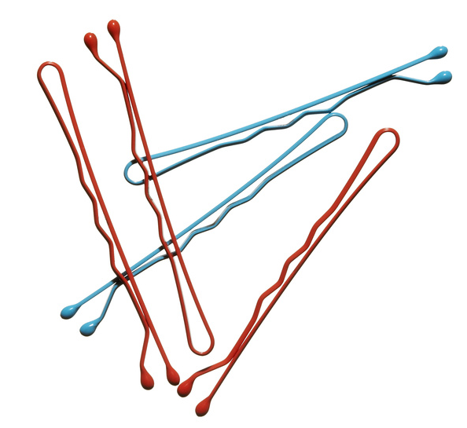
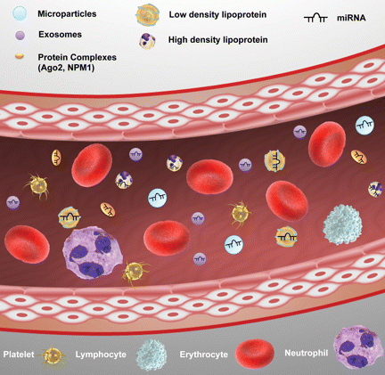
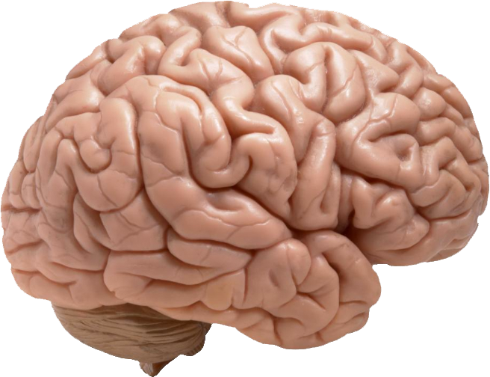
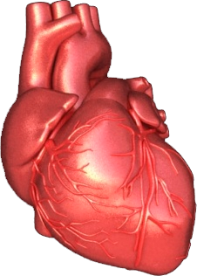
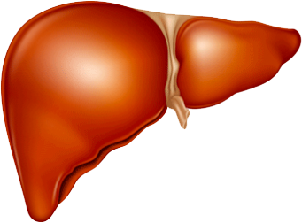
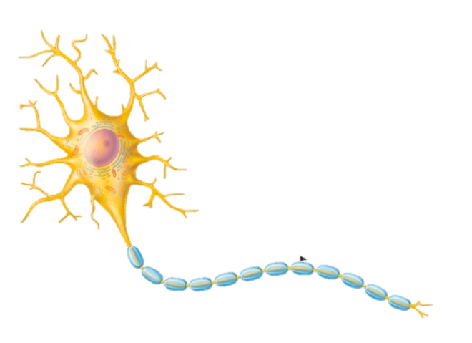
microRNA role in toxicology
Conserved through the Phyla
miRBase v. 20: mature miRNAs
Homo sapiens: 2578
Mus musculus: 1908
Rattus norvegicus: 728
C. elegans: 368
- 60% of mRNA are miRNA targets
- One miRNA may regulated 100 mRNAs
- miRNA targets are twice as likely to be affected by chemicals than not miRNA targets!
Circulating miRNAs:
Biomarkers for:
Cancer
Liver toxicity/injury
Heart injury
Nephrotoxicity
CNS diseases
Rapid response to toxicant treatment
Spatial specific expression:
mir-9
mir-124
mir-122
mir-1
Temporally specific expression:
Pluripotency
Differentiation
miRNAs are more stable than mRNAs:
FFPE
Biofluids
Archive samples
Degraded samples
ES-mirs
Lin-28
let-7
Notes:
The last part of my talk I would like to dedicate to the role of miRNA in toxicoloy This slide summarizes why we should use miRNA for toxicants screening.

Slide 9
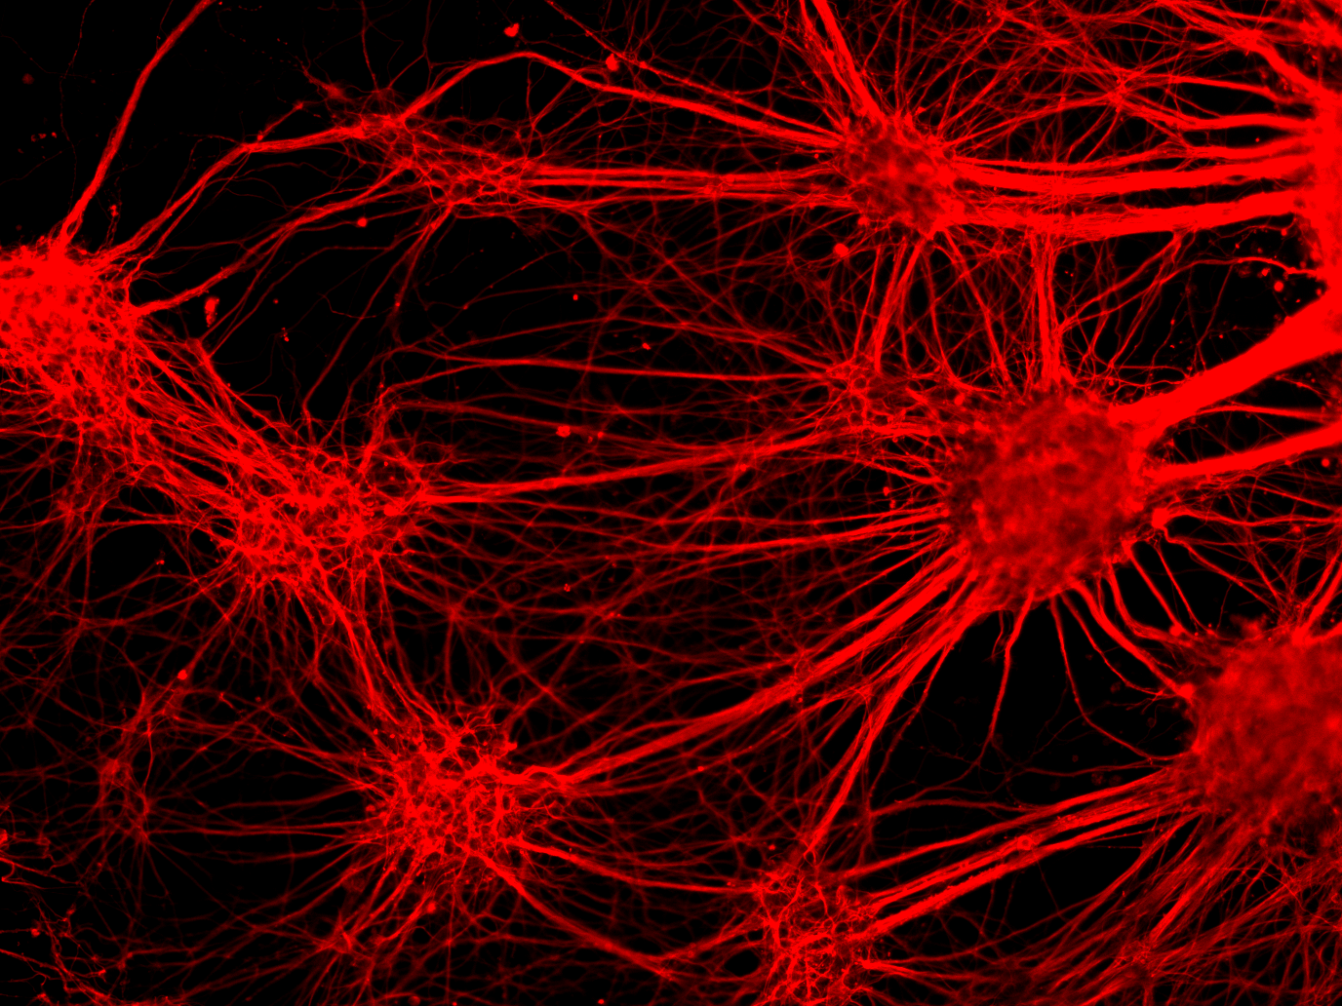
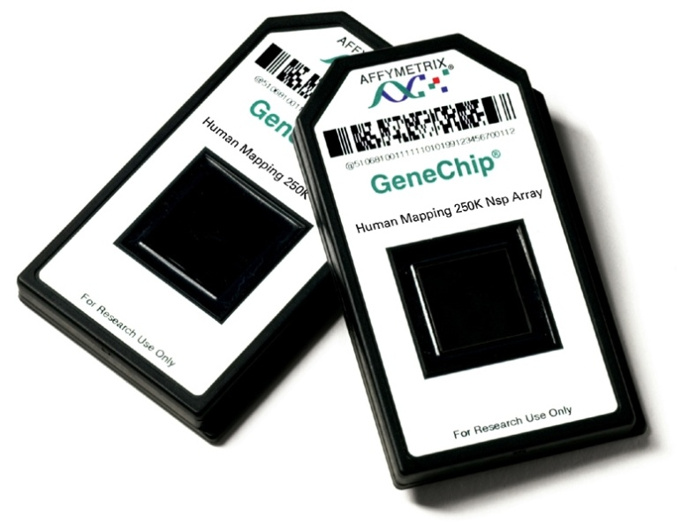
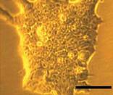
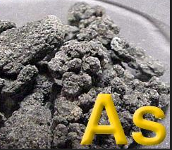
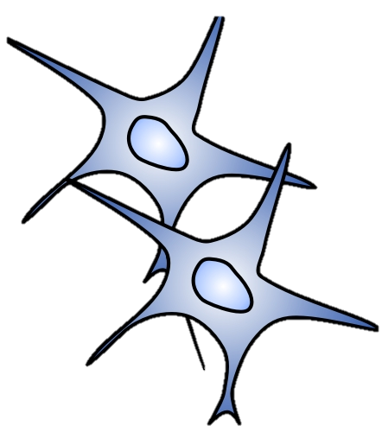
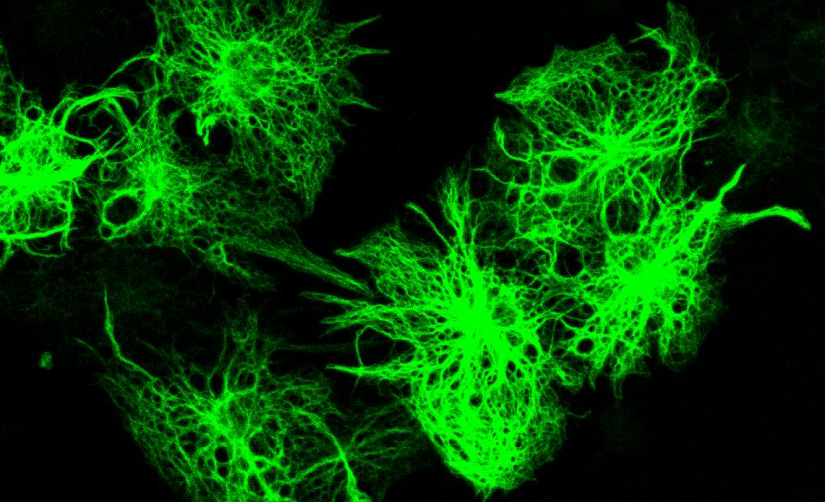
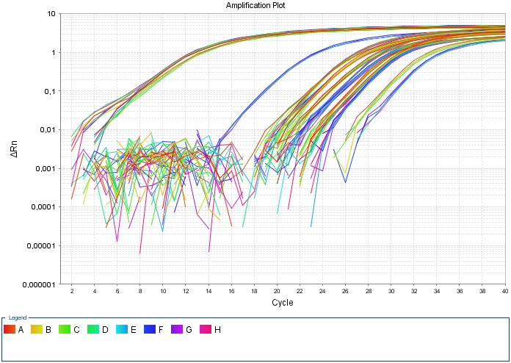
Neural differentiation of ES cells under exposure to developmental neurotoxicants
Quantification of miRNA expression
Neurons
miRNA microarray analysis
Embryonic stem cells
β-III-Tubulin
Astrocytes
miRNA qRT-PCR
GFAP
Notes:
uESC were neural differentiated under exposure to two well known developmental toxicants VPA/As from day 1 to day 16 of differentiation. VPA is an antiepiletic which is used for treatment of bipolar disorders, cancer, AS and migraine prophylaxis. This substance has teratogenic potency: it lead to the heart malformations and neural tube closure defects. VPA is a known HDAC inhibitor, but molecular mechanism of its teratogenicity is not well understood. Arsinic is a very toxic environmental polutant, is tumorigenic and ebmbryotoxic. Its toxic and tumorigenic activity could be mediated by epigenetic mechanisms (DNA-Hyper- and Hypomethylation, Inhibition of DNMT1/3, alteration of histone methylation)
On day 16 of differentiation the cytotoxicity of substances was analyzed by Celltiter Blue assay, in order to estimate IC10 for further gene expression analysis. Neural differentiation was quantified by Immunocytochemistry of flow cytometry with neuron-specific markers. miRNA expression as well as mRNA expression was analysed by microarray experiments. Microarray results were then verified with qRT-PCR.

Slide 10
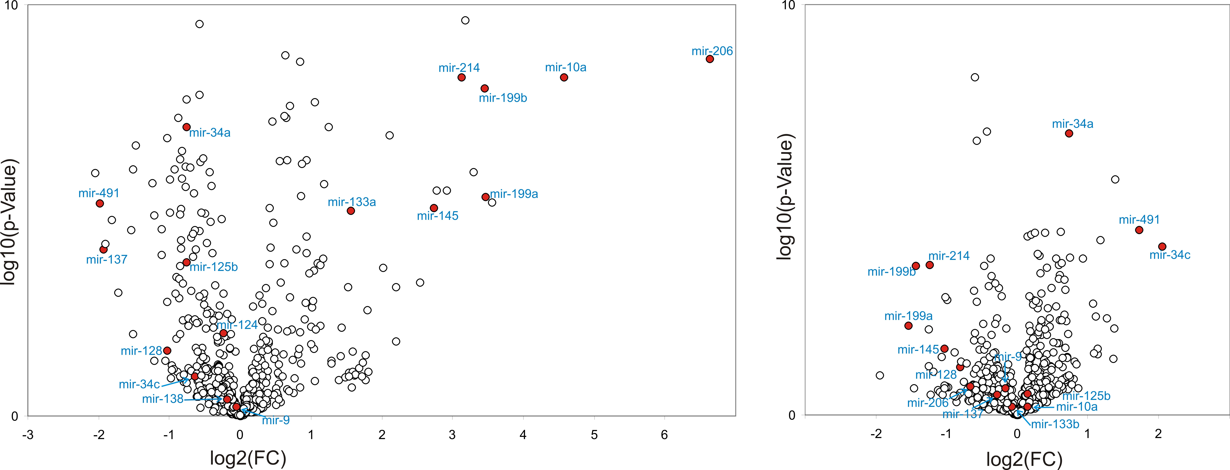
Substance-specific alterations of miRNA expression in neural differentiated ESC.
VPA induced myogenesis during neural differentiation
VPA
As
down
up
down
up
neurons
-log₁₀(p-value)
muscles
-log₁₀(p-value)
log₂(fold change)
log₂(fold change)
Smirnova et al, PLOS One 2014

Slide 11
VPA induced myogenesis during neural differentiation. Morphological confirmation
A
β–III-tubulin
α–actinin
merge
B
β–III-tubulin
α–actinin
merge
Smirnova et al, PLOS One 2014

Slide 12
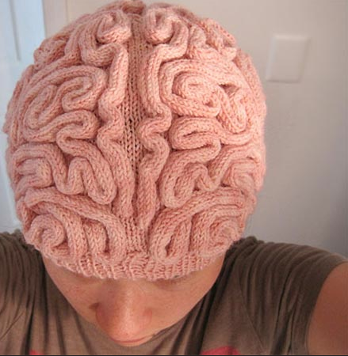
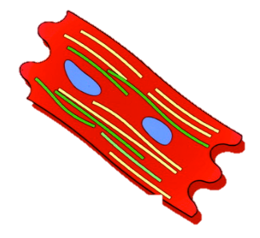
Summary
Embryonic stem cells
Neurons
neural miRNAs
myoMiRs
Myocytes
Notes:
The main road we were studying was neural differentiation of ES cells, where We and others have shown significant contribution of neural miRNA in the regulation and fine-tuning of this process. But when we exposed the cells to HDACi – VPA, we observed that ES cells take a detour in neurodifferentiation and are induced to be differentiated to myocytes. Most probably mir-10a or other myoMiRs can be involved in this process.

Slide 13
Acknowledgment
CAAT team
Thomas Hartung
Helena Hogberg
David Pamies
Georgina Harris
ZEBET team
Andreas Luch
Andrea Seiler
Manfred Liebsch
Charité team
Gregory Wulczyn
Robert Nitsch
Heiko Fuchs
Agnieszka Rybak
LUSH Prize Award 2015

