Slide 1
The Adverse Outcome Pathway (AOP) for Skin Sensitisation (SS): How We Got Here and Where We are Going
T. W. Schultz
Professor Emeritus
The University of Tennessee, College of Veterinary Medicine, Knoxville, TN USA

Slide 2
Topics
The AOP concept
History of the AOPs and development of the AOP for SS
AOP functionalities in the Toolbox
Future activities

Slide 3
Adverse Outcome Pathways
AOPs depict existing knowledge which links two anchor points, the Molecular Initiating Event (MIE), and an Adverse Outcome (AO).
They link these anchor points by a series of Key Events (KE) and the relationships between them (KER).
The KEs are a limited number of measurable and toxicologically-relevant actions which are essential for the development to the AO.

Slide 4
AOP Concept
AOPs are typically represented sequentially by moving from one KE to another, as compensatory mechanisms and feedback loops are overcome.
An AOP is not required to provide a comprehensive molecular description of all aspect of the chemistry and biology, rather it focuses on “critical steps” in the progression of events.

Slide 5
AOP Concept
The AOP concept provides a means of documenting transparent mechanistic justification and weight-of-evidence which increase chemical similarities and reduce uncertainties in the predictions for complex toxicological endpoints.
It is generally considered to be a focal point of future development of the QSAR Toolbox.

Slide 6
Molecular Initiating Event
Macro
-Molecular Interactions
Toxicant
Chemical Profiles
Receptor, DNA,
Protein
Interactions
Biological Responses
Apical Outcome
Mechanistic Profiling
The OECD QSAR Toolbox as of 2010

Slide 7
Molecular Initiating Event
Macro
-Molecular Interactions
Toxicant
Cellular
Organ
Organism
Population
Gene Activation
Protein Production
Signal Alteration
Lethality
Sensitization
Birth Defect
Reproductive Impairment
Cancer
Chemical Profiles
Receptor, DNA,
Protein
Interactions
Altered
Function
Altered Development
Structure
Extinction
Mechanistic Profiling
Cellular & In Vitro Sub-Profiling
In Vivo
Sub-Profiling
The Future OECD QSAR Toolbox as envisioned in 2010

Slide 8
History of the AOP
McKim Conference on Predictive Toxicology
“Using Toxicity Pathway Models in Predictive Toxicology”
Duluth, Minnesota
September 16-18, 2008
“Toxicity Pathways as an Organizing Concept”
Gilman Veith
“Applying Adverse Outcome Pathway Concepts to
ER-mediated Effects”
Pat Schmieder

Slide 9
History of AOP at OECD
OECD 2011a. Report of the Workshop on Using Mechanistic Information in Forming Chemical Categories. OECD Environment, Health and Safety Publications Series on Testing and Assessment No. 138. ENV/JM/MONO(2011)8.
It is recommended that over the next two years (i.e., the near term) a number of tasked be undertaken including:
Develop AOPs for well-established effects (e.g., skin sensitisation).
Establish the work flow for using AOPs in categorisation and read-across (i.e., integrating AOPs in the QSAR Toolbox).

Slide 10
History of AOP at OECD
OECD 2011b. Report of the Expert Consultation on Scientific and Regulatory Evaluation of Organic Chemistry-based Structural Alerts for the Identification of Protein-binding Chemicals. OECD Environment, Health and Safety Publications Series on Testing and Assessment No. 139. ENV/JM/MONO(2011)9.
OECD 2012a. The Adverse Outcome Pathway for Skin Sensitisation Initiated by Covalent Binding to Proteins Part 1: Scientific Evidence. OECD Environment, Health and Safety Publications Series on Testing and Assessment No. 168, Part 1. ENV/JM/MONO(2012)10/PART1.
OECD 2012b. The Adverse Outcome Pathway for Skin Sensitisation Initiated by Covalent Binding to Proteins. Part 2: Use of the AOP to Develop Chemical Categories and Integrated Assessment and Testing Approaches. OECD Environment, Health and Safety Publications Series on Testing and Assessment No. 168, Part 2. ENV/JM/MONO(2012)10/PART2.

Slide 11
AOP for SS
Chemical
Structure &
Properties
Molecular
Initiating Event
Cellular Response
Organ Response
Organism Response
Dendritic cells (DCs)
Lymph node
In chemico /in sliico reactivity
Induction of inflammatory cytokines and surface molecules
Mobilization of DCs
Skin (epidermis)
AbsorptionMetabolism
Histocompatibility complexes presentation by DCs
Activation of T cells
Proliferation of activated T-cells
Inflammation upon challenge with allergen
Covalent interaction with proteins
Keratinocytes
Electrophilic substance
Activation of
inflammatory cytokines
Induction cyto-protective gene pathways
l
Adapted from The Adverse Outcome Pathway for Skin Sensitisation Initiated by Covalent Binding to Proteins. Part 1: Scientific Evidence OECD ENV/JM/MONO(2012) 10 PART 1

Slide 12
Why was the SS AOP so successful?
Many things came together at the right time:
Firstly, more than 2 decades of work by industry and academia had provided the nodes and key events.
Secondly,
“Toxicity for the 21st Century” was looking of an application.
The Toolbox had grown in acceptance and was looking to expand.
Regulators were looking for ways of integrating alternative data.

Slide 13
What are some of the outcomes of the SS AOP?
The AOP concept has become scientifically accepted.
Several different Integrated Assessment and Testing Approached based on AOPs have been proposed. All of which clearly lead to the reduction or elimination of the use of animals in hazard and risk assessment.
Non-in vivo and “New Methods” assays and data are being developed and looked at with regards to their relevance to AOPs.
The OECD has established an AOP program.

Slide 14
Implemented in Toolbox As:
An in silico scheme is associated with specific databases and profilers (KEY NODES) within the Toolbox.
A workflow associated with filtered Toolbox functionalities (KEY EVENTS)
A proof-of-concept in Version 3.0

Slide 15
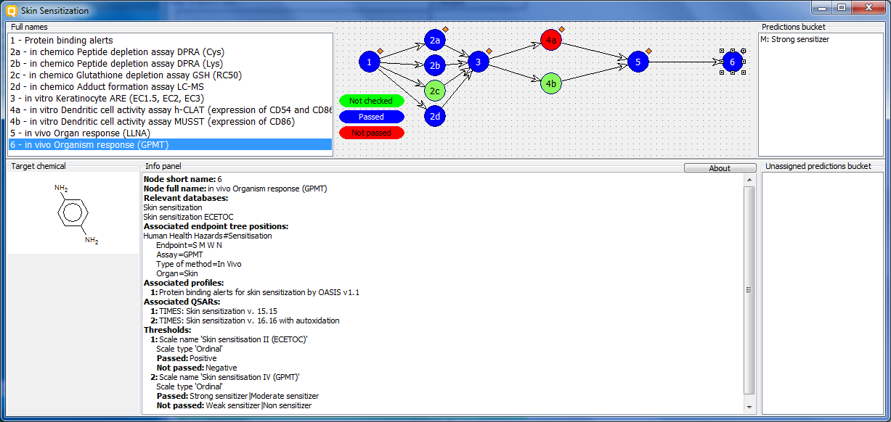
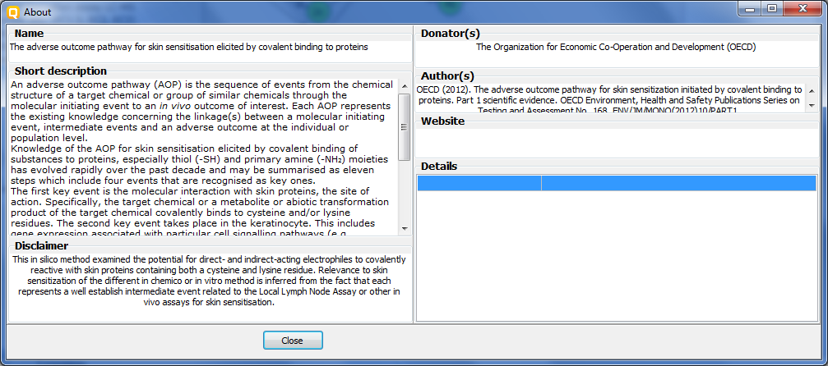
AOP Windows in the Toolbox
Panel with predictions/measured data assigned to the selected node
Panel with full names of nodes
AOP tree scheme
Indication for assigned prediction
Selected node
Color legend
Panel with information for selected node
Panel with unassigned predictions
Target chemical
Short description

Slide 16
Key Nodes and Key Events
Key Nodes
Key Events
1
Protein binding alerts
1) Protein binding – in silico/theoretical
2a
in chemico Peptide depletion assay DPRA (Cys)
2b
in chemico Peptide depletion assay DPRA (Lys)
2) Protein binding potency in chemico
2c
in chemico Glutathione depletion assay GSH (RC50)
2d
in chemico Adduct formation assay LC-MS
3
in vitro Keratinocyte ARE (EC1.5, EC2, EC3)
4a
in vitro Dendritic cell activity assay h-CLAT (expression of CD54 and CD86)
3 & 4)Cellular response
4b
in vitro Dendritic cell activity assay MUSST (expression of CD86)
5
in vivo Organ response (LLNA)
5) Organ response
6
in vivo Organism response (GPMT)
6) Organism response

Slide 17
Workflow Along Nodes and Key Events
MIE: protein binding
In vitro: gene expression assay
In vivo: Organ response (LLNA)
In vivo: Organism response (GPMT)
In vitro: cytokine profiles in dendritic cells
In chemico: protein binding potency assays

Slide 18
Thresholds of the AOP Nodes
Node name | Data/profiling result thresholds | Node status: Pass | Node status: Not pass
1- Protein binding alerts |  | presence of alert | absence of alert
2a and 2b in chemico DPRA Cys and Lys | Peptide depletion, PD (%) > 80 - High 40%≥ PD ≤80% – Moderate 80%≥ PD ≤40% – Low 5%< PD – Not reactive | High |Moderate | Low | Not Reactive
2c - in chemico Glutathione depletion assay GSH (RC50) | RC50 (mmol/L) ≤ 0.099 – Extremely reactive 0.1 ≥ RC50 ≤ 0.99 – Highly reactive 1 ≥ RC50 ≤ 15 – Moderately reactive 16 ≥ RC50 ≤ 70 – Slightly reactive 70.1 ≥ RC50 ≤ 135 – Suspect RC50 > 135 – Not reactive | Extremely Reactive| Highly Reactive | Moderately Reactive | Slightly Reactive | Suspect |Not Reactive | Not reactive at saturation
2d - in chemico Adduct formation assay LC-MS | Adduct formation (%) ≥ 30% - Positive Adduct formation (%) < 30% - Negative | Positive | Negative
3 - in vitro Keratinocyte ARE (EC1.5, EC2, EC3) | EC3 (%) ≤ 20 – Very high 20 > EC3 ≤ 50 – High 50 > EC3 ≤ 100 – Moderate 100 > EC3 ≤ 2000 – Low EC3 > 2000 - Negative | Very High |High| Moderate | Low | Negative
4a and 4b in vitro Dendritic cell activity assay h-CLAT and MUSST (expression of CD54 and CD86) | expression of CD54 and CD86 Positive Negative | Positive | Negative
5 - in vivo Organ response (LLNA) | 0 ≥ EC3 (%) <50 – Positive EC3 > 50 - Negative | Positive | Negative
6 - in vivo Organism response (GPMT) | Data provided: Strong sensitizer; Moderate sensitizer; Weak sensitizer; Non sensitizer | Strong sensitizer |Moderate sensitizer | Weak sensitizer |Non sensitizer

Slide 19
As A Proof-of-Concept
Data for most key nodes limited to about 70 compounds.
Profilers were incomplete.
Cut off value for potency classes were simple estimates.
The assessment was limited to sensitiser or non-sensitiser.
The work flow was not streamlined.

Slide 20
Future Activities
Data sets for most key nodes will be expanded to more that 200 discrete compounds.
Current profilers will be revised.
Potency classes will be refined and assessments of sensitisation be made more quantitative.
New nodes (e.g., LuSens, SENS-IS, GARD, human in vivo) may be added.
The work flow will be streamlined.

Slide 21
In Closing
The development of the SS-AOP would not have been possible without the work of many people. I am honored to represent them here.
For SS, the AOP has brought the promise of the third R (replacement) to a near-term reality.
Thank you for your attention!

