Slide 1
Lush Prize 2015
“Body-on-a-Chip; In vitro Human Models for Drug and Chemical Testing”

Slide 2
The Team
Michael L. Shuler – Cornell University
mls50@cornell.edu
James Hickman – University of Central Florida
jhickman@ucf.edu
Mandy B. Esch - Cornell University, Syracuse University
mbesch@syr.edu
Tracy Stokol – Cornell University
ts23@cornell.edu
Gretchen Mahler – Cornell University, State University New York at Binghamton
gmahler@binghamton.edu
Hickman & Shuler have started Hesperos, Inc.

Slide 5
Basic Concepts
Animal models are not very effective in drug development
  Ethical, cost, time issues.
  Poor predictors of human response: 11% of drugs entering clinical trials came out as approved products.
      For every 50 drugs found safe for animals only 1 proves safe in humans (2%); one drug company finds 6% of animal trials predict human response
  In vitro models using human cells/tissues provide potential models with improved accuracy.

Slide 6
Search for Replacements
Both regulatory agencies, pharmaceutical and chemical companies recognize problems with animal studies
The current drug development process is too costly; both regulators and companies open to new technologies that are more accurate and cost-effective
Increased success in clinical trials from 11% to 33% would have big economic impact; replacements need not be perfect, only better than animals

Slide 7
Developing a Human Surrogate
“Human-on-a-Chip”
Goal: Integration of organs-on-a-chip to form a “body-on-a-chip”
Why: Predict in pre-clinical studies how humans will respond to drugs or chemicals
How: Experimental device guided by Physiologically Based Pharmacokinetic (PBPK) model; more than a simple multi-organ system: it attempts to maintain physiological relationships among organs and add biological function beyond metabolism
When: Conceived Spring 1989 (US Pat. 5,612,188); microfabricated systems in 1998 (US Pat. 7,228,045)

Slide 8
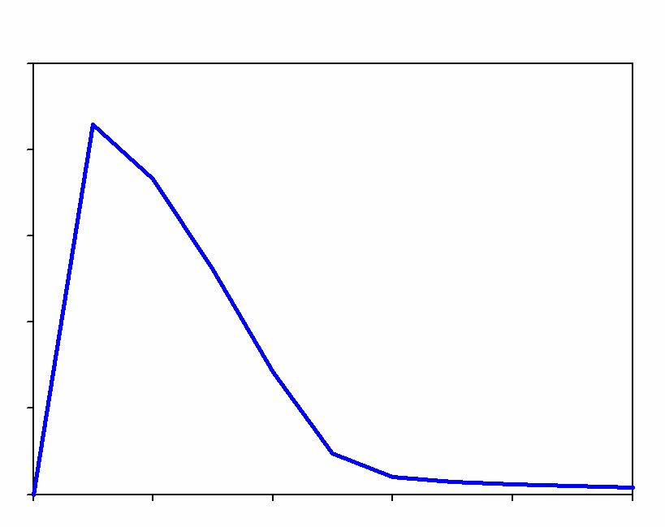
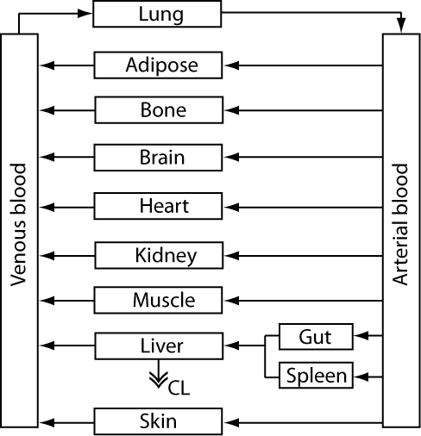
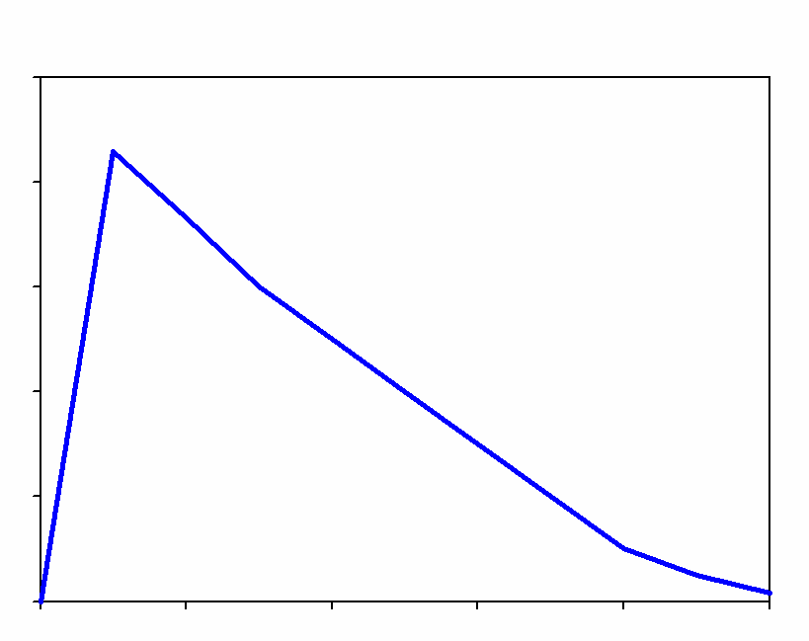
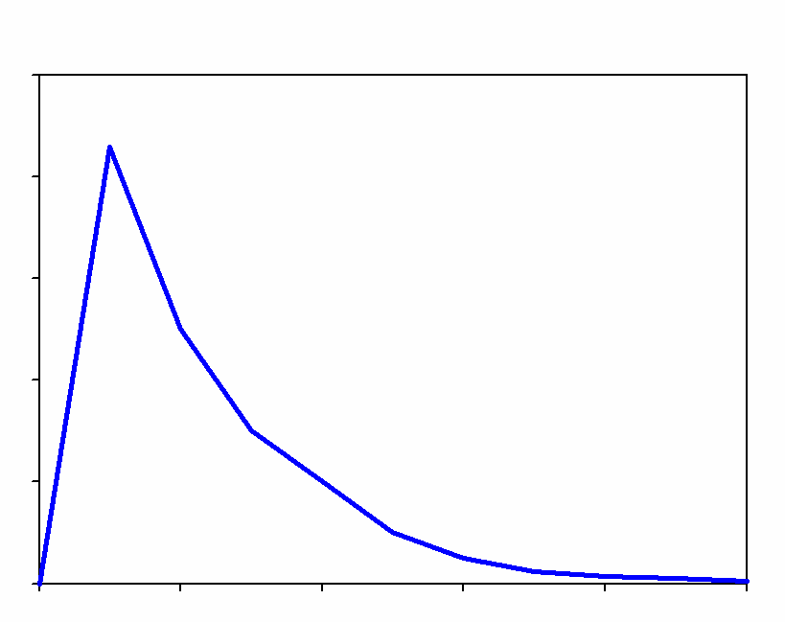
Mathematical Models Can Predict Drug Distribution
Lung
Liver
Blood
PBPK model
PBPK (Physiologically-Based Pharmacokinetic) computer models treats human body as a series of interconnected compartments
Compartments are reactors, absorbers, or holding tanks
PD (Pharmacodynamic model) predicts pharmacological effect

Slide 9
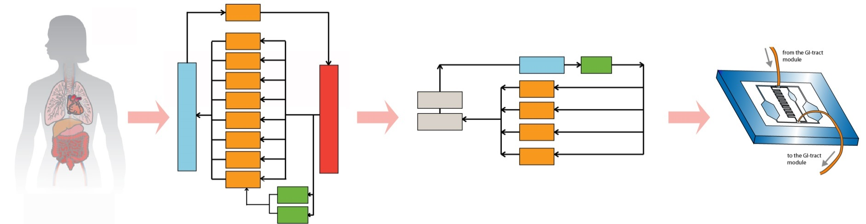
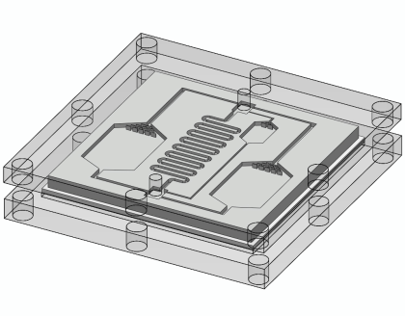
Physiologically Designed Systems
Human body
PBPK
Chip PBPK
Body-on-a-Chip
Lung
Brain
Adip.
Plasma
Gut
Bone
Bone
Venous Blood
Heart
well perfused
Adip.
Kidney
Arterial Blood
poorly perfused
Muscle
Kidney
Skin
Liver
Liver
Spleen
Gut
Organ volume ratios translate into ratios of microfluidic chamber volumes.
Fluid residence time per organ translates into fluid residence time per organ chamber.
A passive fluid flow split achieves the required fluid flow rates.
The chip is operated with a common medium in which all tissues will grow.

Slide 10
Design Criteria to Emulate PBPK
Realistic ratio of cell mass in one organ to another
Mimic flow split of blood during recirculation
Residence time in “organ/tissue” compartment is realistic
Physiological shear rates
Where possible ratio of liquid to cells in a compartment is physiologic
Biological response of cells in compartment is authentic: tissue engineered constructs may be ideal

Slide 11
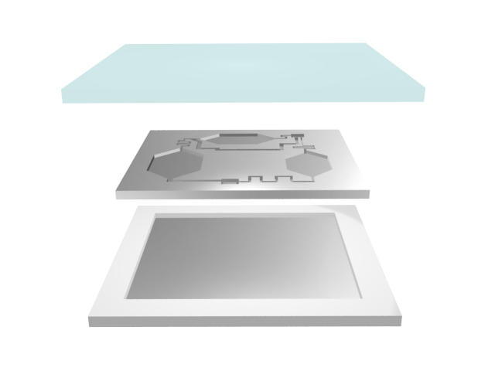
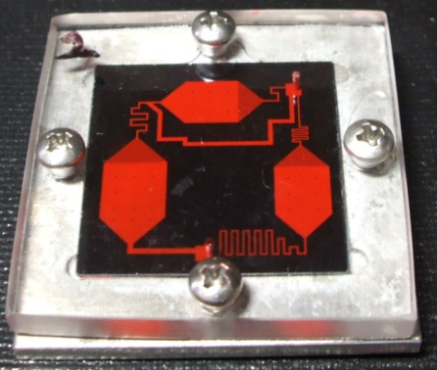
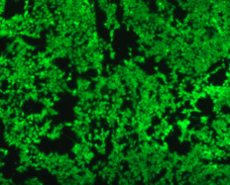
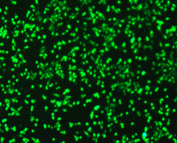
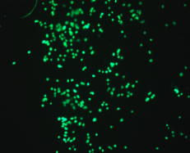
Design and Assembly: Passive Flow Control
Polycarbonate
Tumor (HCT-116)
Silicon
Liver(HepG2/C3A)
Aluminum
 | Tumor | Liver | Marrow
Calculation
Residence time (s) | 70 | 52 | 128
Velocity (um/s) | 71.5 | 160.7 | 53.6
Measurement
Residence time (s) | 69.7±3.8 | 49.7±3.5 | 136.5±2.9
Velocity (um/s) | 68.9±1.6 | 167.9±6 | 58.6±0.5
Marrow (Kasumi-1)
Fabricated from silicon
Based on previous μCCA
Designed to test drugs for colon cancer
Liver/tumor/marrow
Flow residence times are matched to physiological values
No Valves Required!

Slide 12
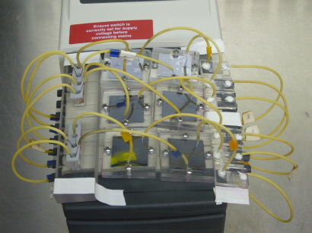
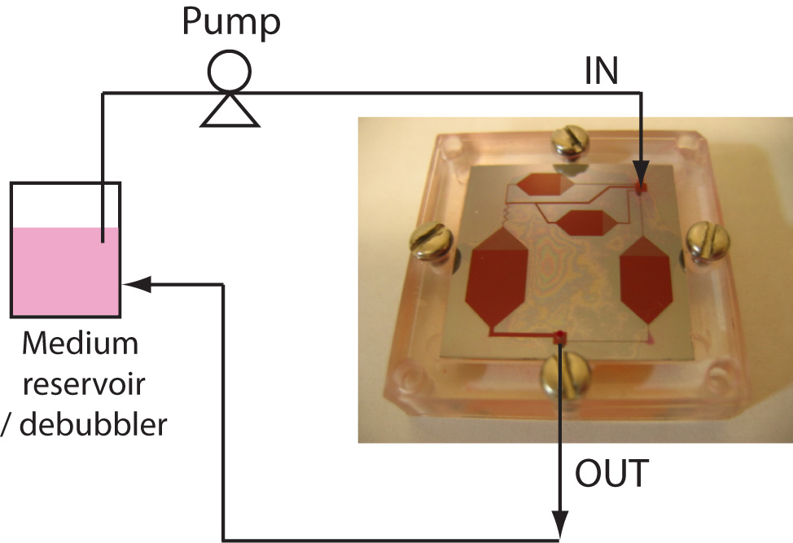
System Operation
Medium reservoir
Bubble trap
μCCA
Medium is recirculated (200μL) to mimic the body’s recirculation 6~8 chips, operating time: 3 days without medium exchange

Slide 13
Example: Naphthalene
Naphthalene (3 organ chambers)
  Demonstrate capability to define or confirm mechanism of action and explain why mice and rats differ in terms of toxicological response
  Demonstrate that naphthalene toxicity is due to formation of naphthoquinone in the liver and circulation to the lung
Toxicology In Vitro 9:307 (1995); Biotechnol Prog. 16:33, 471 (2000); Biotechnol. Prog. 20:316, 338, 590 (2004)

Slide 14
Example: Multidrug Resistant Cancer
MDR (4 organ chambers- liver, bone marrow, uterus(both MDR & sensitive), other tissues)
  Test combination treatment
  (Doxorubicin, cyclosporine & nicardipine)
  Found that MDR suppressors have synergistic interaction
  Can use device and PBPK to estimate appropriate drug doses for in vivo trials
Tatosian, DA and ML Shuler. 2009. Biotechnol. Bioeng. 103: 187.

Slide 15
Example: Colon Cancer with Prodrug
Treatment with Tegafur (prodrug for 5 Fluorouracil) and Uracil (inhibits degradation of 5FU) for colon cancer
Liver (metabolism) – colon (target) – marrow (Kasumi-1) all entrapped in hydrogels/3D culture
Response consistent with clinical observations:
  Liver cells required for toxicity to colon cancer
  Uracil enhances toxicity
  Semi-quantitative
Sung, JH and ML Shuler. 2009. Lab on a Chip 9” 1385.

Slide 16
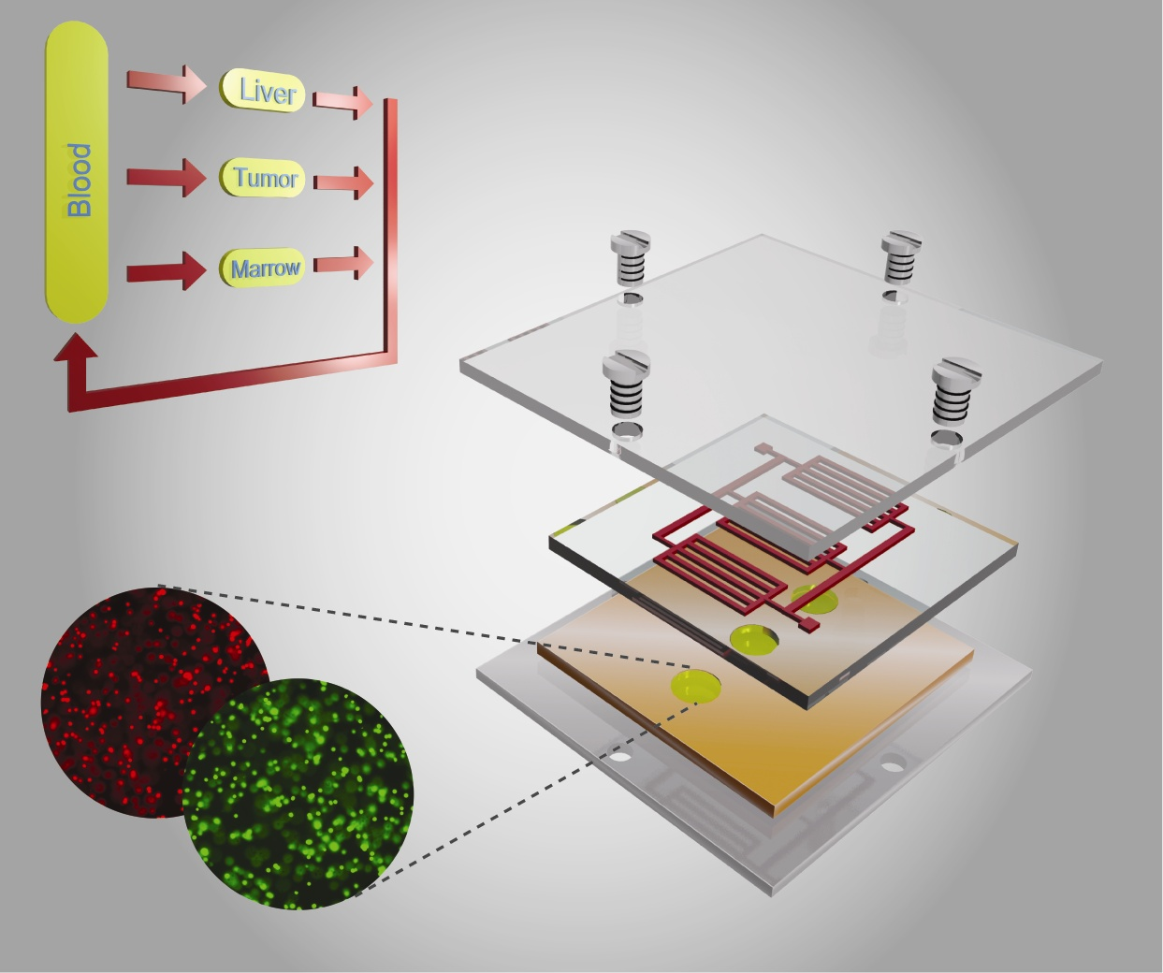
Design to Simplify Operation
Jong Hwan Sung, Carrie Kam, Michael L. Shuler, A microfluidic device for a pharmacokinetic-pharmacodynamic (PK-PD) model on a chip Lab on a chip, 2010, (10: 446, 2010)

Slide 17
Multichamber device on rocker platform made from silicon sheets and polycarbonate frame; low cost; easy to modify
Easy to implement (rapid set-up and minimal operator training)
Low cost format (no pump, multiple units on a rocker platform, optical and electrical access)
Robust operation (no gas bubbles, removes tubing that causes dead volumes and unphysiologic absorption, no moving parts to fail)
Cornell “Pumpless” System
Easy set up, low cost, robust

Slide 18
Can Barrier Models be Incorporated into Body-on-a-Chip Systems?
Examples of important barrier tissues:
  Gastrointestinal (GI) Track
  Lung Epithelium
  Skin
  Blood Brain Barrier
Barriers control entry of drugs into systemic circulation or into specific tissues (e.g. brain)
To mimic oral uptake, inhalation, or adsorption, need barrier/systemic circulation model

Slide 19
Building Models of Each “Organ” Compartment Using Human Primary on iPS Cells
GI tract
Skin (with Christiano/Columbia)
Vasculature
Liver (with Applegate/RegeneMed)
Blood brain barrier (from Shusta/U,WI)
Cardiac (Hickman at UCF)
Neuromuscular junctions (Hickman at UCF)
Other tissues still based on cell lines but will be replaced with human primary or stem cells as project develops

Slide 20
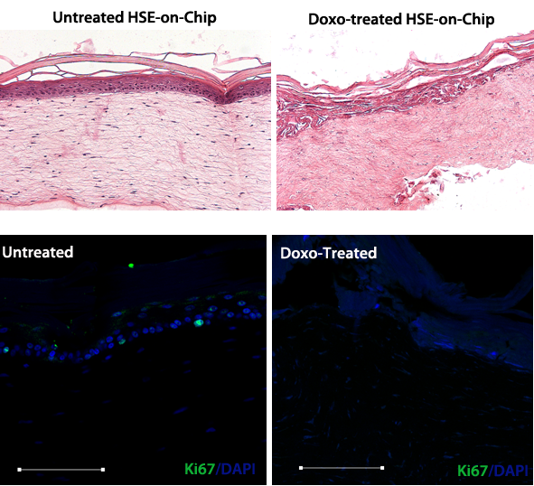
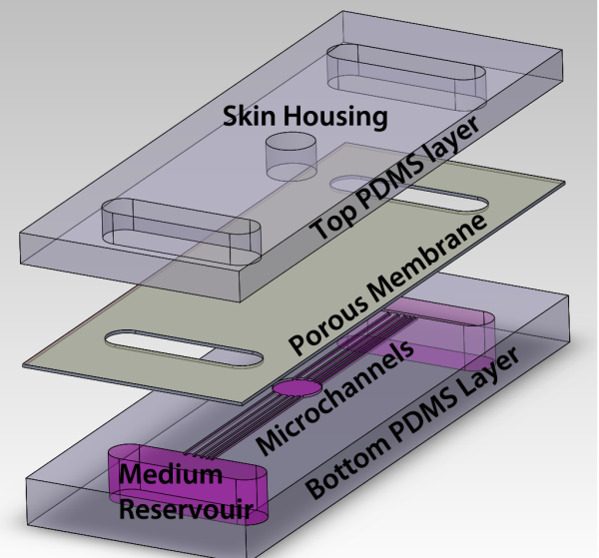
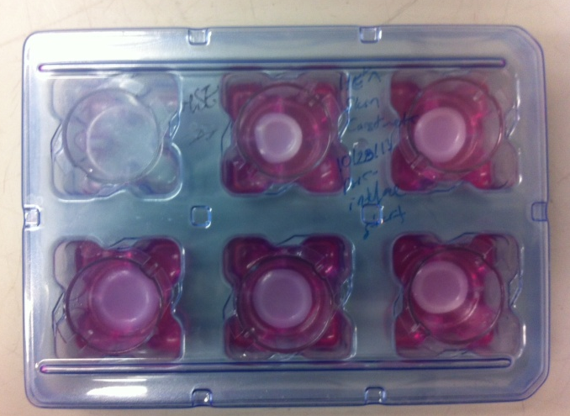
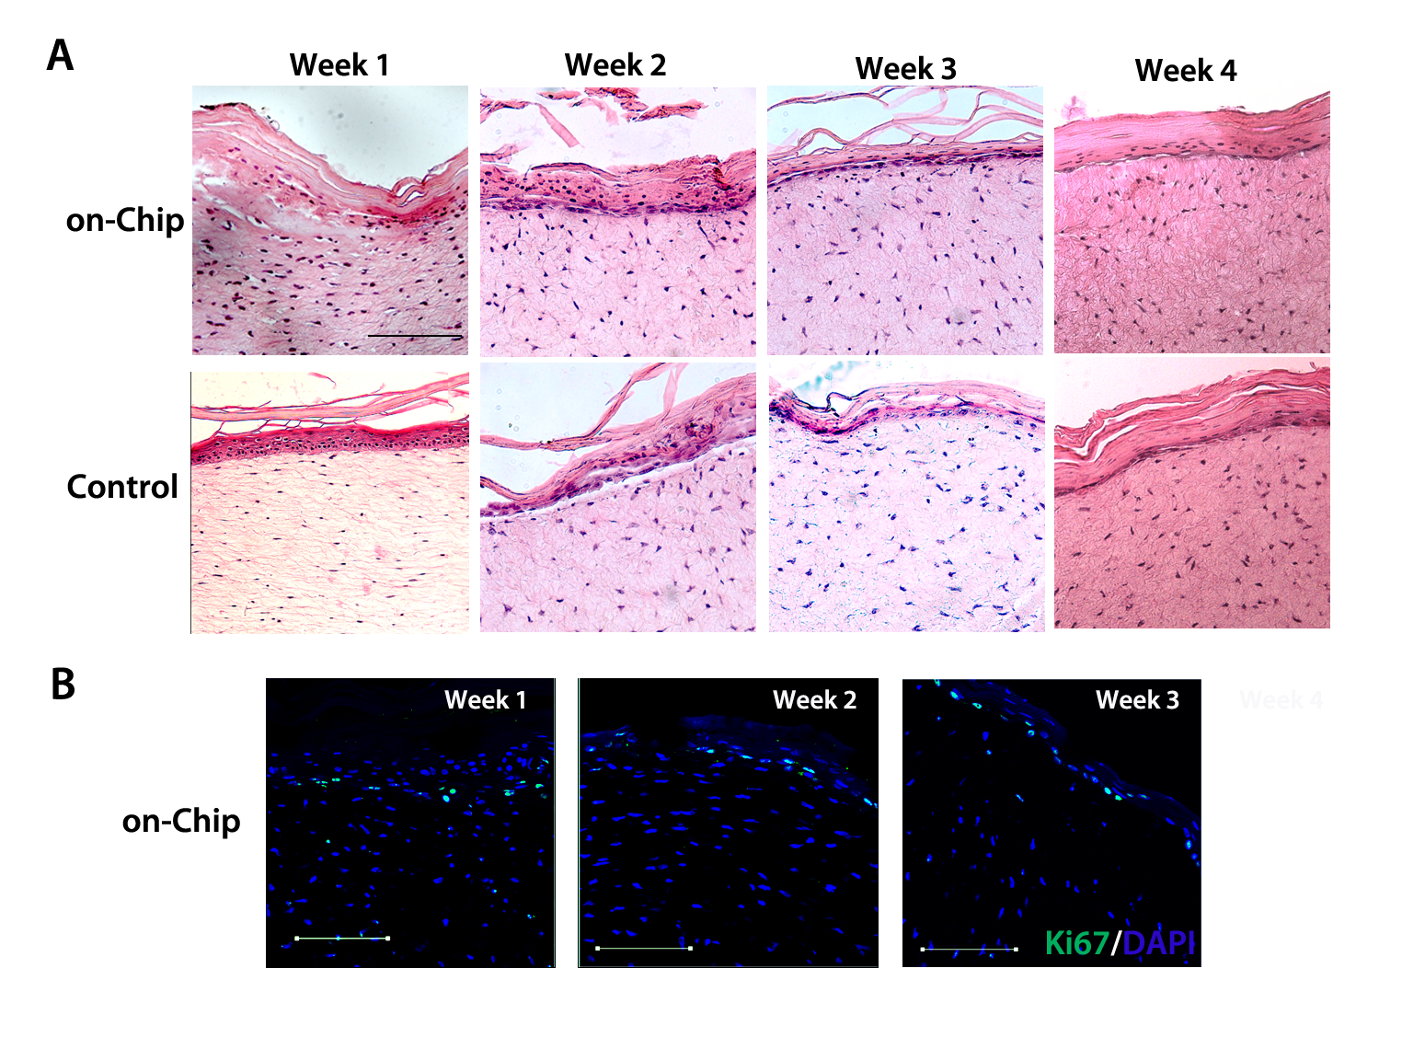
Human skin equivalents (HSE)-on-a-Chip
Long-term maintenance of HSE-on-chip
Lab Chip (15):882-888 (2015)
The HSEs were prepared and successfully transported from Columbia to Cornell University in transwell plates
HSEs were punched out in 3 mm circles and transferred into HSE-on-chip platform
Drug testing using HSE-on-chip
Skin constructs were maintained for 3 weeks on-chip
All epidermal layers formed
Skin barrier function maintained
Basal keratinocytes remained proliferative
Doxorubucin treatment causes a spatial detachment of the basal layer along the epidermis-dermis interface
One week of doxorubucin treatment inhibited keratinocyte proliferation
Jointly with Christiano Lab, Columbia

Slide 21
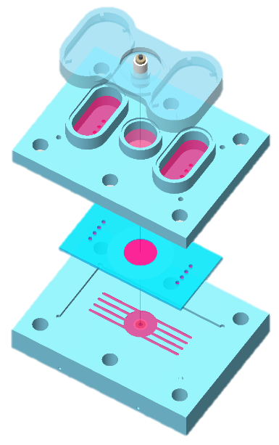

Human Blood Brain Barrier-on-a-Chip (BBBoC)
In vitro BBB model from human iPS cells (from E. Shusta & S. Palecek)
Tight Junctions formed
The BBB constructs were prepared from iPSC derived brain microvascular endothelial cells (BMEC) co-cultured with astrocytes on a porous membrane;
BBB construct barrier functions sustained on chip
R
Top electrodes
Trans-Endothelial Electrical Resistance (TEER) sustained at high levels
Astrocytes
Reservoirs
BMEC
BBB construct
microchannels
Bottom electrodes
Rocker platform
Human Blood Brain Barrier-on-a-Chip (BBBoC)

Slide 22
Broadening Potential Impact
Measure function (mechanical and electrical as well as metabolic/chemical)
Requires different types of organ modules
Serum-free, common medium needed
Can support 7 different organ modules in serum-free medium; removes dependence on animal serum
Example: Stancescu, et al, Biomaterials 60; 20, 2015 (Hickman Lab)

Slide 23
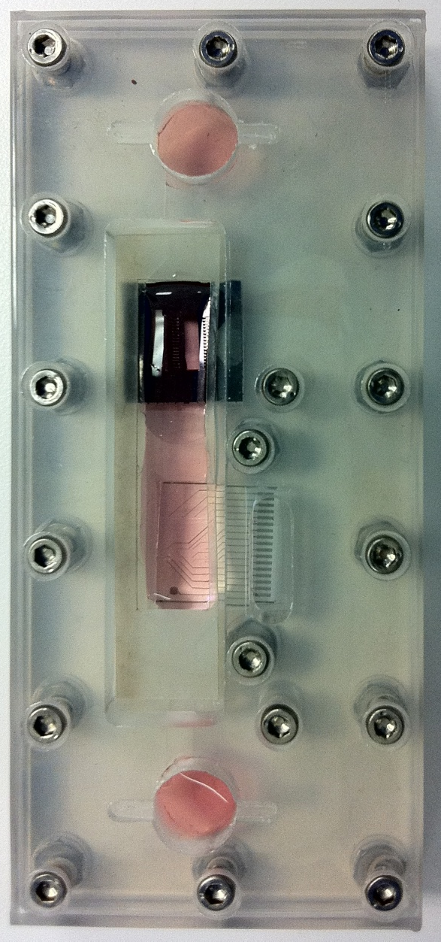
HSL Integrated CardioVascular Module
Polycarbonate lid
with reservoirs**
PDMS vasculature
Polycarbonate
membrane
Polycarbonate
frame
with PCB**
Silicone gasket
Cantilever and cMEA chips
Polycarbonate
bottom plate
**
Lid and PCB not shown
(for clarity)

Slide 24
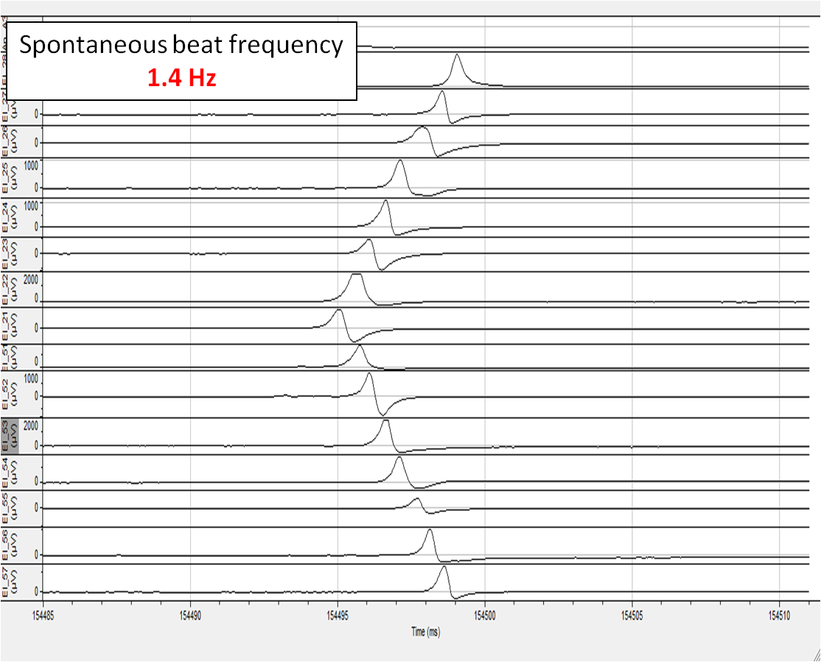
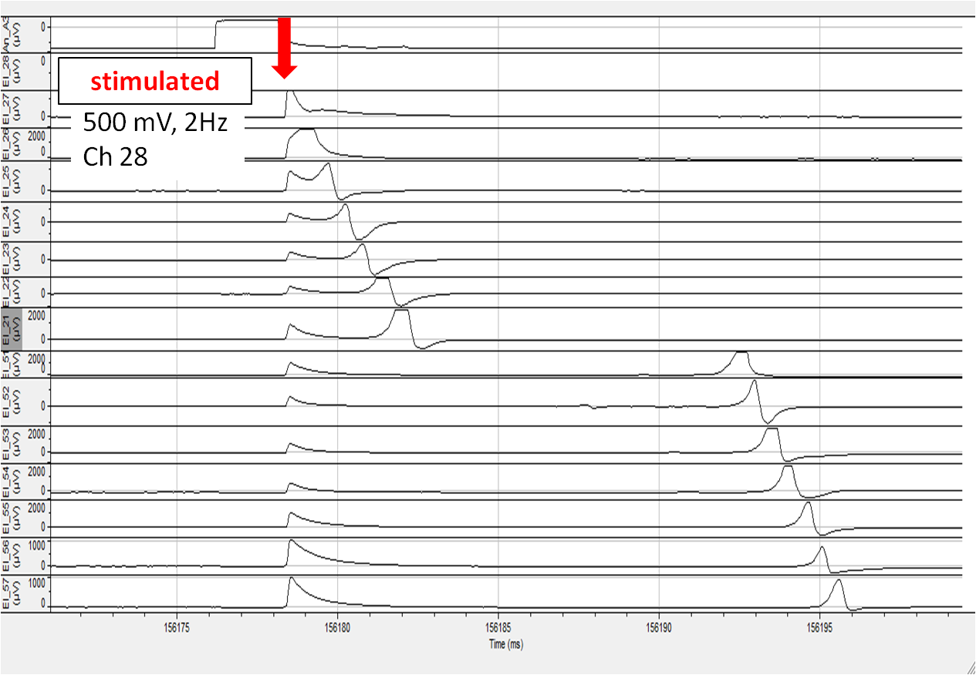

Electrophysiology – hIPSC cardiomyocytes on MCS MEA
Conduction velocity measurement
stimulated
QT interval
Calculated Conduction velocity = 0.42 m/s

Slide 25

Bi(o)morph Force/Displacement Detection Schemes
I. Deflection (optical lever)
Laser
photodetector
II. Piezoresistive (embedded strain gauge)
v

Slide 26
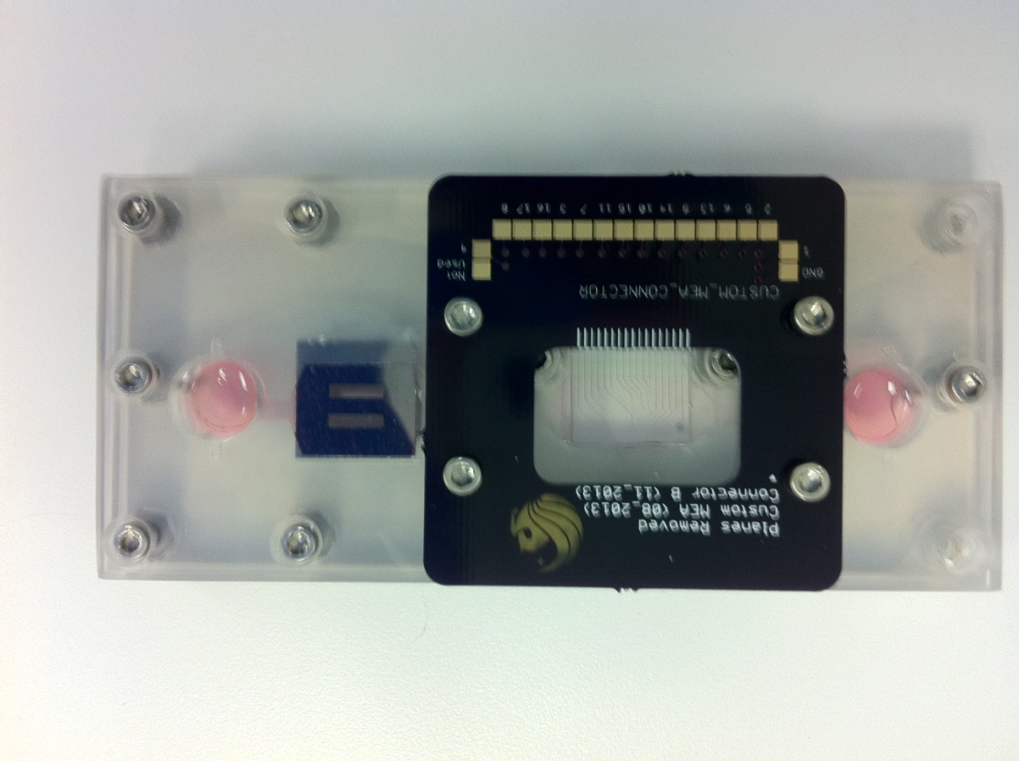
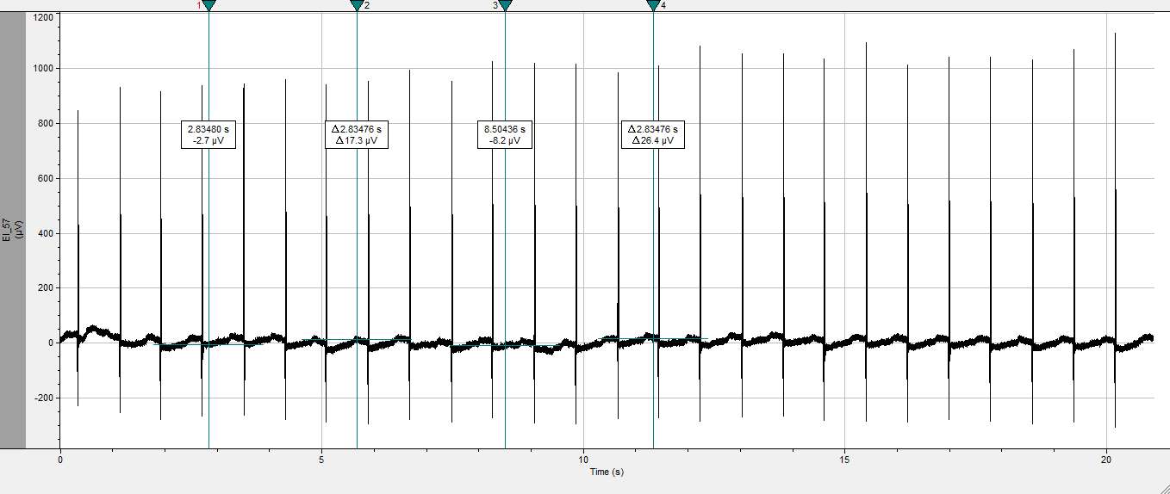
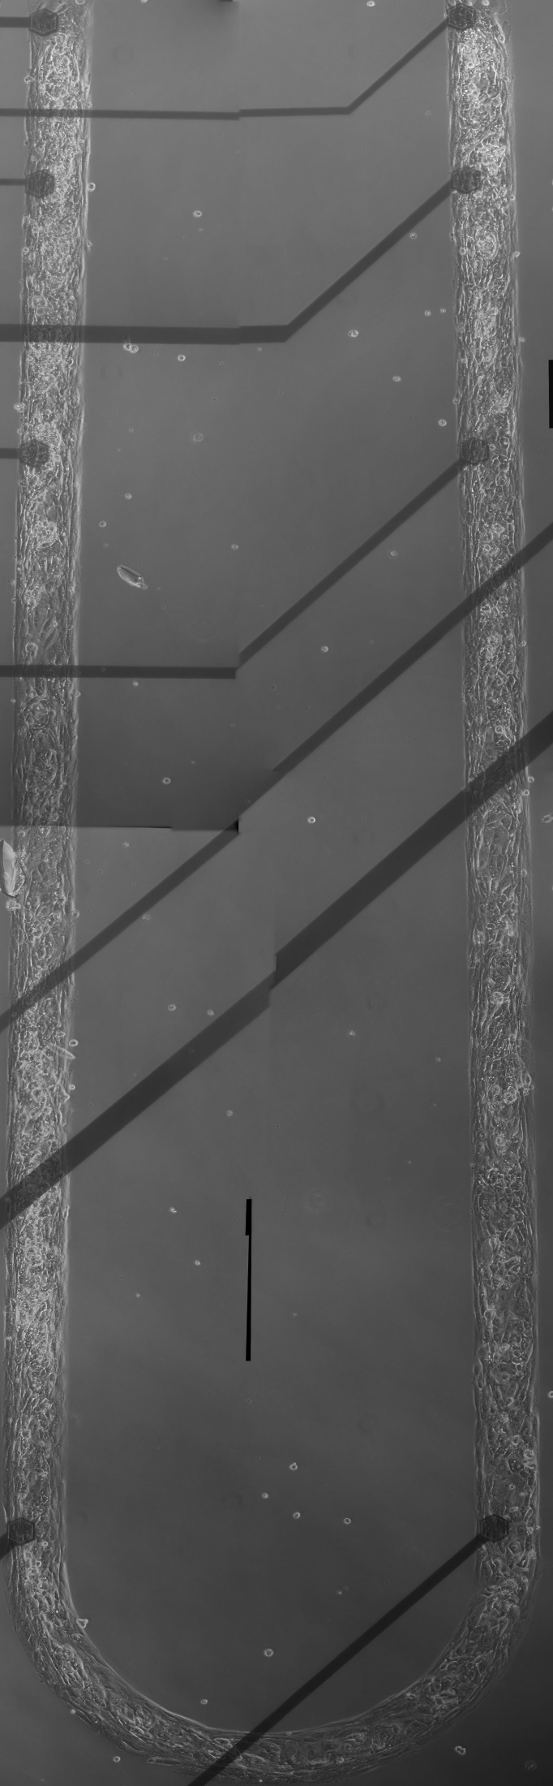
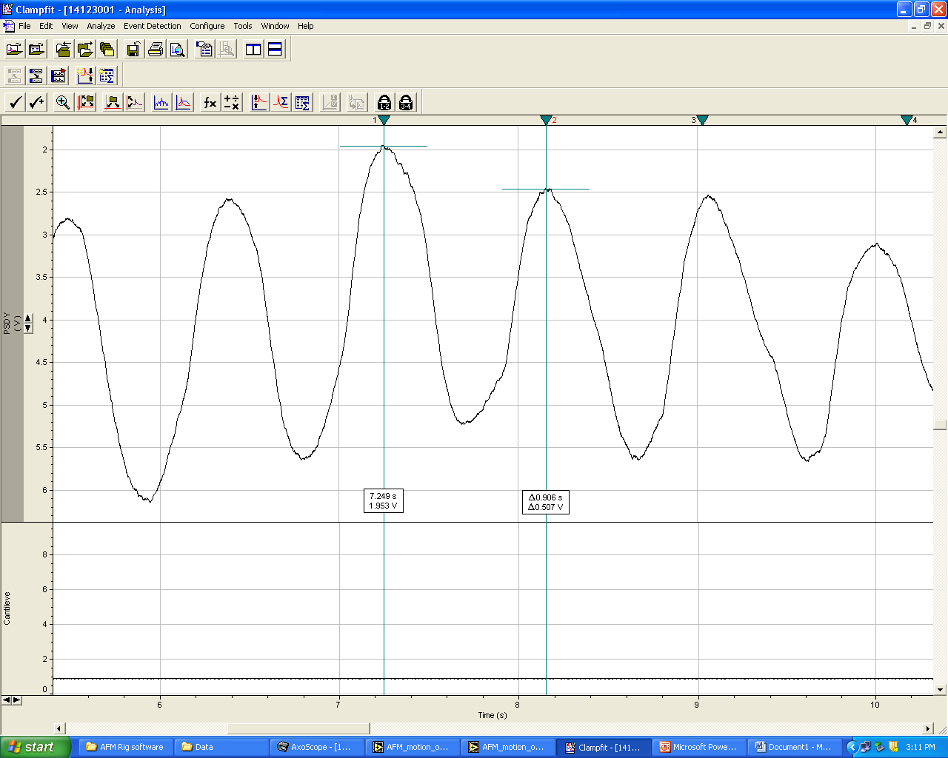


Functional Evaluation- hIPSC cardiomyocytes
on HSL Integrated Cardiac Module
MEA Recording
Electrical
Force
Cantilever Recording

Slide 27
Testing with cardioactive compounds
Compound | Mode of Action | Effect
Norepinephrine | Adrenergic agonist | n = 3, Increase beat frequency and contractile force
Epinephrine | Adrenergic agonist | n = 4, Increase beat frequency and contractile force
Acetylcholine | Parasympathetic neurotransmitter; cardioprotective | n = 4, effect inconclusive; confirm AchR expression with immunostaining
Verapamil | L-type calcium channel blocker; antiarrhythmic | n = 3, decrease beat frequency and contractile force Decrease conduction velocity; Prolongs QT interval
Sparfloxacin | Non-cardiac drug; antimicrobial | n = 1, QT prolongation as a side effect
Sotalol | Anti-arrhythmic | n = 2, Decrease conduction velocity; Prolongs QT
Propanolol / Metoprolol (after Epinephrine) | Anti-arrhythmic, beta-blocker | n = 2, Counteracts adrenergic effects

Slide 28
Basis for Advanced Multi-Organ Systems
Chemical, biological, electrical & mechanical responses
Both in situ (online) measurements and off-line from “blood” surrogate
Can capture impact of metabolic conversions and organ-to-organ exchange
PPBPK model of device leads to PBPK of human response to predict human response to a variety of exposure scenarios

Slide 29
13 Organ Device

Slide 30
Toward a Physiological Model
A rocker platform design reduces problems associated with pumps (e.g. gas bubbles)
2 layered system allows direct organ to organ communication: Barrier tissues to internal organs
Organ sizes are scaled proportionately to each other using average adult human male organ volumes (Price 2003)
Channel dimensions calculated to match the flow to obtain physiological organ residence times

Slide 31
Hesperos,Inc.; Making Systems Widely Available
1. Goal is to commercialize Functional “Body-on-a-Chip” technology as well as individual organ systems for humans.
2. Work with customer to custom design systems as well as offer standard tests for cardiac, NMJ, liver, muscle and combinations thereof; available skin & GI soon.
3. Functional tissues; Chemical, electrical, mechanical, and biological outputs measured.
4. All systems in serum free defined medium utilizing human cells.
5. Shuler as CEO; J. Hickman as Chief Scientist; Jeff Anderson as business manager (janderson@hesperos.net)

Slide 32
Acknowledgements
Colleagues | Prior PhD Students | Post-Doc
Ray Glahn | Lisa Sweeney | Mandy Esch
Sung June Kim | Kwan Viravaidya | Jean Matthieu Prot
Don Cropek | Aaron Sin | H. Erbil Abaci
Don Kim | Dan Tatosian | Ying Wang
Jay Hickman | Gretchen McAuliffe | Joyce Chen
Angela Christiano | Hui Xu
Dawn Applegate | Jay Sung
Brian Davis
John March | Funding
Xiling Shen | Nanobiotechnology Center, NSF, U.S. Army (CERL) NIH
Steven Lipkin | CNF (Cornell Nanofabrication Facility), NYSTAR

