Slide 2
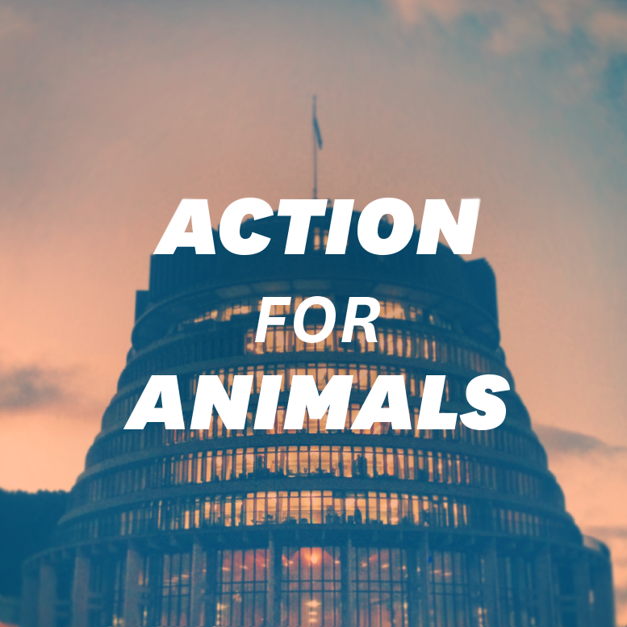

Slide 3
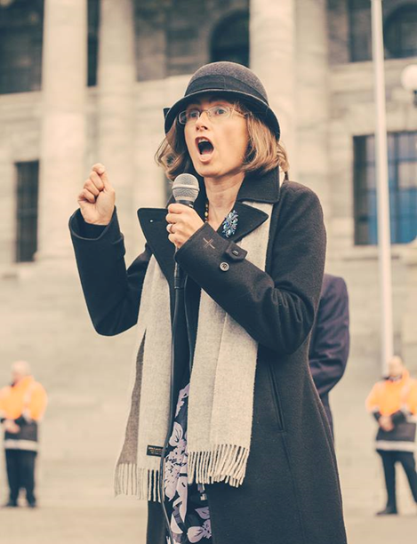
Animal Welfare Amendment Bill:
I saw this as an opportunity to lobby for changes to animal welfare law in NZ, including a ban on animal testing of cosmetics
In August 2013 I launched the “Take Action for Animals” campaign and Facebook page
I ran submission workshops through out the country
There were over 2,000 submissions from the public

Slide 4
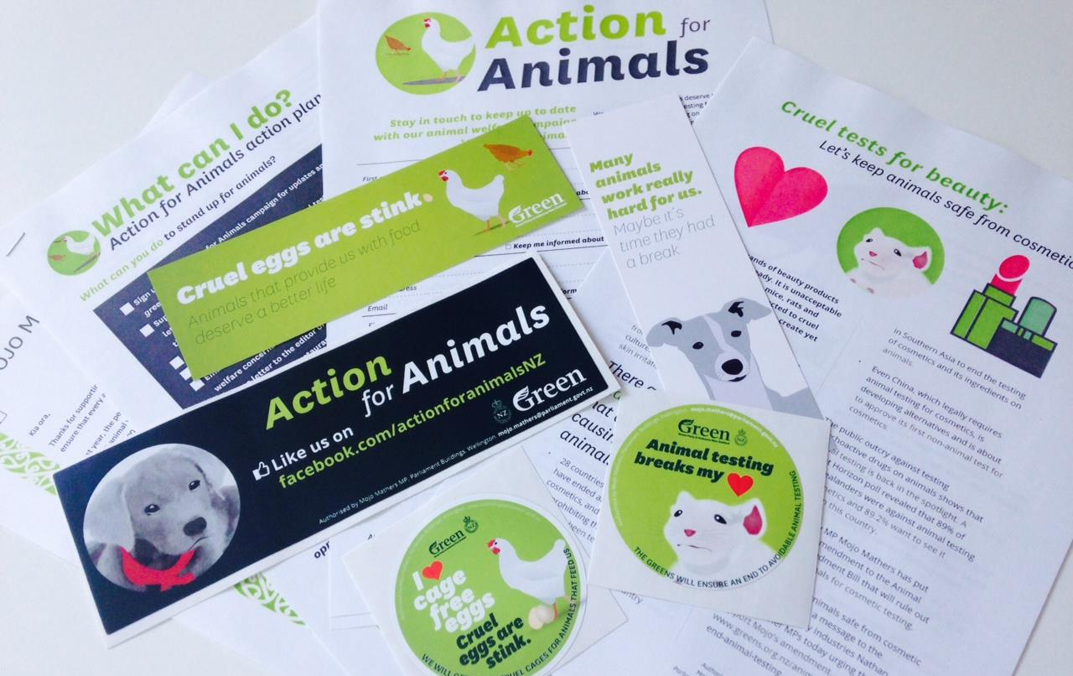

Slide 5
In 2014, during deliberations in the Select Committee on the bill I tabled an amendment that would bring in a ban, developed with the help of a NZ lawyer passionate about animal rights.

Slide 6
No 423
House of Representatives
Supplementary Order Paper
Tuesday, 18 March 2014
Animal Welfare Amendment Bill
Proposed amendments
Mojo Mathers, in Committee, to move the following amendments:
Clause 4
After subclause 4(5) (after line 6 on page 6), insert:
(6) In section 2(1), after the definition of controlled surgical procedure,
insert:
“cosmetic––
“(a) means any substance, mixture of substances, or article, used
or represented for use for the purpose of cleansing, protecting,
beautifying, improving the attractiveness of, altering the
appearance of, perfuming, or deodorising the skin, hair, nails,
or other external part of the human body, teeth, or the mucous
membranes of the mouth; and
“(b) includes any ingredient or component of a substance, mixture
of substances, or article specified in paragraph (a).”
New clause 31A
After clause 31 (after line 20 on page 14), insert:
31A New section 82A inserted (Prohibition on use of animals
in research, testing, and teaching relating to a cosmetic
product)
After section 82, insert:
“82A Prohibition on use of animals in research, testing, and
teaching relating to cosmetic product
“(1) Notwithstanding any other provision in this Act, no person
may carry out research, testing, or teaching involving the use
of animals if the research, testing, or teaching relates, wholly
or in part, to a cosmetic product as defined by section 2 of the
Medicines Act 1981.
1

Slide 7
We also started a social media campaign to get the public to email all politicians to support my amendment.

Slide 9
Advice from ministry officials was that the proposed amendment would have unintended consequences.

Slide 10
So I tabled a second amendment!

Slide 11
No 473
House of Representatives
Supplementary Order Paper
Thursday, 26 June 2014
Animal Welfare Amendment Bill
Proposed amendments
Mojo Mathers, in Committee, to move the following amendments:
Clause 4
After clause 4(5) (page 6, after line 34), insert:
(6) In section 2(1), insert in their appropriate alphabetical order:
“cosmetic––
“(a) means any substance, mixture of substances, or article,
used or represented for use for the purpose of cleansing,
protecting, beautifying, improving the attractiveness of,
changing the appearance of, perfuming, or deodorising
the skin, hair, nails, or other external parts of the human
body, teeth, or the mucous membranes of the mouth;
and
“(b) includes—
“(i) any ingredient or component for use in a cosmetic;
and
“(ii) any substance, mixture of substances, or article
declared to be a cosmetic by regulations made
for that purpose under section 183; but
“(c) does not include—
“(i) a medicine as defined in section 3 of the
Medicines Act 1981; and
“(ii) any substance, mixture of substances, or article
declared not to be a cosmetic by regulations
made for that purpose under section 183
“substance has the same meaning as in section 2(1) of the
Medicines Act 1981”.
1

Slide 12
After much discussion, the National Party members of the committee voted against supporting my SOP

Slide 13
But not all was lost! There was a final opportunity to get a ban in place during the next stage of the bill where my amendment would be put to the vote of the whole house. This meant putting more pressure on the other parties to vote for my amendment!

Slide 14
It was time to hit the social media campaign trail again!

Slide 15
I wrote more blogs…
Animal Welfare Amendment Bill: The good, the bad and the ugly
June 26, 2014
The Bill has just been reported back from the Primary Production Select Committee. Like most bills it contains a mix of things that we agree with and those that we don’t. It has mostly been a missed opportunity to get it right for animals experiencing the greatest suffering in NZ which is in animal testing…

Slide 17
‪#‎AnimalTestingBreaksMyHeart‬
Pet Selfies on social media!

Slide 19
There was a huge response from the public !

Slide 20
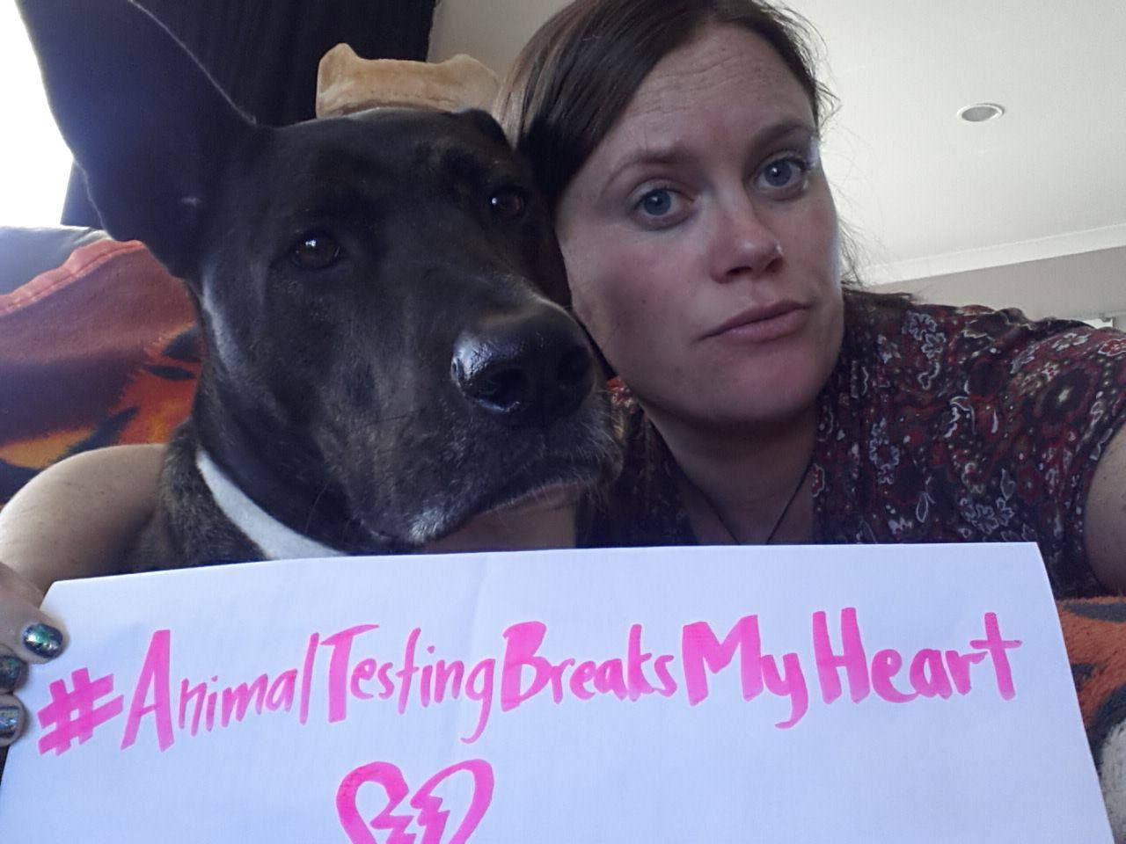

Slide 21
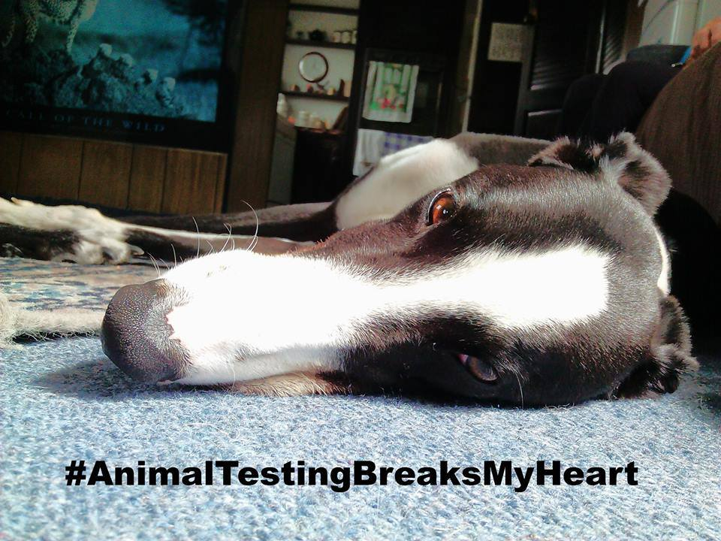

Slide 22
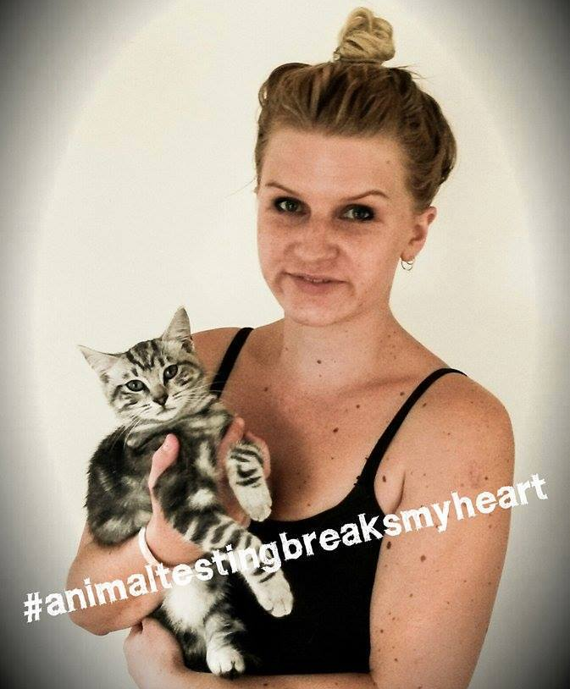

Slide 23
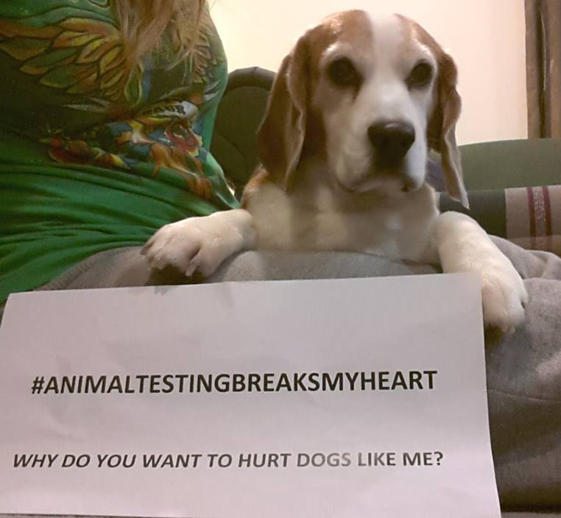

Slide 24
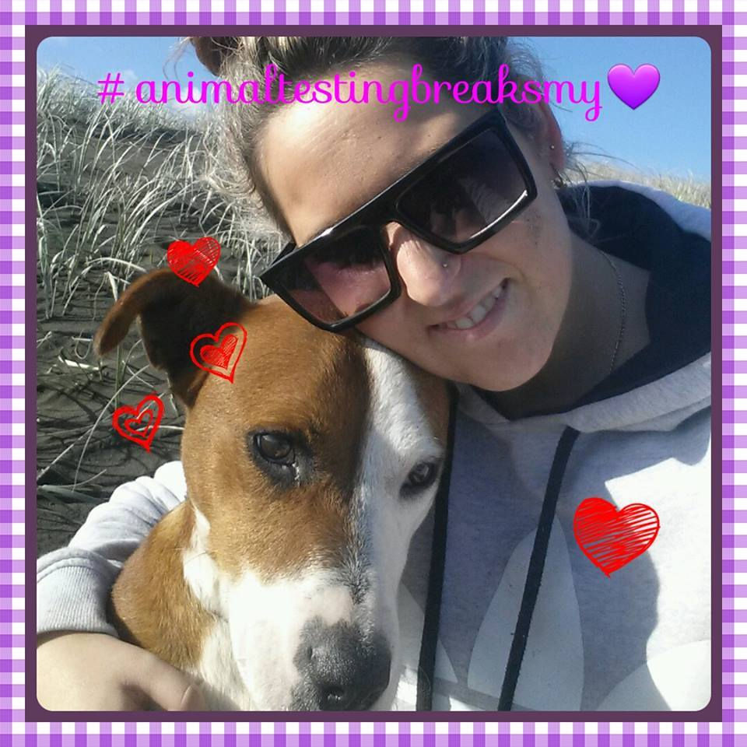

Slide 25
It was great to have the support of #BeCrueltyFree!

Slide 26
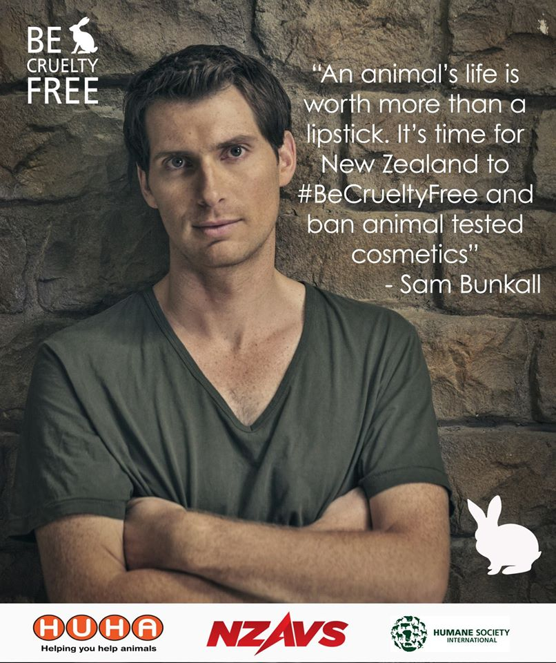

Slide 27
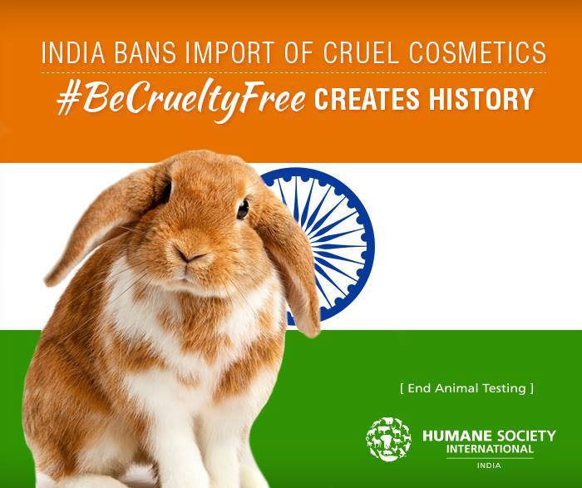
Wins overseas added momentum to the NZ campaign

Slide 28
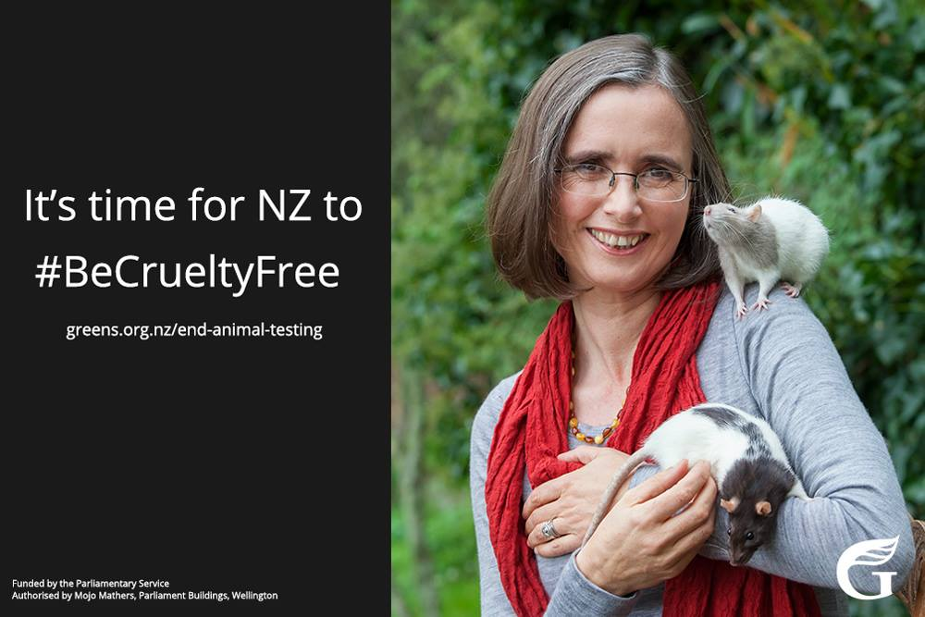

Slide 29
Third and final amendment drafted with help of Humane Society International (HSI) and local lawyer!

Slide 30
No 44
House of Representatives
Supplementary Order Paper
Wednesday, 11 February 2015
Animal Welfare Amendment Bill
Proposed amendments
Mojo Mathers, in Committee, to move the following amendments:
Clause 4
After clause 4(5) (page 6, after line 34), insert:
(6) In section 2(1), insert in their appropriate alphabetical order:
“cosmetic––
“(a) means any substance or mixture of substances intended
for application to any external part of the human body
(including skin, hair, or nails), or to the teeth or the mucous
membranes of the oral cavity, for the sole or primary
purpose of beautifying, promoting attractiveness,
improving, protecting, altering, cleansing, perfuming,
or deodorising; and
“(b) includes—
“(i) any substance or mixture of substances intended
for use as an ingredient in any substance or mixture
of substances that falls within paragraph
(a); and
“(ii) any substance or mixture of substances that is, or
that is of a kind that is, or belongs to a class that
is, declared by regulations made under section
183 to be a cosmetic for the purposes of this Act;
but
“(c) does not include—
“(i) a medicine as defined in section 3 of the
Medicines Act 1981; or
“(ii) a medical device as defined in section 3A of the
Medicines Act 1981; or
1

Slide 31
I wrote more blogs….
Time for NZ to #BeCrueltyFree
February 13, 2015
The Government is about to progress the final stages of the Animal Welfare Amendment bill. This will be our last opportunity to get changes made to improve the bill to ensure a better outcome for animals. I have put forwards a number of amendments including one to ban the testing of cosmetic products and ingredients

Slide 32
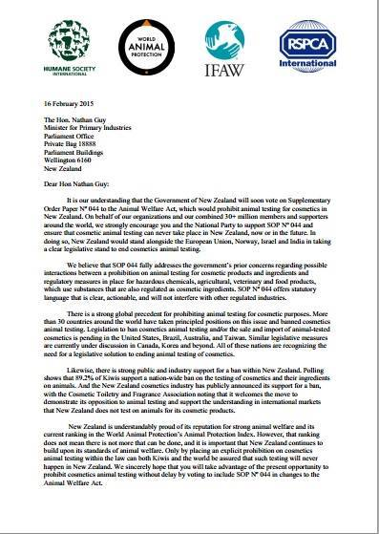
Four of the worlds largest animal welfare charities wrote and urged the New Zealand government to support my amendment

Slide 33
We needed to find new angles to keep the story alive in the media

Slide 34
Crumpet the rabbit visits parliament!

Slide 35
New Zealand Anti-Vivisection Society, HSI, SAFE and other groups all collaborated to do a final mass email to party leaders! Over 90,000 people signed!

Slide 36
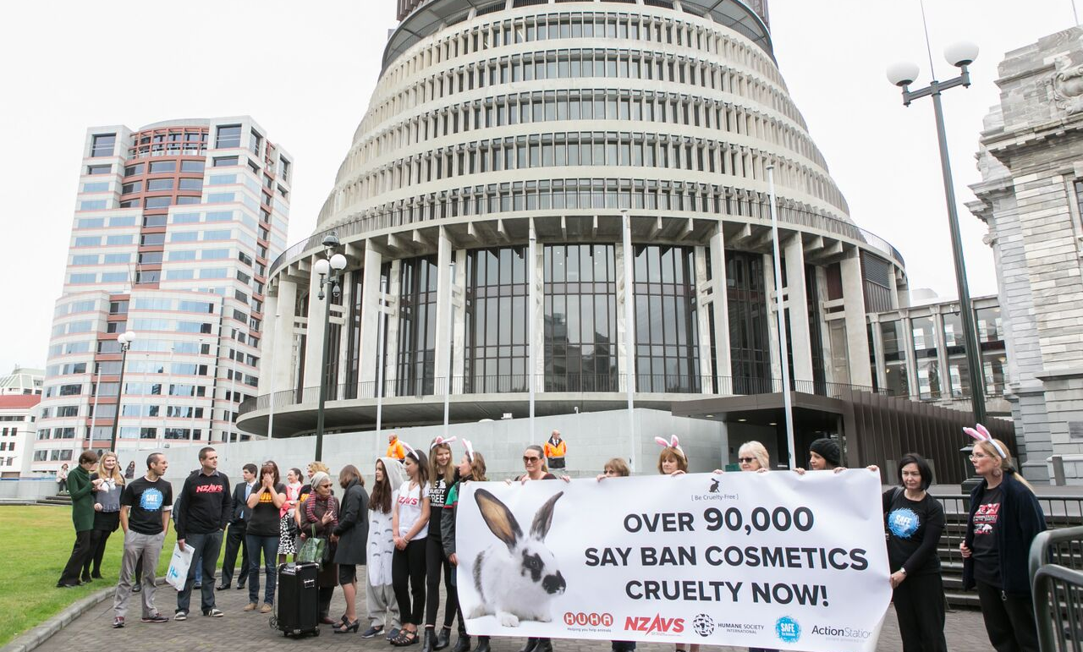

Slide 37
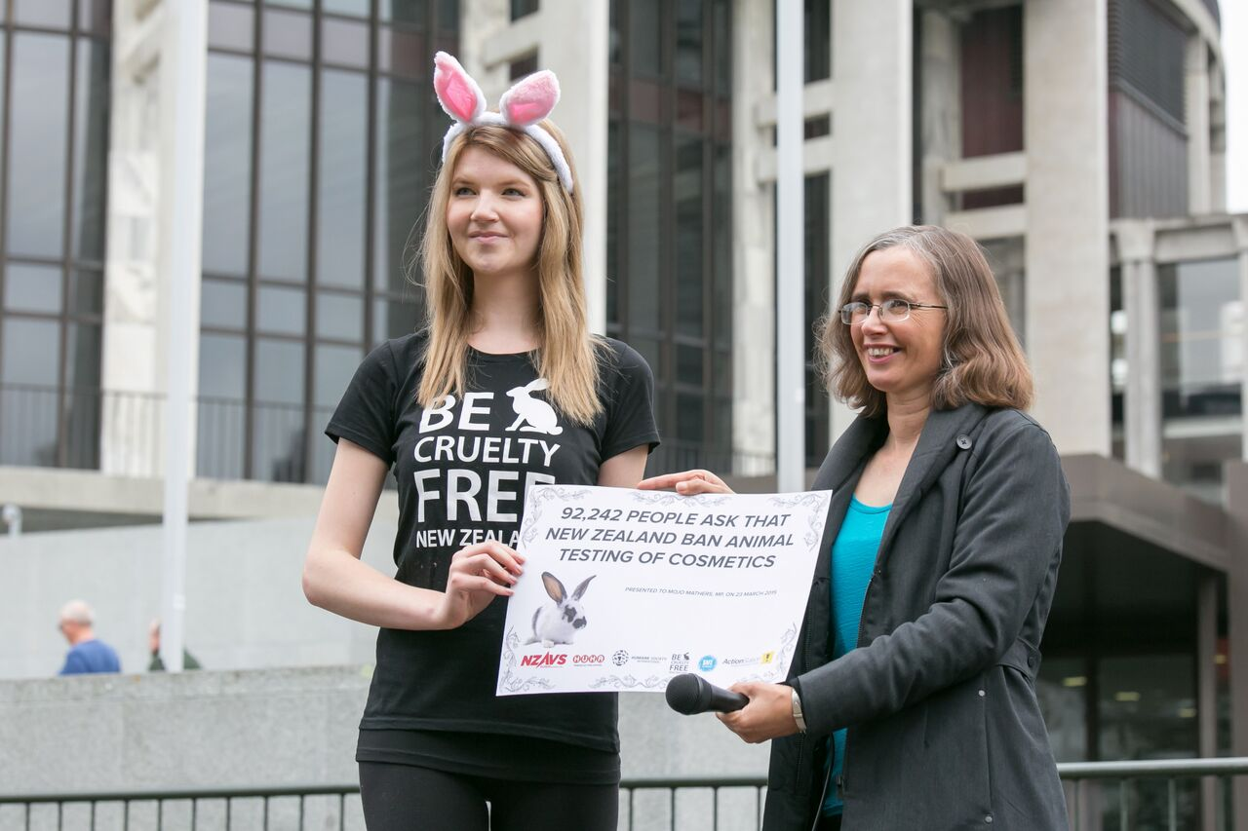

Slide 38
The government minister still kept saying that there was no need for a ban because such tests had never happened in NZ.

Slide 39
So I asked the minister a question in the house and tabled evidence that we could not rely on such assurances to hold in the future.

Slide 41
On the day of the vote, the minister called me into his office to let me know that they were putting up their own amendment banning animal testing of finished cosmetics and single purpose cosmetic ingredients! All parties voted for the amendment.

Slide 42
