Slide 1
Minimising animal tests through education and training
Gilly Stoddart, PhD
GillyS@piscltd.org.uk
PISCltd.org.uk
20 November 2015
Notes:
Thanks very much to Lush for the opportunity to talk about the work we’ve been doing which led to us receiving the lush prize for training.

Slide 2
Overview
PETA International Science Consortium Ltd.
Education and training
  Training sessions
  Outreach
  Webinars
REACH webinar series
Notes:
Today, I’ll start by giving you some background information about the PETA International Science Consortium. I’ll then talk about our work to reduce testing on animals through education and training, focusing on the REACH webinar series.

Slide 3
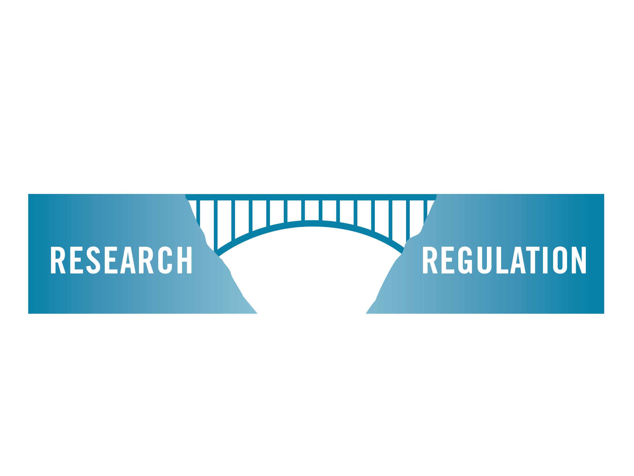



PETA International Science Consortium
Notes:
Many of you will have heard of the animal charity PETA, People for the Ethical treatment of Animals. PETA was founded in the US 35 years ago and is the largest animal rights charity in the world. There are seven other PETA affiliates around the world. PETA and its affiliates employ more scientists than any other animal protection organization and the Science Consortium was created to coordinate that expertise more effectively. The Science Consortium focuses on several key activities that will reduce the numbers of animals used in laboratories. For example we
funds research and validation efforts for promising non-animal tests AND
bridges the gap between research and regulatory agencies to establish and promote clear paths to validation and regulatory use of non-animal techniques
3) promotes harmonisation across international regulatory bodies, and
4) promotes awareness regarding accepted non-animal methods.

Slide 4
Education and Training
Training sessions
Outreach: piscltd.org.uk
Webinars
Notes:
The Science Consortium was awarded the lush prize training award for its multifaceted approach to providing educational outreach to companies and regulators through
initiating face-to-face training sessions,
developing educational resources to promote the acceptance and uptake of non-animal methods for regulatory purposes and
organising webinars.
I’ll talk briefly about the training sessions and outreach and then focus the rest of the talk on the REACH webinar series that ran from the end of 2014 to the middle of this year.

Slide 5
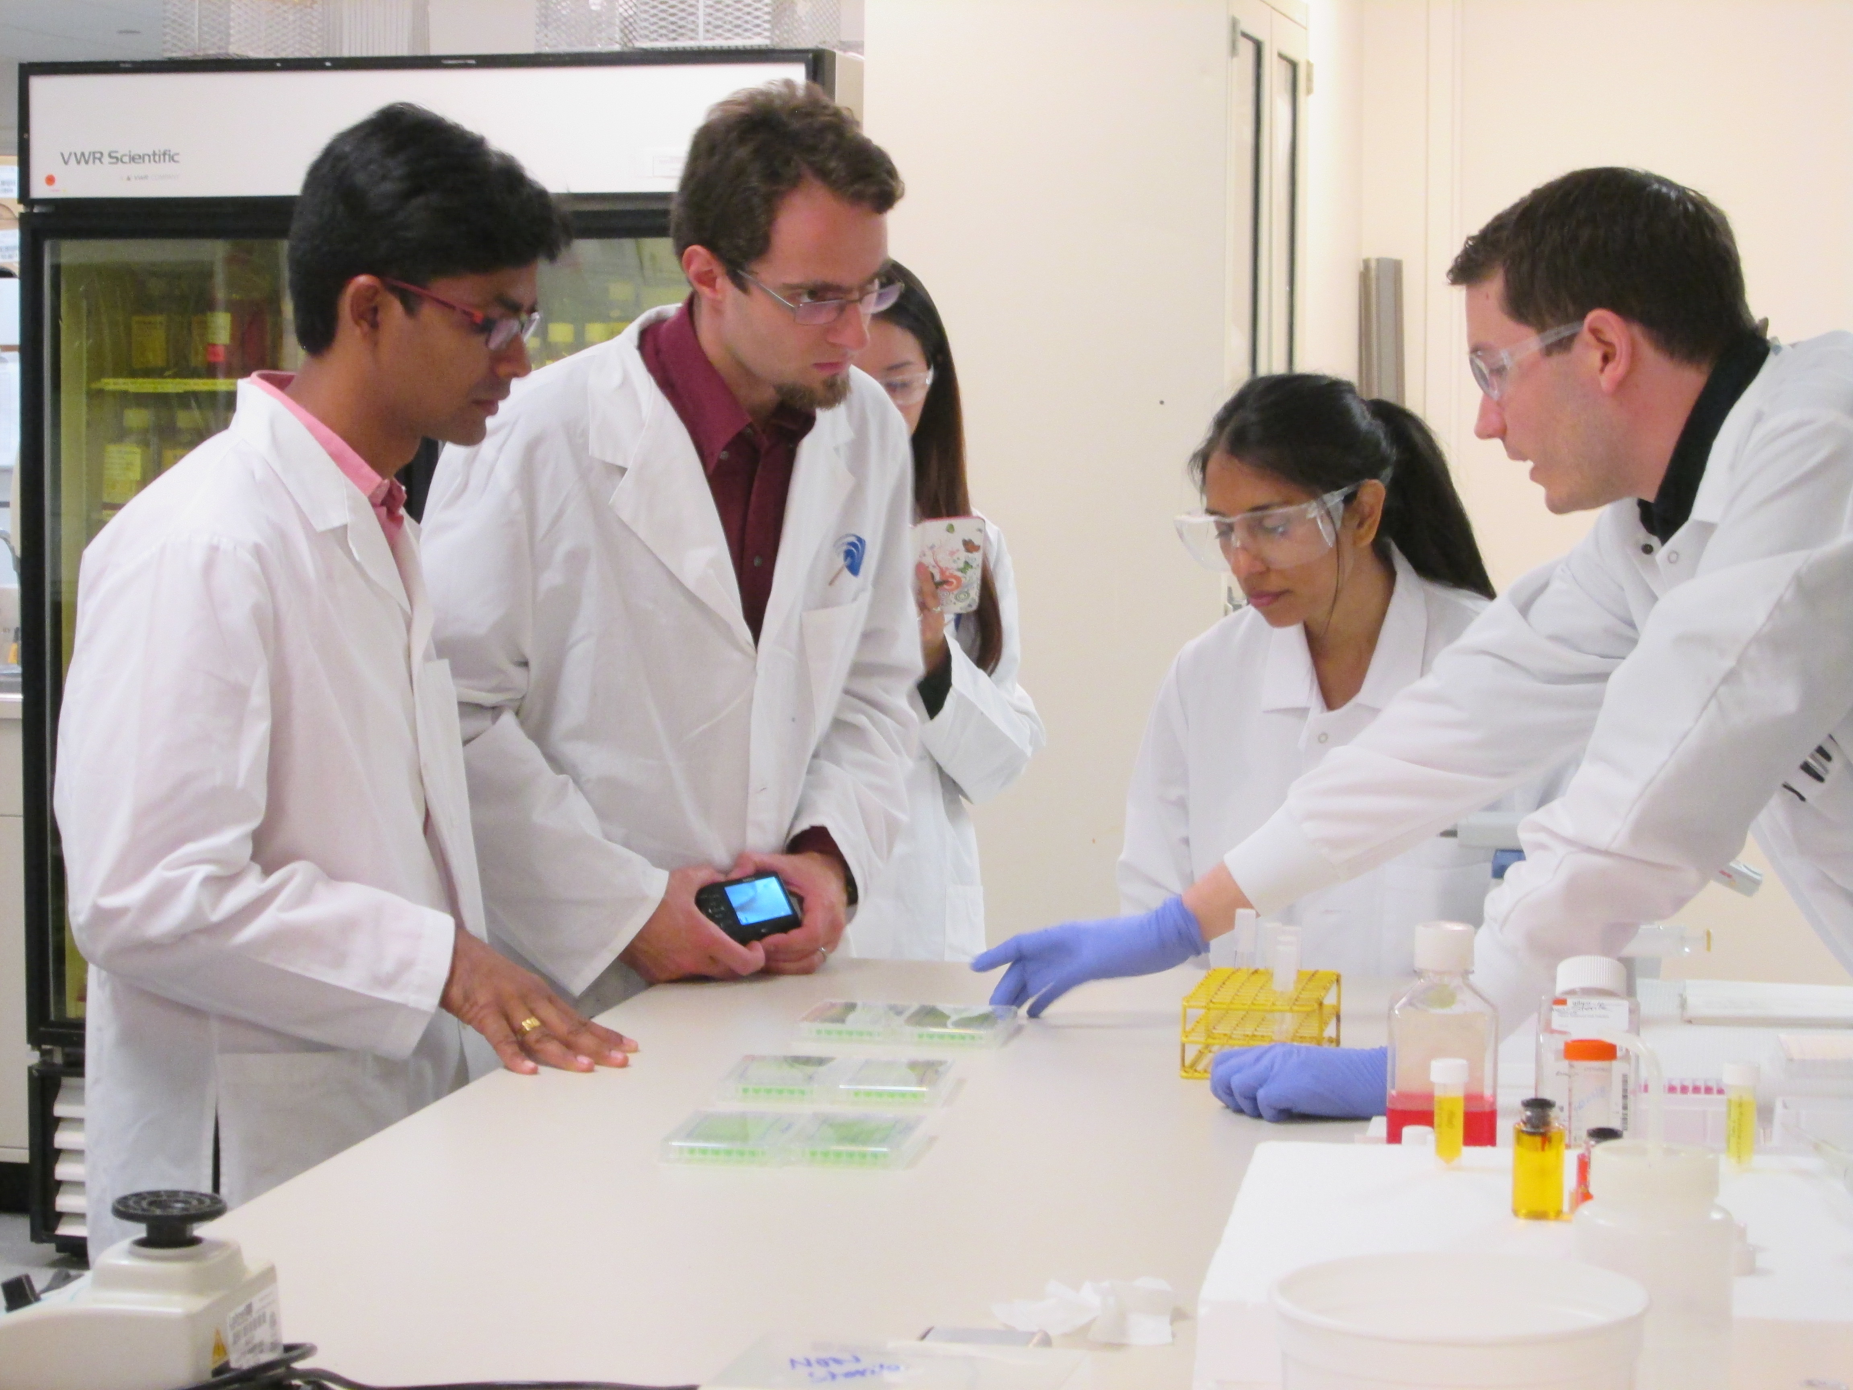
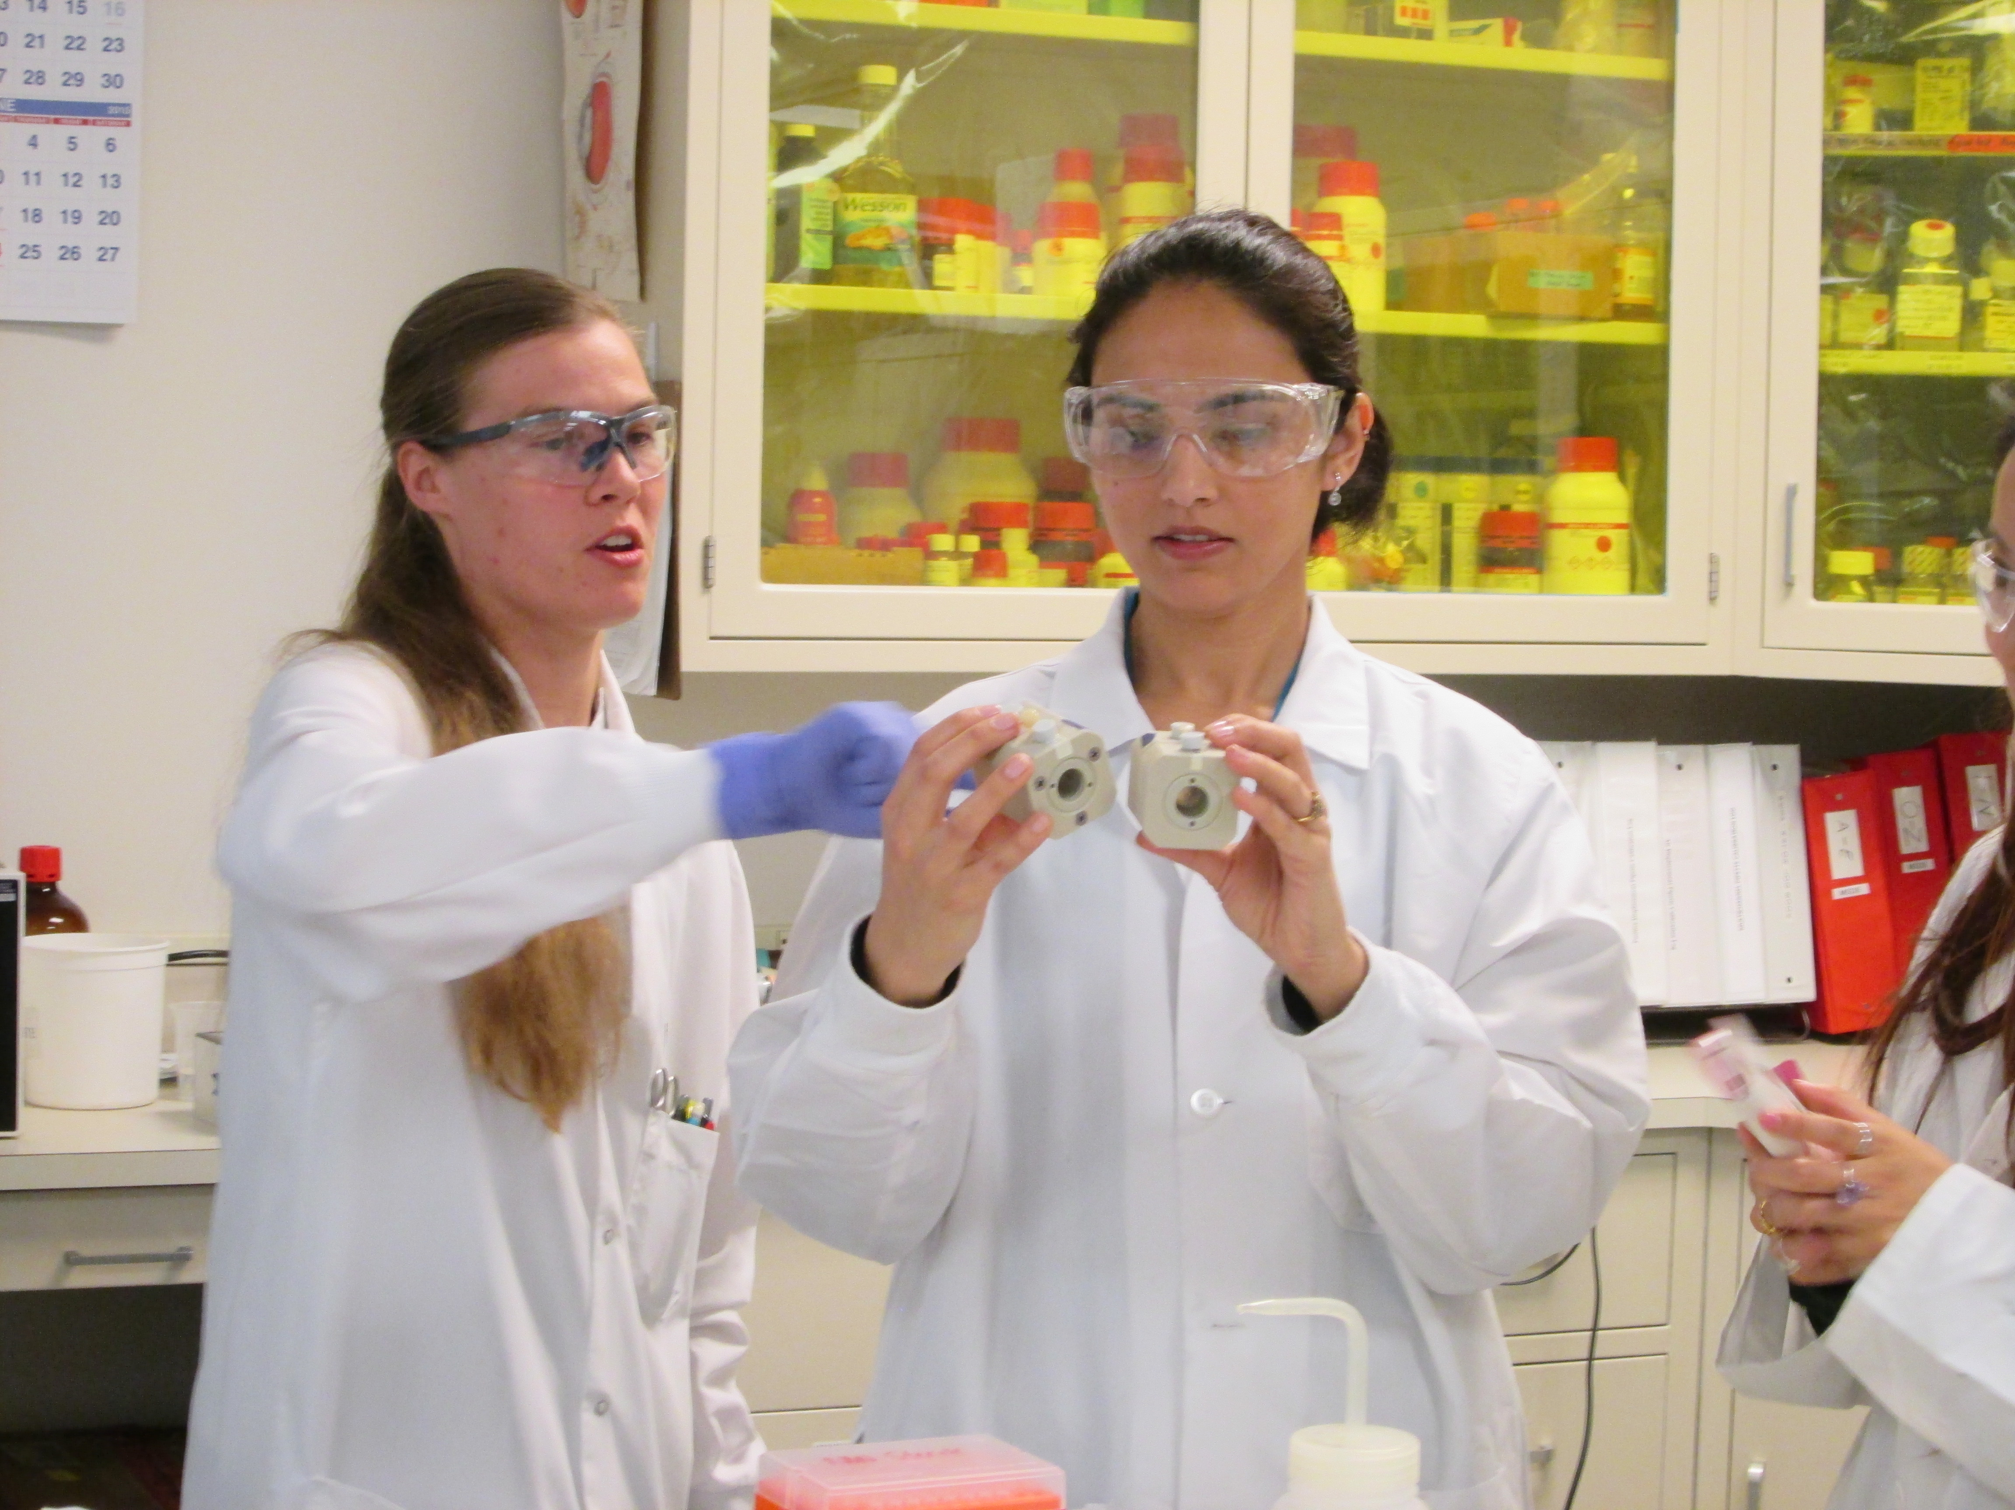
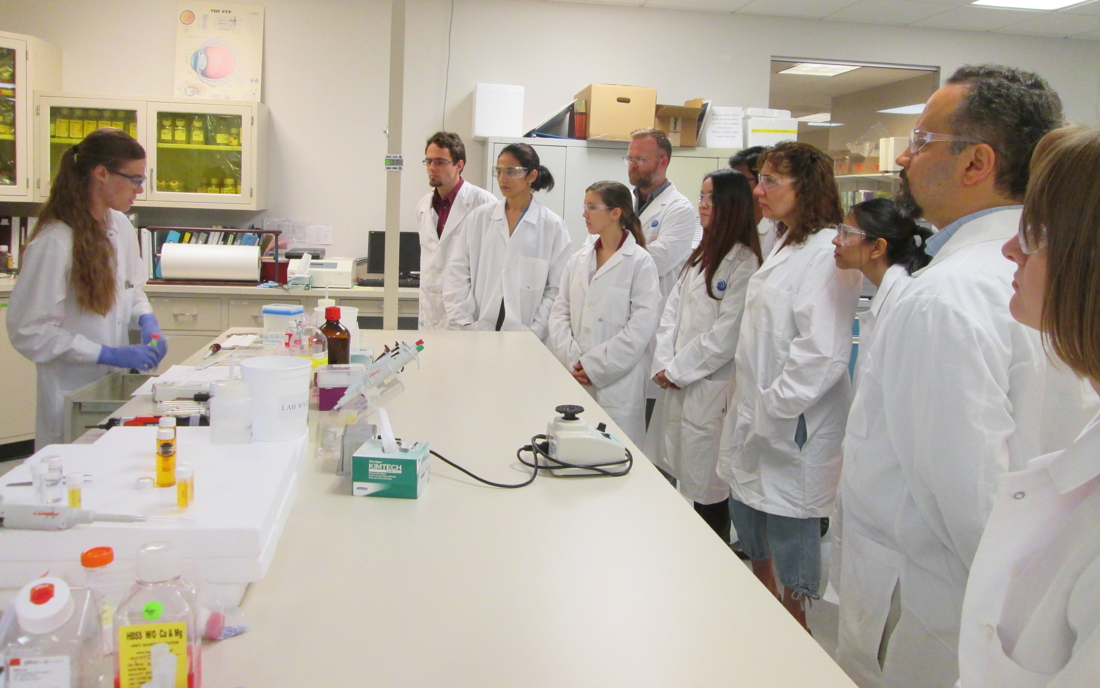
Training Sessions
Notes:
The Science Consortium’s work regarding education and training has focused largely on animal testing for regulatory purposes, that’s testing on animals that is required by law, for example testing chemicals, pesticides and biocides. Regulatory acceptance is critical to reducing tests on animals; so the Science Consortium initiated training for the Environmental Protection Agency on the use of in vitro methods. The training was provided by leading experts in the field from the Institute for In Vitro Sciences and took place on the 4th August of this year. This was the first IIVS/EPA training session and there are plans to make this an annual event. Additional training opportunities with other regulators are planned for next year.
This is a group, actually our group, at an IIVS for training. They provide hands on training for many non-animal methods that can be use to replace tests on animals, for example, skin sensitization, skin and eye irritation.

Slide 6
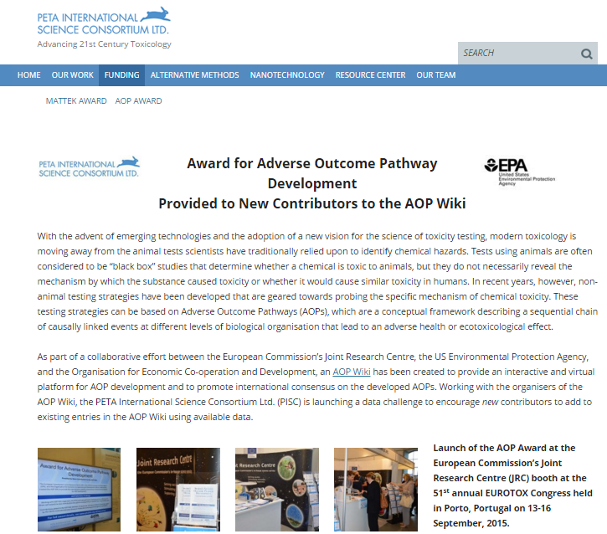
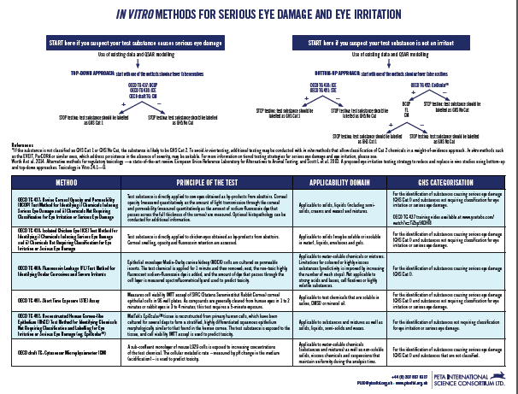
Outreach
FUNDING OPPORTUNITIES
FACTSHEETS
Notes:
Using our website, we provide valuable resources to companies regarding the use of non-animal methods, including a list of validated and regulatory accepted alternative methods, factsheets on non-animal methods and information about testing nanomaterials using non-animal methods. We publish widely on the use of alternatives methods in peer reviewed journals and in the trade press and present at international conferences. If you haven’t already I encourage to take a look at our site where you can download the factsheets.
We also provide funding opportunities and prizes. For example, the Science Consortium recently teamed up with a company called MatTek. MatTek produces human cell-based tissues that can be used as alternatives to testing on animals. Free or discounted tissues were awarded to selected researchers who submitted proposals on how MatTec tissues could be used in their work to reduce animal testing.
Recently, the Science consortium awarded $200,000 for the development of an in vitro test to assess the inhalation toxicity of nanonmaterials.
We have an ongoing competition at the moment to encourage researchers to contribute to the development of Adverse Outcome Pathways. An Adverse Outcome pathways is a framework describing a sequential chain of linked events that can lead to an adverse health or ecotoxicological effect. The competition is running until the 15th of March if you would like more information about the competition I have some flyers with me and I’m happy to talk with you at the end of the session.
We recognise that webinars are a valuable training medium and we launched our first webinar series at the end of 2014 which I’ll talk about now.

Slide 7
Animal Testing for REACH
Animals Killed
≥1 ≥10 ≥100 ≥1000
tonnes per year
Notes:
The webinar series directly addressed the animal testing implications of the European chemical testing programme called REACH. Some of you will have heard of REACH but many won’t so I’ll explain a little about it first.
REACH is the regulation on the Registration, Evaluation, Authorisation and Restriction of Chemicals and the regulation was adopted to improve the protection of human health and the environment from the risks that can be posed by chemicals.
Each chemical that is manufactured or imported into Europe above 1 tonne per year needs to registered and the data required to register a chemical increases depending on the amount of the substance manufactured or imported into Europe. Data is required on the human health and environmental effects of the chemical and tests on animals are often required. If there is no existing data for a particular chemical, the animal testing implications of REACH are huge.
For some chemicals thousands of animals may be used in testing. When you consider that tens of thousands of substances are expected to be registered for this deadline you can see that we expect millions of animals to be used in the coming years.
REACH includes a number of provisions to ensure that tests on animals are only conducted as a last resort. These include specific and general adaptations of the standard animal testing information requirements. This means that where a non-animal method is available it must be used instead of testing on animals. There are non-animal methods available for many of the tests required for the 2018 deadline although the use and acceptance of these methods is not as good as it could be. We felt that we couldn’t rely on the regulators to promote the use and acceptance of non-animal methods so we developed a webinar series address this issue.

Slide 8


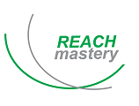










Webinar Series: Leading Experts
Notes:
We teamed up with the online news service, Chemical Watch, to co-host the 7-part webinar series promoting the use of non-animal methods to meet REACH data requirements focusing on the tests required for the 2018 deadline.
We felt that it was essential that the webinars be presented by leading experts in the field, including industry and REACH consultants, academics and regulators. This was important to ensure that the content was relevant to those who would be using the methods and also so that personal experiences and advice could be shared. The European Union reference laboratory for alternatives to animal testing played a pivotal role in the webinar series and participated in 4 of the 7 webinars. You can see that experts from a number of large international companies also contributed to the series. The institute of in vitro Science also participated in two of the webinars.
At the end of each webinar there was the opportunity for those listening to ask the presenters questions and for many of the webinars the experts took the opportunity to provide written answers to some of the questions which can be downloaded from our website.

Slide 9
Webinar Topics
WEBINAR 1 | OECD QSAR TOOLBOX AND READ-ACROSS | Dr. Grace Patlewicz, formerly of DuPont Prof. Mark Cronin, Liverpool John Moores University
WEBINAR 2 | SKIN IRRITATION AND CORROSION | Dr. Gertrude-Emilia Costin, Institute for In Vitro Sciences Dr. Costanza Rovida, REACH Mastery and CAAT Europe
WEBINAR 3 | SERIOUS EYE DAMAGE AND EYE IRRITATION | Dr. Kim Norman, Institute for In Vitro Sciences Dr. João Barroso, EURL ECVAM
WEBINAR 4 | SKIN SENSITISATION | Dr. Susanne Kolle, BASF SE Dr. Silvia Casati, EURL ECVAM
WEBINAR 5 | ALTERNATIVE APPROACHES TO MAMMALIAN ACUTE SYSTEMIC TOXICITY TESTING | Dr. Pilar Prieto, EURL ECVAM Dr. Lawrence Milchak, 3M
WEBINAR 6 | (ZEBRA)FISH EMBRYO ACUTE TOXICITY TEST TO PREDICT SHORT-TERM TOXICITY TO FISH (AND BEYOND | Dr. Marlies Halder, EURL ECVAM Prof. Thomas Braunbeck, University of Heidelberg Dr. Scott Belanger, Procter & Gamble
WEBINAR 7 | THE REGULATORY PROCESSES INVOLVED IN ACCEPTANCE OF NON-ANIMAL TESTS | Dr. Derek Knight, ECHA Ms. Karin Kilian, European Commission
Notes:
We covered a wide range of subjects including general topics such as the use of computer models to predict toxicity and the regulatory processes involved in the acceptance of non-animal methods.
We also covered more specific topics such as non-animal methods for skin and eye irritation. The animal test to assess skin and eye irritation involves applying the chemical to a rabbits sensitive eyes or skin. However, there are several non-animal methods that can be in an integrated testing strategy to avoid doing the animal test. Another example is skin sensitisation, or skin allergy. Mice or guinea pigs are used in these tests but a battery of non-animal methods is available which can be used in place of the animal test.
We also had a webinar on alternatives to acute toxicity testing. Some of you will have heard of the LD50 test. This is a test used to determine what dose of a chemical will kill half the animals. Because death is measured it’s a particularly horrible test. The use of non-animal tests and other strategies that can be used to reduce the occasions when these tests on animals are required were described in the webinar.

Slide 10
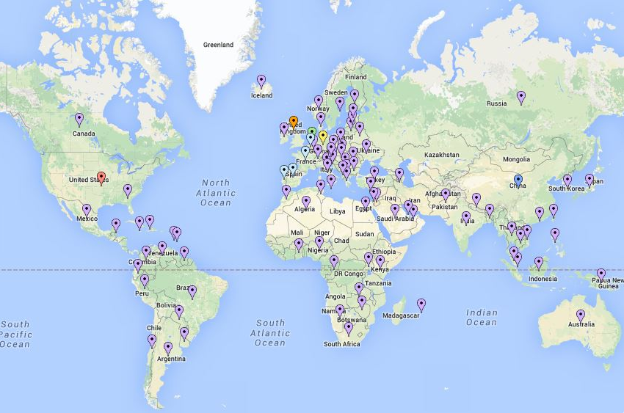
International Audience
Notes:
Because companies from all over the world are affected by REACH it was essential that the webinars reached an international audience. As you can see our webinar series reached people from all over the world and we feel Chemical Watch’s involvement in promoting the webinar series was very important for reaching this wide audience.
The number of people registering to attend the webinars was quite variable. Several hundred people registered for each webinar, but we had exceptionally large numbers registering for some. For example 950 people registered for the skin allergy webinar and more than 700 people registered for the skin irritation and corrosion webinar.
One reason for the success of the webinar series that it was freely available – there was no registration fee to attend the live presentations or download the slides or recordings afterwards. The webinars are available on several websites including the Science Consortium website, Chemical Watch’s website, the European Union Reference Laboratory for alternatives to animal testing, EURL ECVAM, and even on the European Chemical’s agency website in the section on support by accredited stakeholders.
This was the first webinar series that the Science Consortium had organised so we wanted to make sure that we were hitting the mark and achieving our goals so we asked Chemical Watch to send an extended survey to all those who registered for the webinar. We also used this survey to get an indication of people’s attitudes towards using non-animal methods.
In the next few slides I’ll show you the responses to some of the key questions for the first 4 webinars. I’ve focused on the first 4 webinars because, due to the nature of the last three webinars, the survey questions were slightly different.

Slide 11
Awareness of Testing Strategies
Q: “I gained some useful guidance on how to incorporate non-testing/non-animal methods into a testing strategy”.
%
Notes:
In a number of instances, there is not a one-to-one replacement of an animal test with a single non-animal method and testing strategies that use several methods are required in most cases. Describing testing strategies was a key part of most of the webinars and as you can see most people either agreed or strongly agreed that they gained some useful guidance on how to incorporate non-testing and non-animal methods into a testing strategy.

Slide 12
Likely Use of Non-Testing Methods
Q: “As a result of attending this webinar, are you more or less likely to use non-testing methods for REACH 2018”?
%
Notes:
Attendees were asked whether, as a result of attending the webinar if they were more or less likely to use non testing methods for REACH 2018. We were very pleased with the response. Around 50% were either much more likely or slightly more likely to use non testing methods for REACH 2018.
Around 45% of respondent's mentioned that there was no difference in their likelihood of using non-testing methods. Comments received as part of the webinar survey indicate that this is because many were already using non-animal methods.

Slide 13
Barriers to Uptake of Non-Testing and Non-Animal Methods
Q: “What do you think are the main barriers to the uptake of a) non-testing and b) non-animal testing methods for REACH”?
%
Notes:
We asked about what listeners thought the barriers were to the uptake of non-testing methods, and non-animal methods. There was a broad range of responses but concerns about regulatory acceptance and a lack of harmonisation stand out as the major barriers to uptake of non-testing methods. A lack of awareness and a tradition of using animal methods are other key challenges.

Slide 14
Conclusions
The Science Consortium uses a multifaceted approach to education and training, including:
  Training sessions
  Outreach
  Webinars
REACH webinar series
  The Science Consortium teamed up with Chemical Watch and leading experts
  Feedback indicates that the webinars were effective in increasing the intent of companies to use of non-animal methods.
Notes:
PETA’s Science Consortium has adopted a multifaceted approach to education and training that incorporates webinars, initiating face-to-face training sessions, for example the IIVS/EPA training session, and developing educational resources to promote the implementation and acceptance of non-animal methods for regulatory purposes.
In the past year we developed an extremely successful webinar series to address the animal tests required for the 2018 REACH deadline. To ensure we reached a wide audience we teamed up with the chemical trade press outlet, Chemical Watch, to promote and co-host the webinar series. We also ensured that world leading experts in the field of non-animal methods presented the webinars. Another important aspect of the webinar series was that it was completely free for people to attend the webinars and they can be freely downloaded from a number of websites including the Science Consortium, EURL ECVAM, Chemical Watch and ECHA websites.
Feedback from the webinar series indicates the webinars effectively increased the intent of companies worldwide to use of non-animal methods.

Slide 15
Acknowledgements
Notes:
I’d like to acknowledge all those who were involved in making the webinar series so successful. Particular thanks go to Chemical Watch for co-hosting and promoting the webinar series. The Institute for In vitro Sciences presented in two of our webinars and also gave face to face training at the US EPA. EURL ECVAM presented in 4 our the webinars. Also thanks to all of our academic, industry and consultant experts who participated.
I’d also like to thank Lush on behalf of the Science Consortium for awarding us this prize. We have big plans for next year and we are delighted that we have more resources to help With our goal of eliminating tests on animals.

Slide 16
Thank you!
Gilly Stoddart, PhD
GillyS@piscltd.org.uk
PISCltd.org.uk
Notes:
If anyone would like more information about the Science Consortium or any of our projects please feel free to get in touch.

