Slide 1
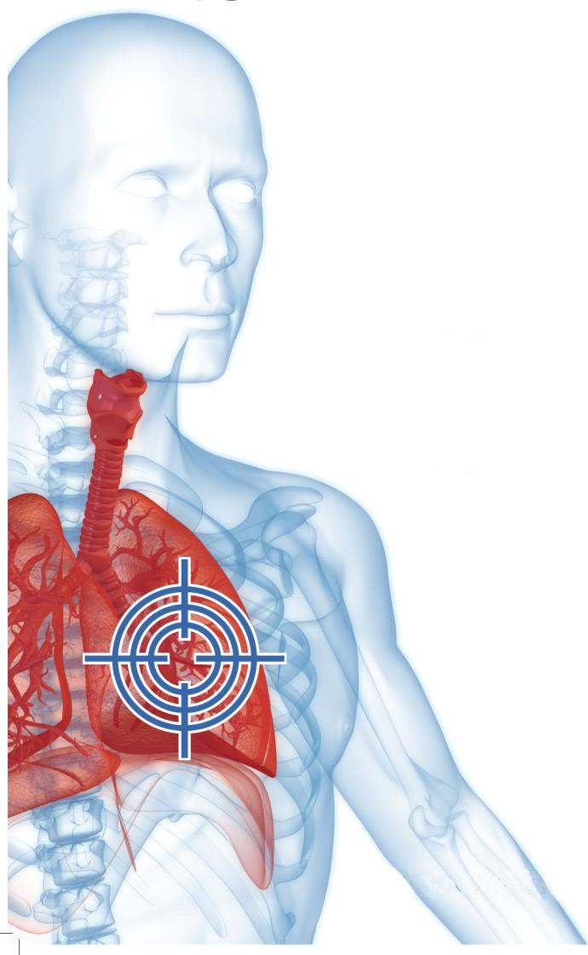
A novel 3D human tissue culture model
for in vitro lung cancer research
Christophe Mas
PhD, CSO

Slide 2
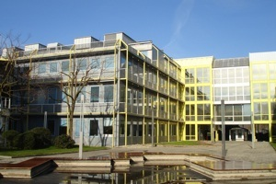
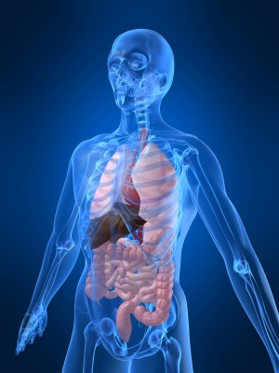
Human in vitro tissue models
for cancer research
Geneva, Switzerland
Nasal cavity
cancer
Mesothelioma
Lung cancer
Colon cancer

Slide 3
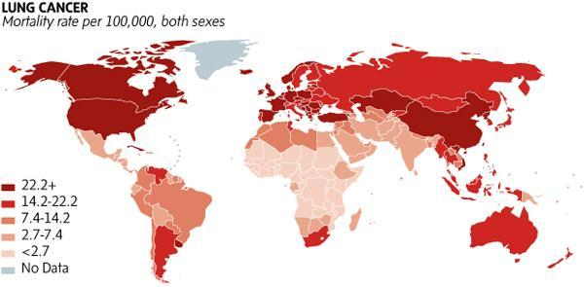
Lung cancer
>1 million deaths
Source : IARC, 2012
3
Notes:
3

Slide 4
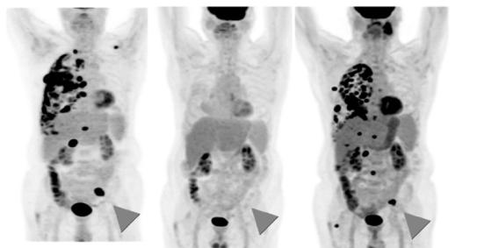
Lung cancer: clinical management
First line
Broad chemotherapies
► cisplatin
>1 million
deaths
► pemetrexed
pemetrexed + bevacizumab (PET scan)
► paclitaxel
► docetaxel
Second line
Targeted therapies
► erlotinib
► gefitinib
► afatinib
baseline
4 months
9 months
>1 million
deaths
recurrence
► crizotinib
► ceritinib
► ramicirumab
► bevacizumab
Cuaron et al. Front. Oncol. 2013; 2:208.
Lush Prize – London Nov2015

Slide 5
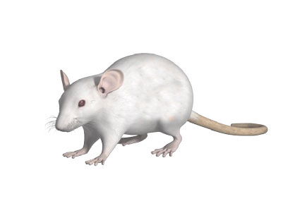
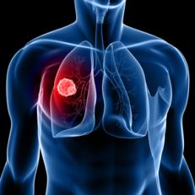
Current preclinical models
Genetically Engineered Mouse (GEMs)
Tumor cell line xenograft
mut*
Lung adenocarcinomas ( K-ras^{G12D} p53^{f/+} )
SCLC (Rb1^{f/f} ; p53^{f/f})
Patient Derived Xenograft (PDX)
>1.5 million
► Failure rate for new drugs > 85% !
5
Lush Prize – London Nov2015

Slide 6
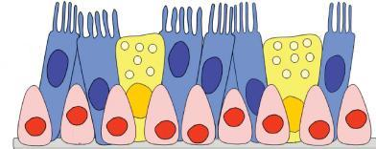
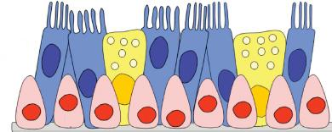
A new model for lung cancer research
100% human
in vitro
3-Dimensionnal
accessible
Ciliated
Tumor
Goblet Cells
Basal cells
Human Fibroblasts
6
Lush Prize – London Nov2015

Slide 7
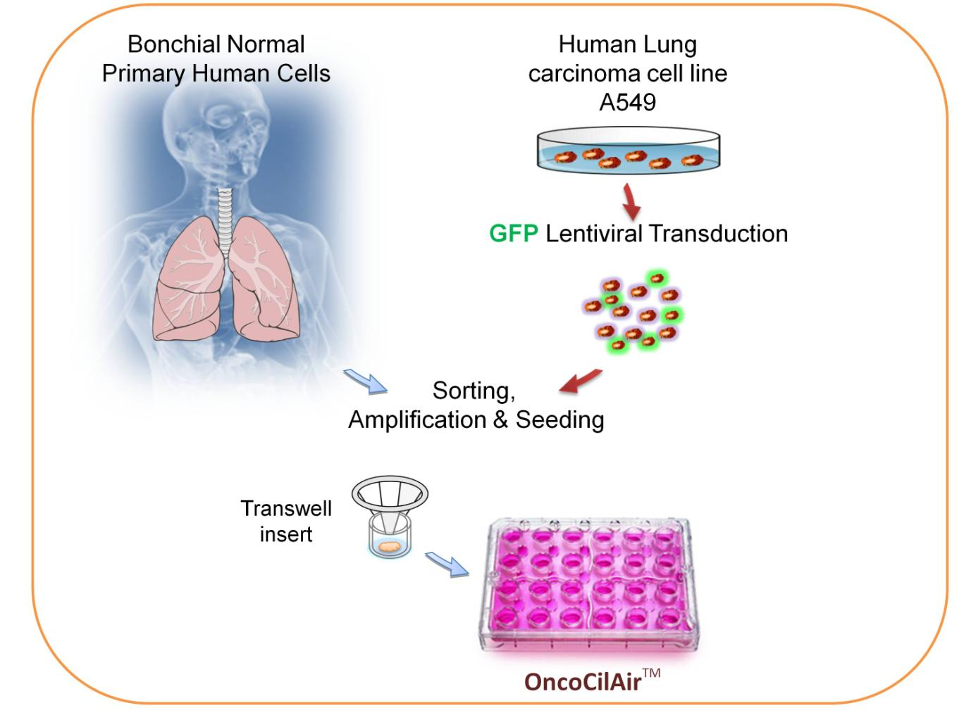
Process overview
7
Lush Prize – London Nov2015

Slide 8
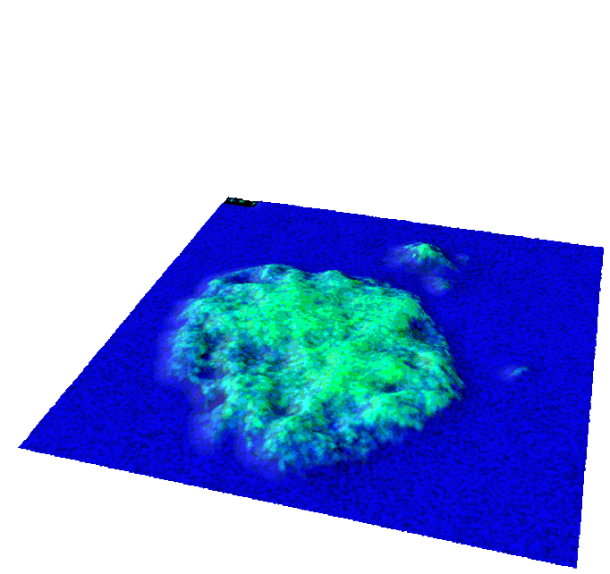
OncoCilAir™
Histology and confocal imaging
A
1 mm
B
*
100 µm
8
Lush Prize – London Nov2015

Slide 11
Efficacy study of the MEK inhibitors Selumetinib and Trametinib
EGF
KRAS activated in
∼ 30% of lung adenocarcinoma
erlotinib
EGF
Receptor TK
GRB2
SOS
KRAS
RAF
MEK
selumetinib / trametinib
ERK
MEK1/2
inhibitors
nu
cle
us
Cell proliferation
decreased
11
Lush Prize – London Nov2015

Slide 12
Efficacy study of the MEK inhibitors Selumetinib and Trametinib
DMSO
selumetinib
trametinib
erlotinib
day 0
day 9
day 20
12
Lush Prize – London Nov2015

Slide 13
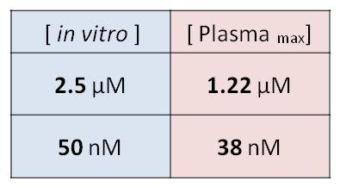
selumetinib
trametinib
erlotinib
days
treatment
wash
selumetinib
trametinib
13
Lush Prize – London Nov2015

Slide 14
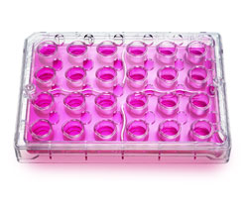
Lung adenocarcinoma stratification
Lung Cancer
NSCLC
adenocarcinomas
Panel of OncoCilAirTM
50%
KRAS
NRAS
RET1
1
1
30%
2%
HER2
4%
DDR2
1
1
4%
AKT
MEK
2%
PTEN
3%
MET
15%
ALK
EML4
1
1
PIK3CA
BRAF
EGFR
2%
1
ROS1
FGFR1
14
Lush Prize – London Nov2015

Slide 15
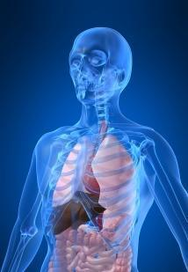
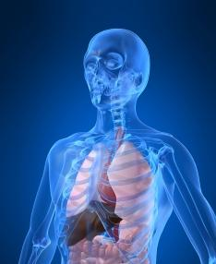
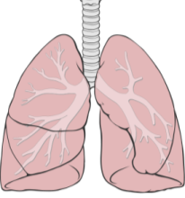
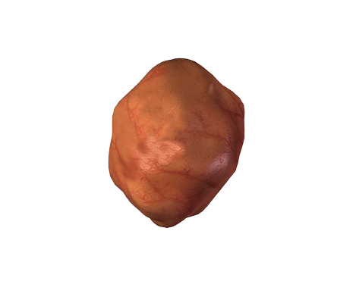
Patient derived OncoCilAir™
Bonchial Normal
Primary Human Cells
Patient
Primary Tumor Cells
GFP+
reporter
combination,
amplification & seeding
Transwell
insert
OncoCilAirTM
15
Lush Prize – London Nov2015

Slide 16
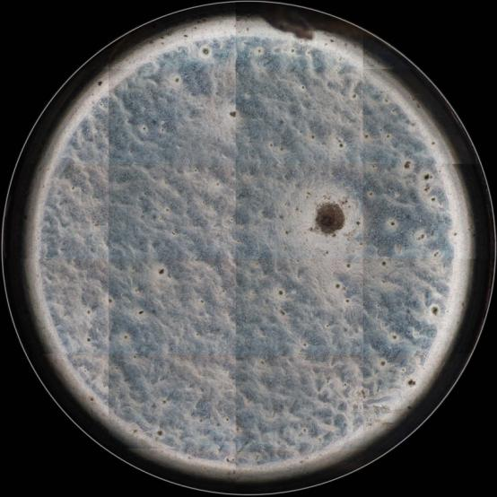
Patient derived OncoCilAir™
Squamous cell carcinoma Day10
PDOCA_023
PDOCA_023_5x
16
Lush Prize – London Nov2015

Slide 17
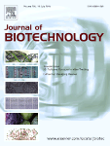
OncoCilAir : an innovative in vitro lung cancer model
Healthy airway epithelium
Tumour nodules
Concurrent testing of efficacy AND toxicity
Lifetime > 3 months
Chronic exposure
Test of recurrence
Development of resistance
“ Antitumour efficacy of
the selumetinib and trametinib MEK inhibitors
in a combined human airway–tumour–stroma
lung cancer model ”
Mas et al. J Biotechnol. 2015 ;205:111-9.
Air-liquid interface
Aerosol therapies
Systemic treatment
17
Lush Prize – London Nov2015

Slide 18
Epithelix
Ligue Suisse
contre la Vivisection
christophe.mas@oncotheis.com

Slide 19
Side-toxicity evaluation
Cytotoxicity
LDH
Trans Epithelial
Electrical Resistance
19
Lush Prize – London Nov2015

